Slide 2
I Will Call upon the LORD
15
_
_
_
Hymn: arr. Michael O'Shields (1981); st. 2-3 unknown; from Psalm 18:3, 46 (KJV)
Tune: Michael O'Shields (1981), arr. Pam Stephenson
© 1981 Sound III, Inc.

Slide 3
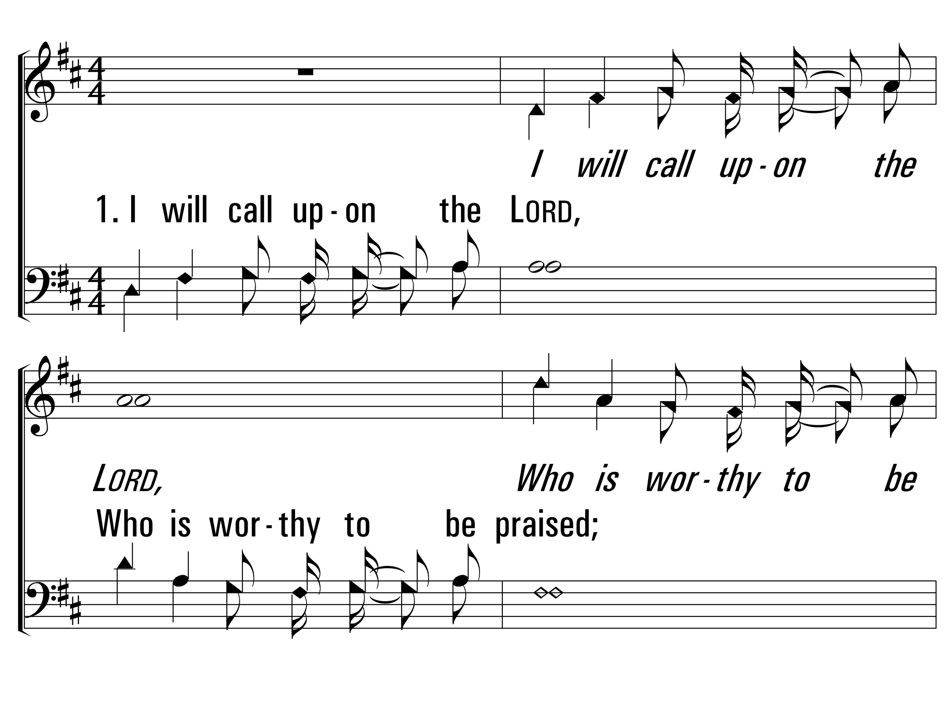
IWillCallUponTheLord_st1_a
Vs 1
© 2014 Sumphonia Productions, LLC

Slide 4
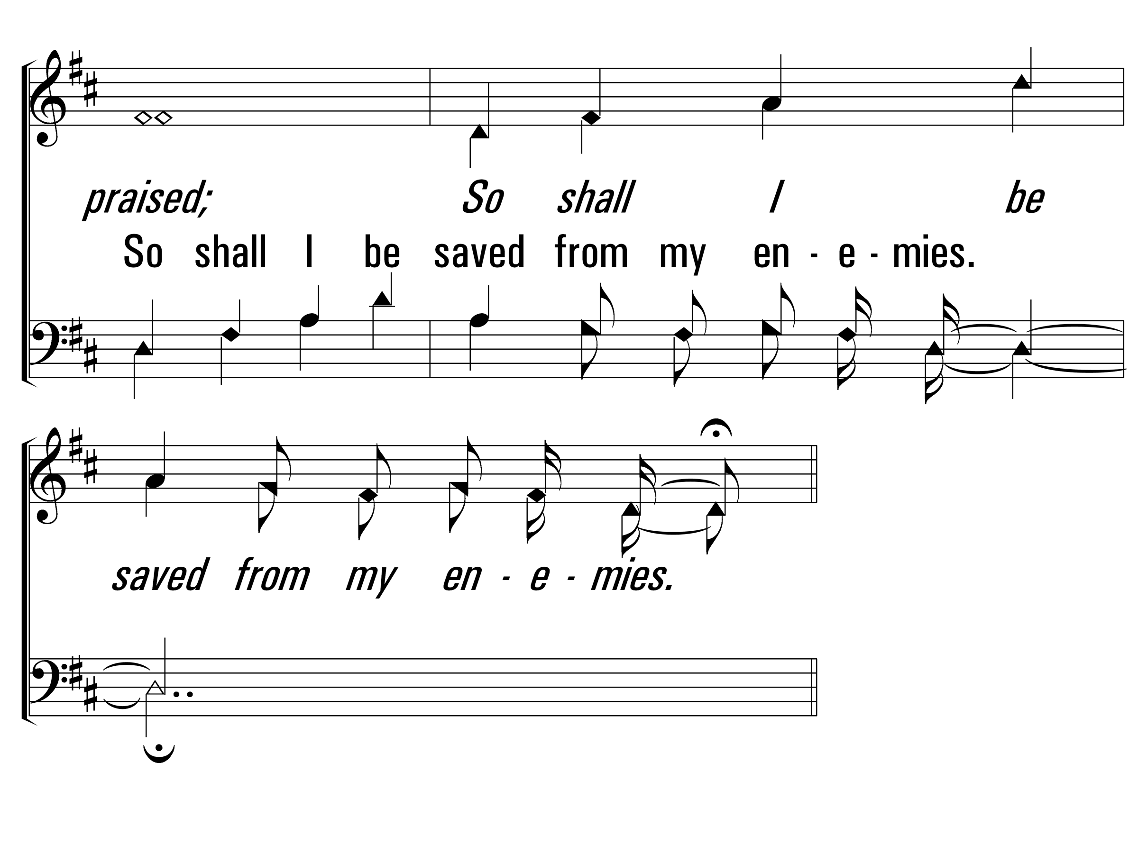
IWillCallUponTheLord_st1_b
Vs 1
© 2014 Sumphonia Productions, LLC

Slide 5
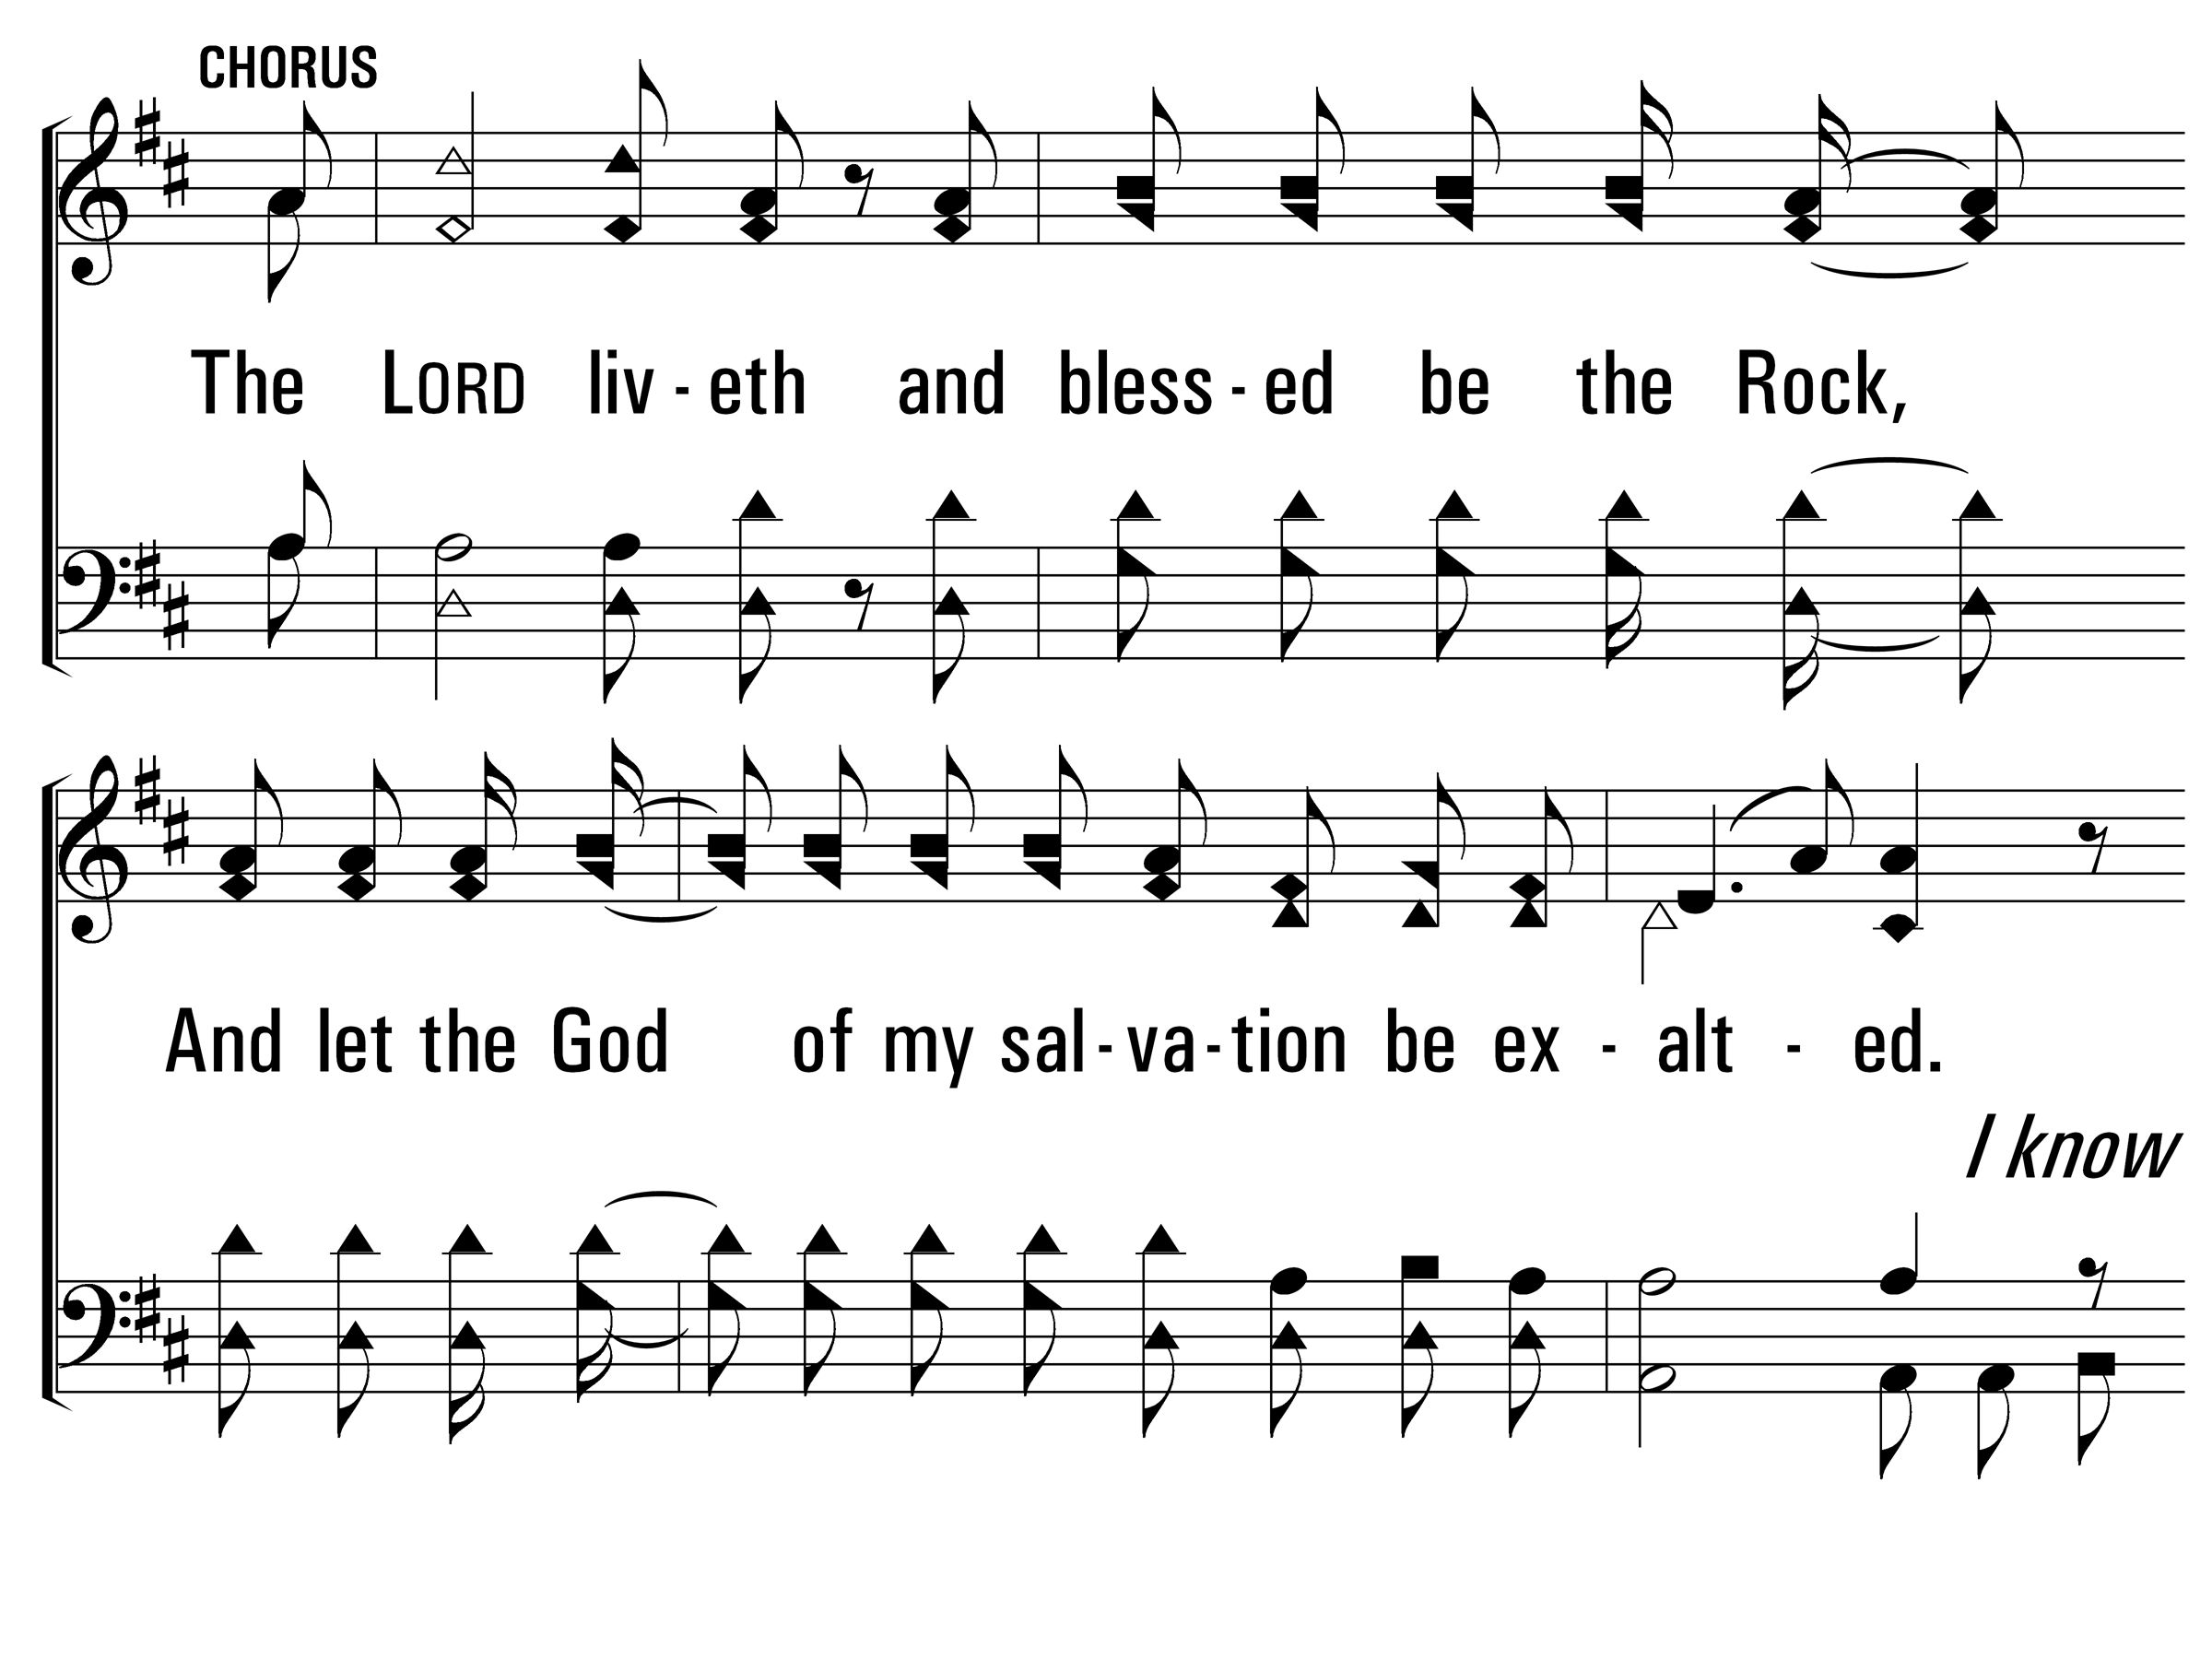
IWillCallUponTheLord_cho_a
Chorus
© 2014 Sumphonia Productions, LLC

Slide 6
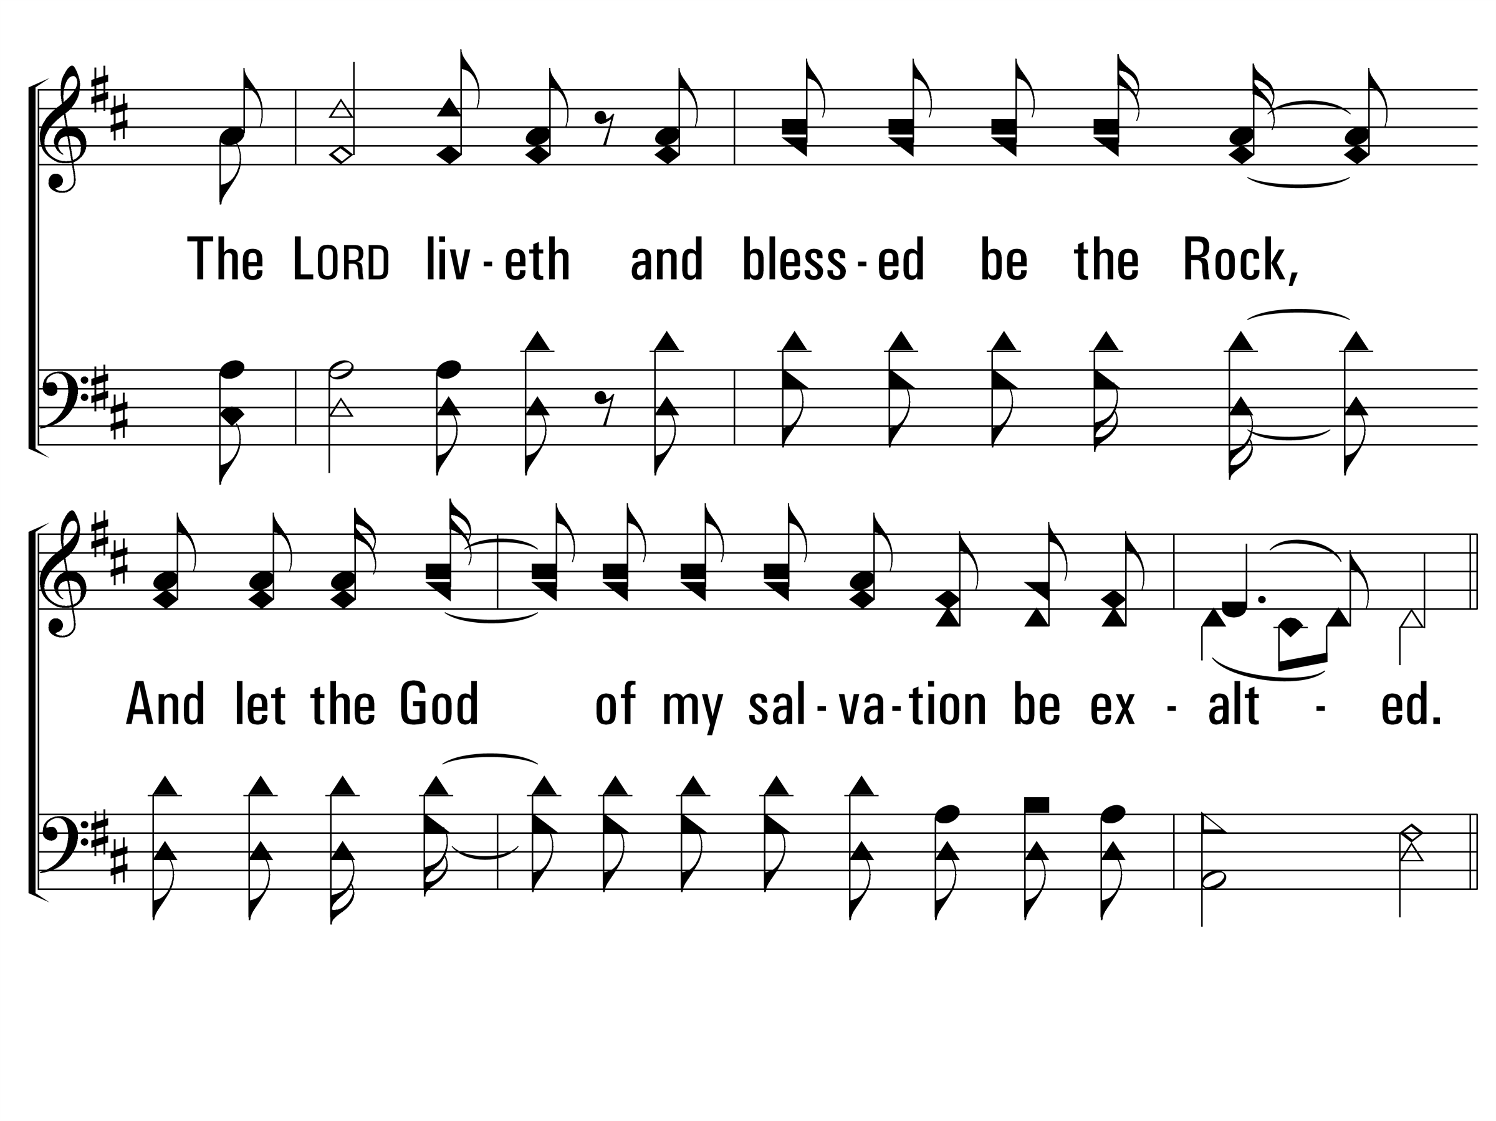
IWillCallUponTheLord_cho_b
Chorus
© 2014 Sumphonia Productions, LLC

Slide 7
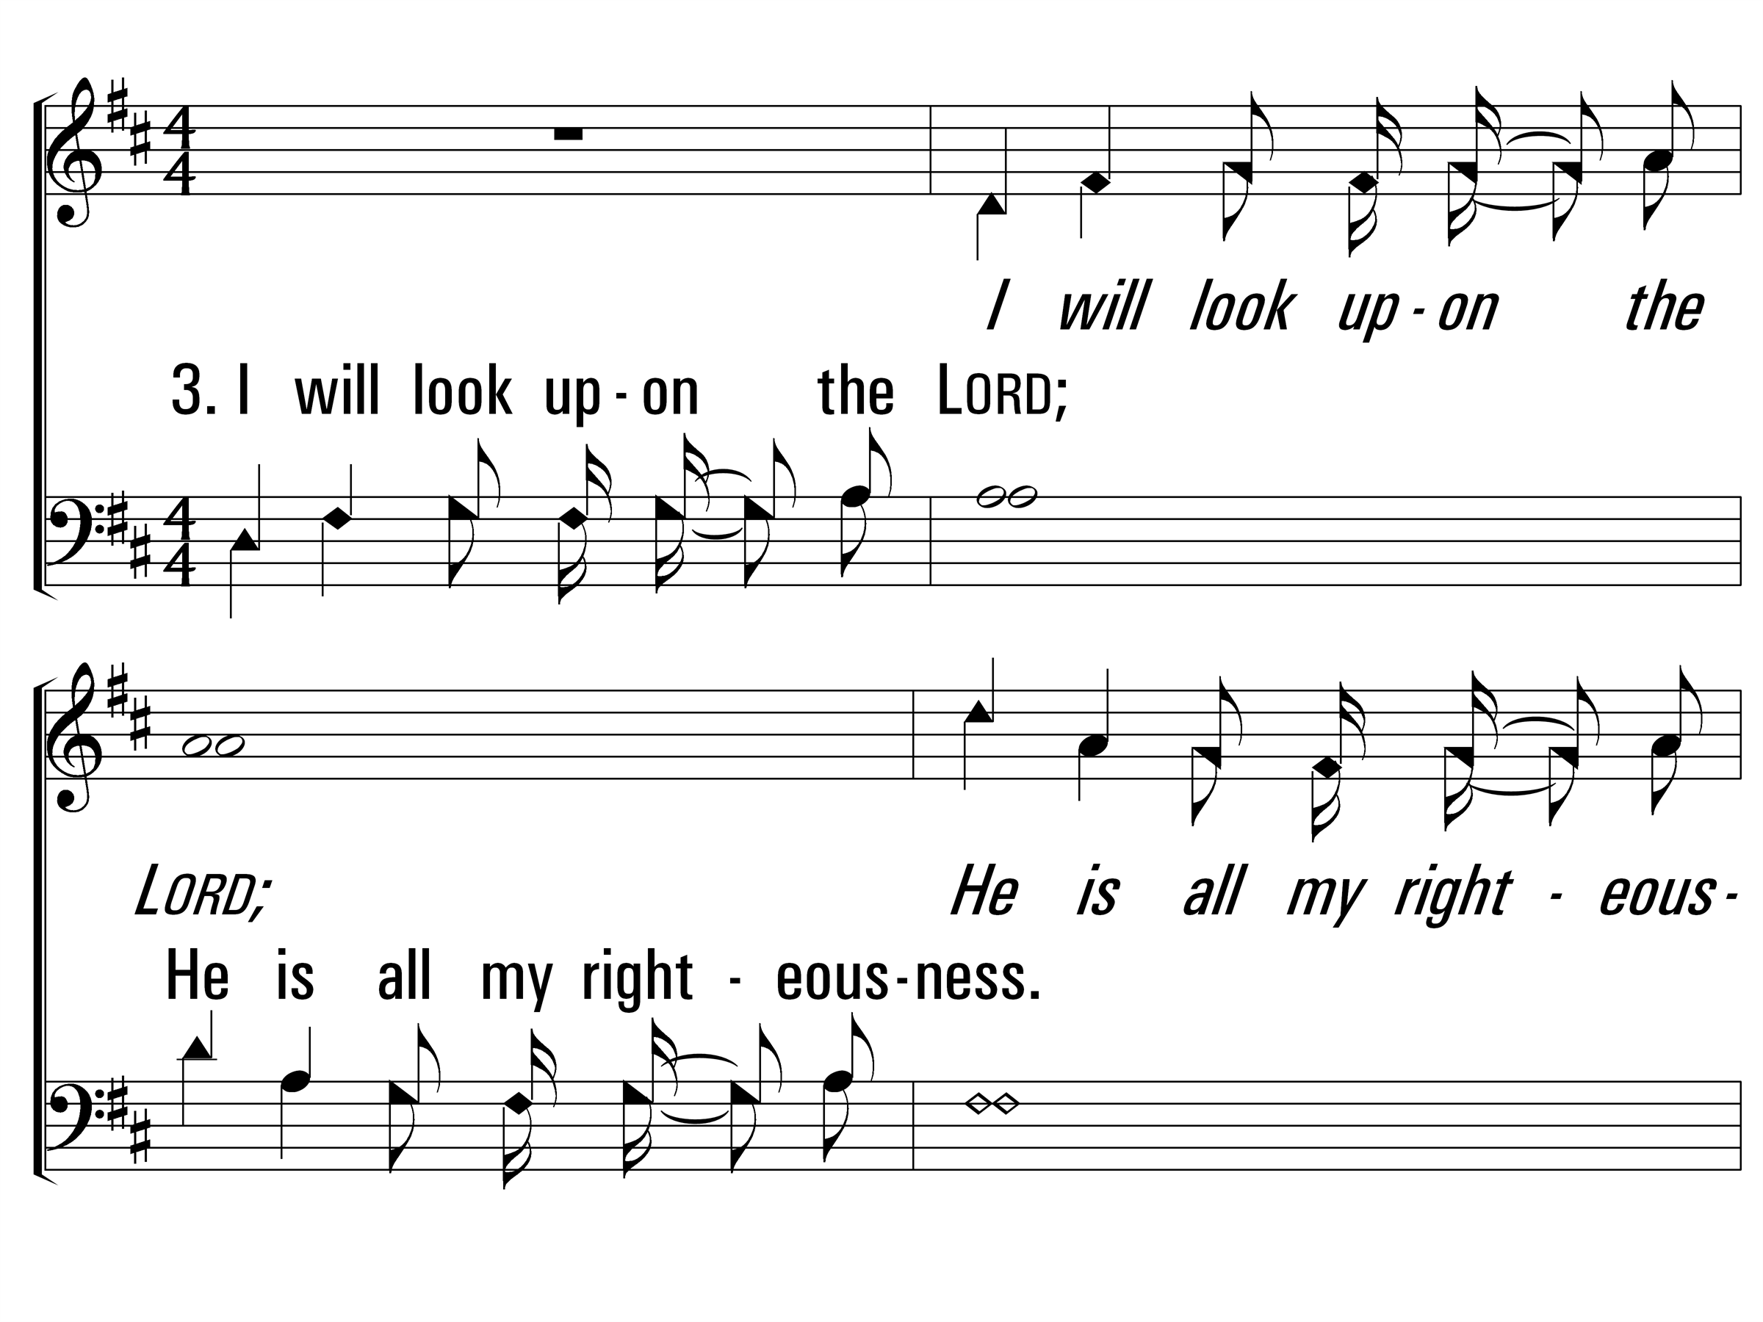
IWillCallUponTheLord_st3_a
Vs 3
© 2014 Sumphonia Productions, LLC

Slide 8
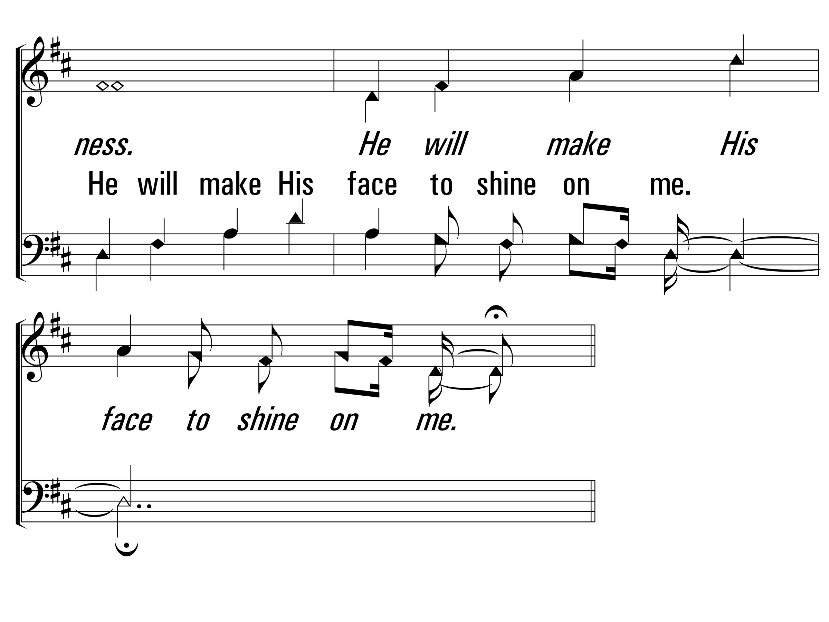
IWillCallUponTheLord_st3_b
Vs 3
© 2014 Sumphonia Productions, LLC

Slide 9
IWillCallUponTheLord_cho_a
Chorus
© 2014 Sumphonia Productions, LLC

Slide 10
IWillCallUponTheLord_cho_b
Chorus
© 2014 Sumphonia Productions, LLC

Slide 11
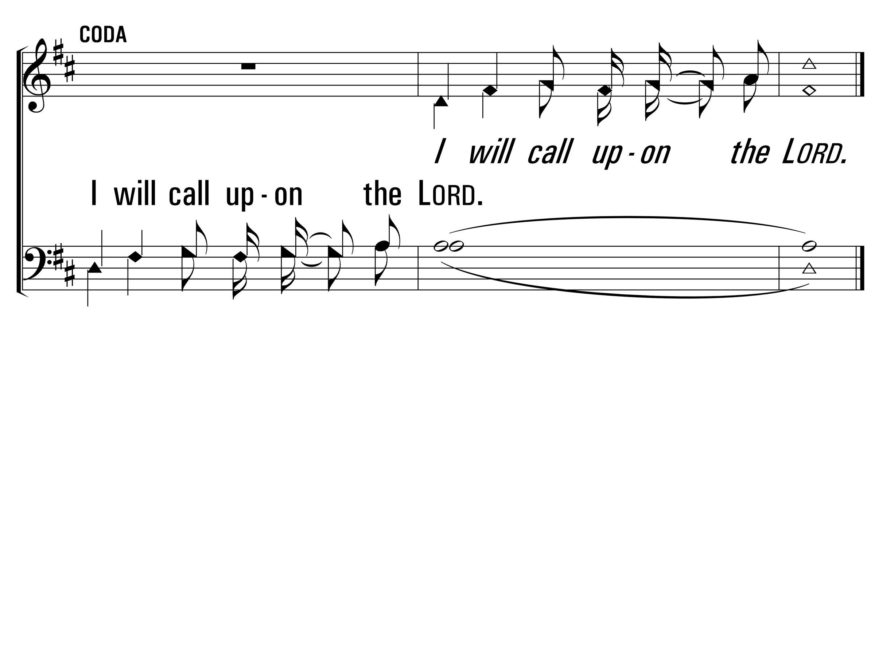
IWillCallUponTheLord_coda_a
Coda
© 2014 Sumphonia Productions, LLC
End

Slide 12
Sanctuary
579
_
_
_
Hymn: J. W. Thompson (1982); Randy Scruggs (1982)
Tune: J. W. Thompson (1982); Randy Scruggs (1982)
© 1982 Whole Armor/Full Armor

Slide 13
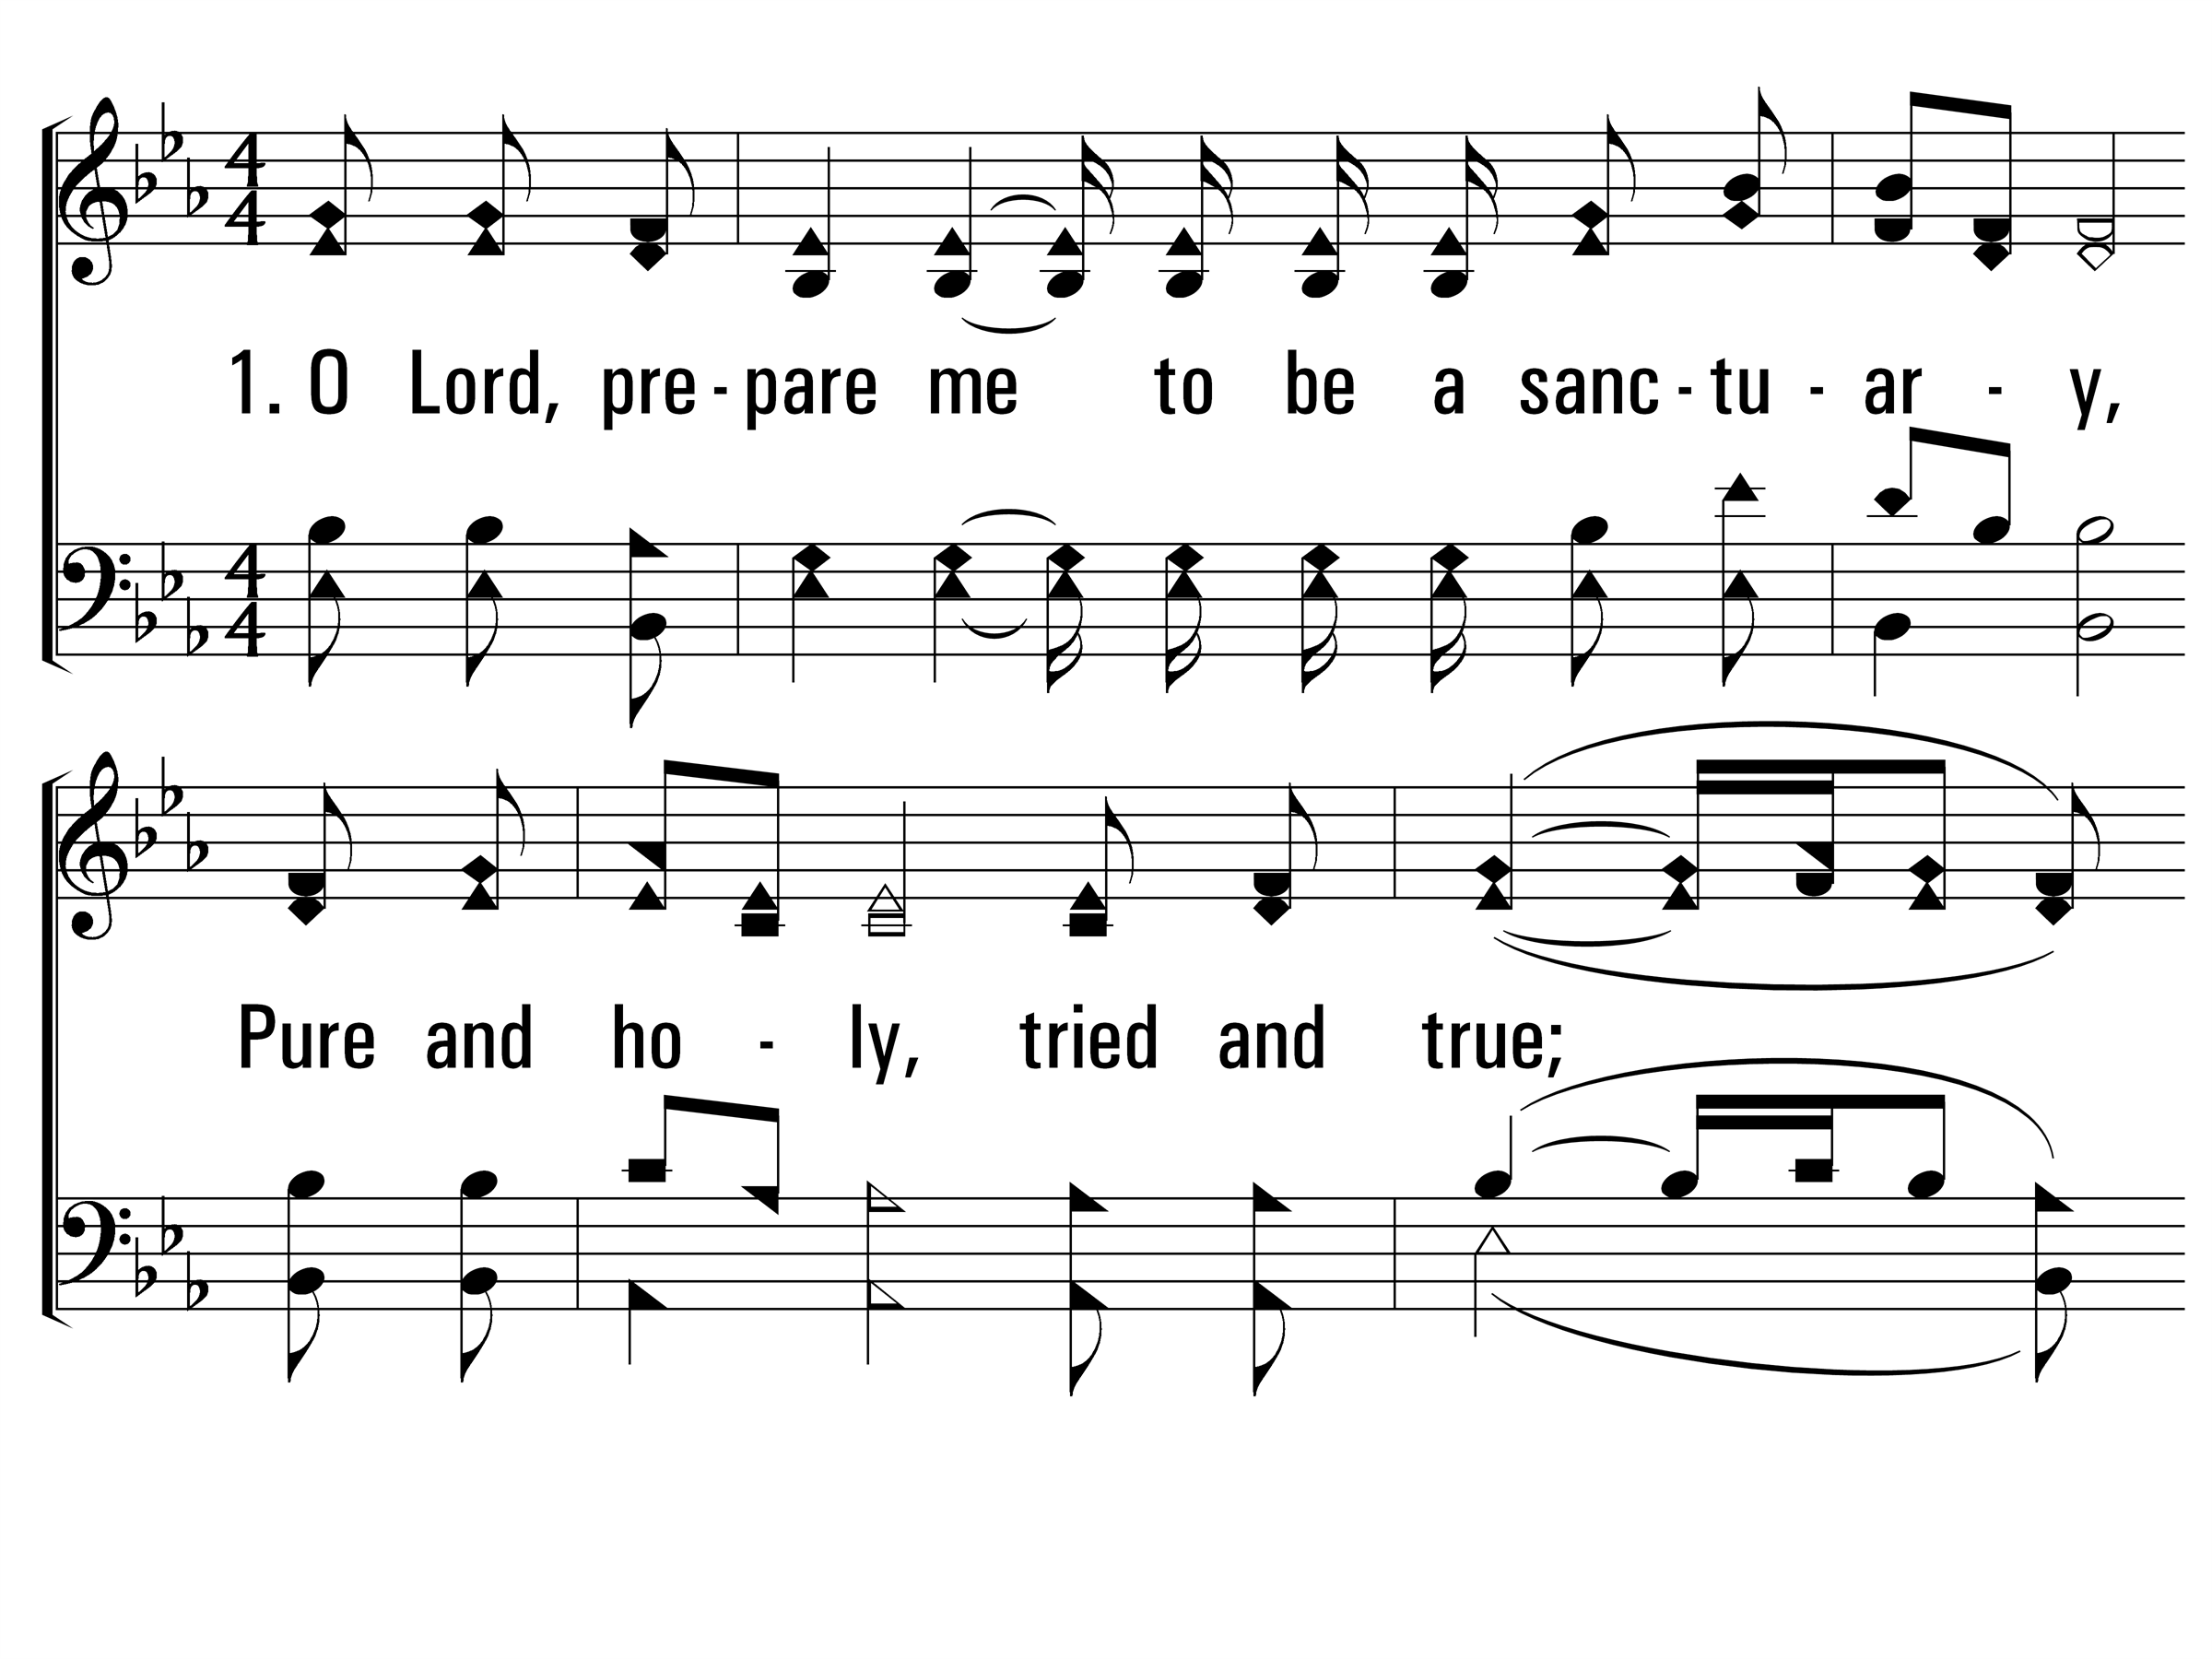
Sanctuary_st1_a
Vs 1
© 2014 Sumphonia Productions, LLC

Slide 14
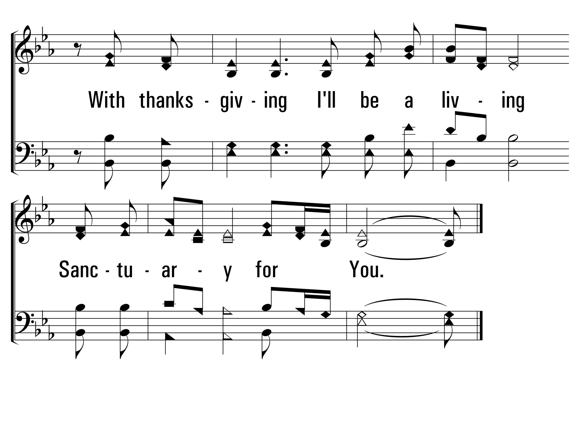
Sanctuary_st1_b
Vs 1
© 2014 Sumphonia Productions, LLC

Slide 15
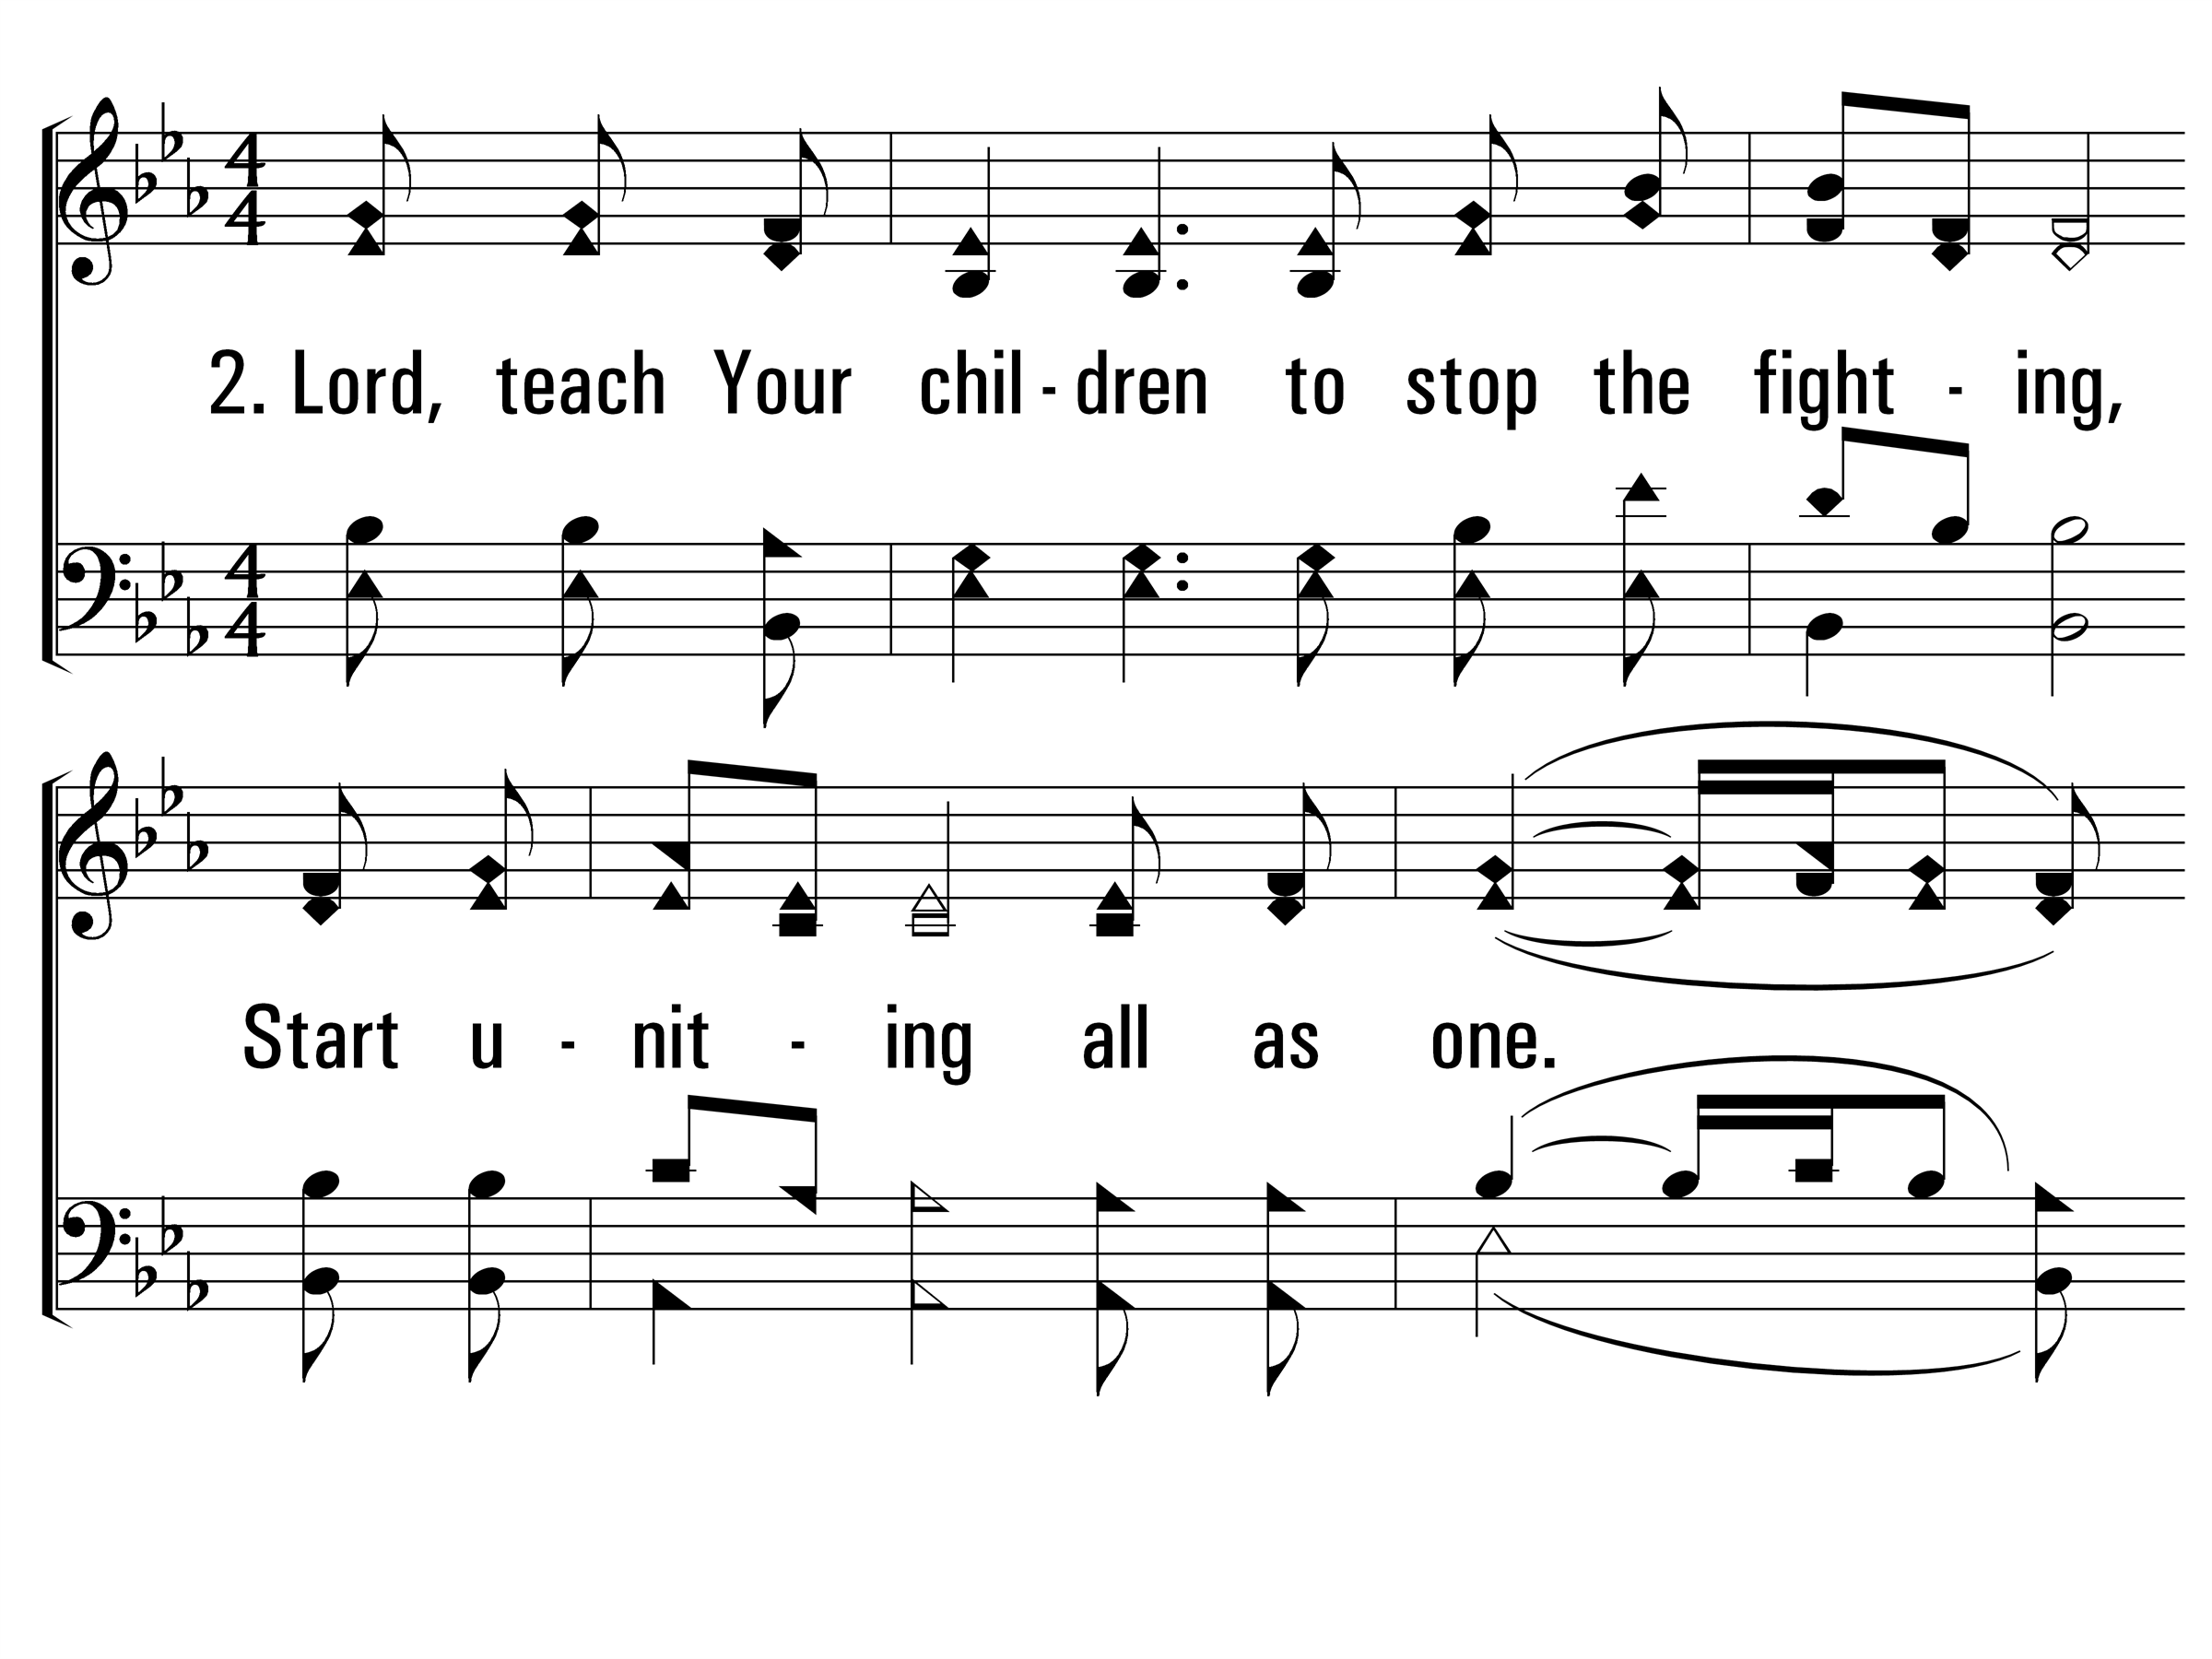
Sanctuary_st2_a
Vs 2
© 2014 Sumphonia Productions, LLC

Slide 16
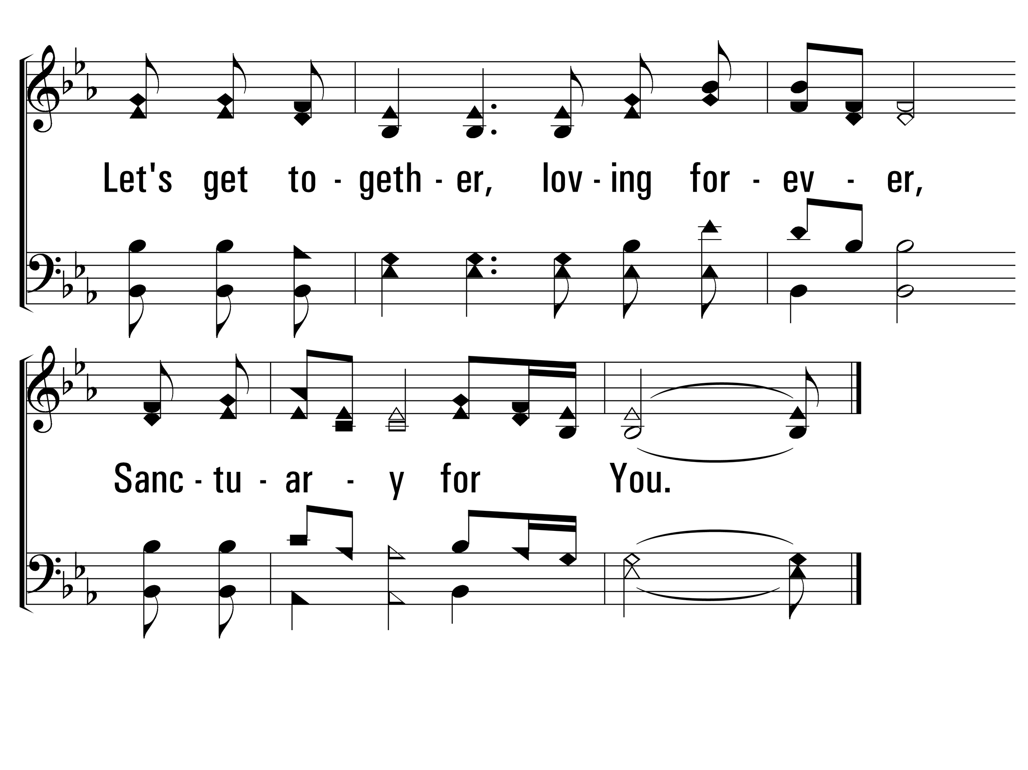
Sanctuary_st2_b
Vs 2
© 2014 Sumphonia Productions, LLC

Slide 17
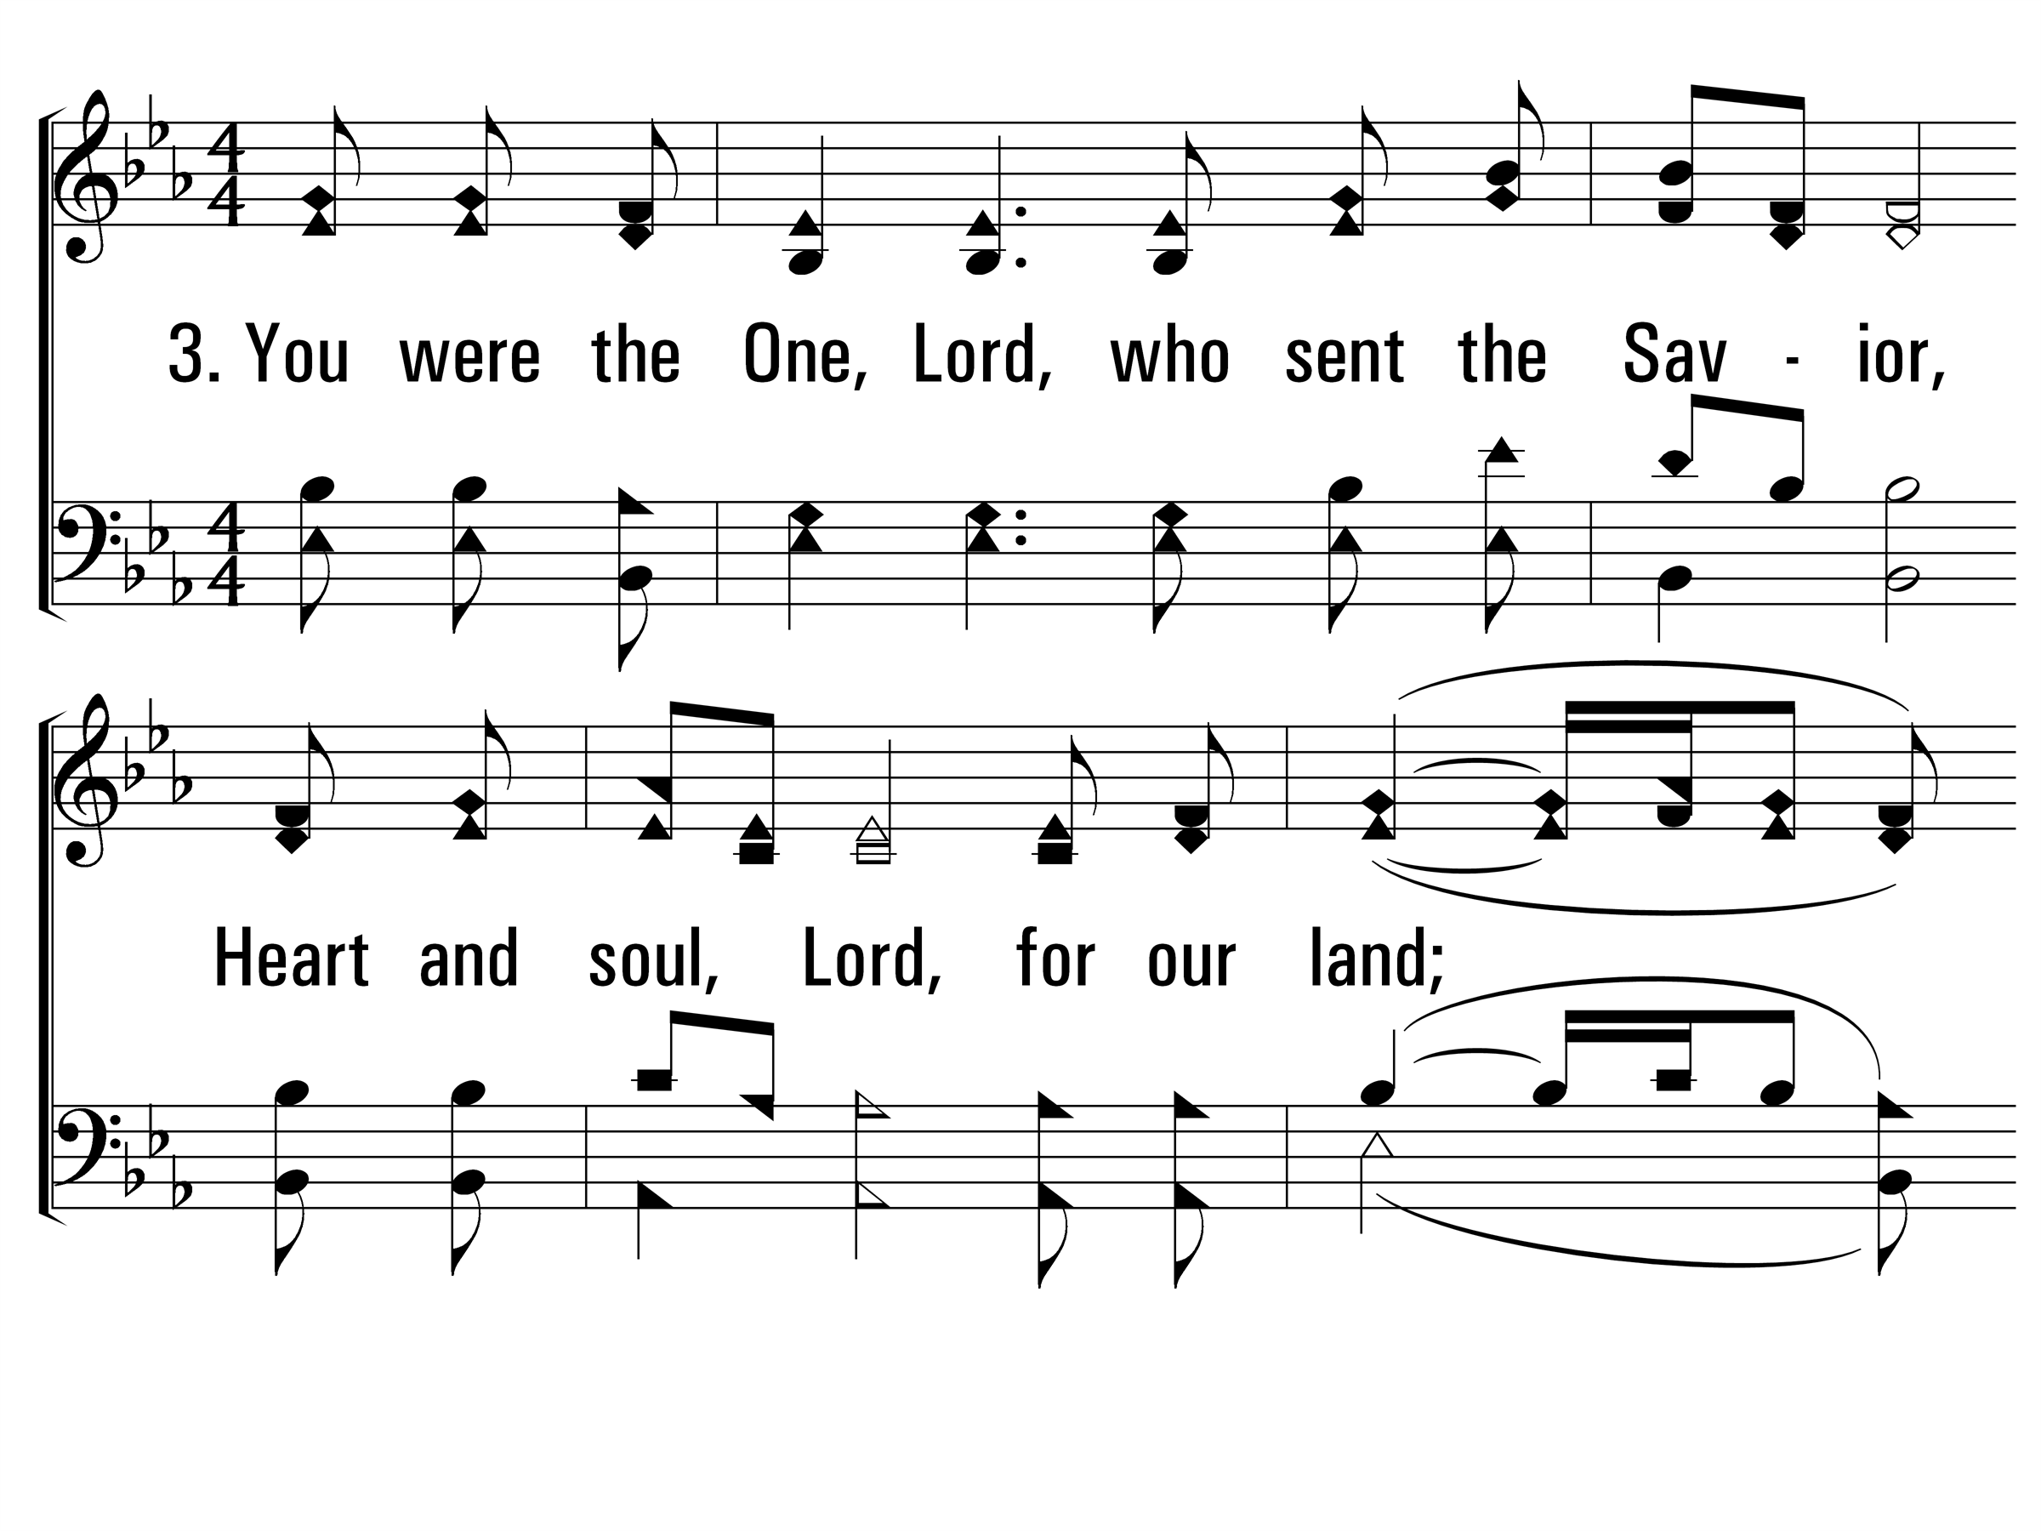
Sanctuary_st3_a
Vs 3
© 2014 Sumphonia Productions, LLC

Slide 18
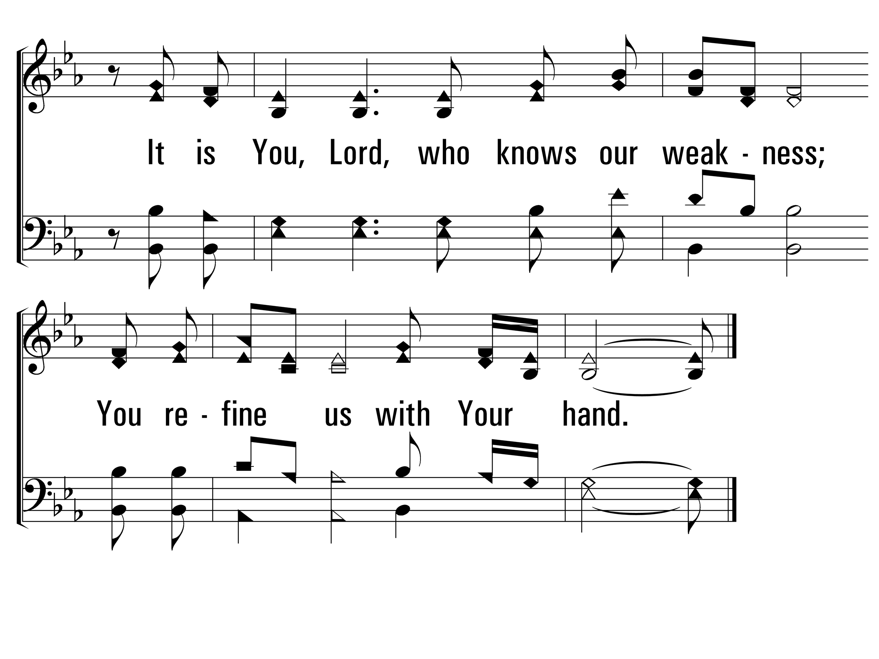
Sanctuary_st3_b
Vs 3
© 2014 Sumphonia Productions, LLC
End

Slide 20
He Loves Me!
200
_
_
_
Hymn: Lloyd O. Sanderson (1948); cho. Showalter's Song-Land Messenger, No. 2 (1898)
Tune: HE LOVES ME • Showalter's Song-Land Messenger, No. 2 (1898); arr. Lloyd O. Sanderson (1948)
© 1948 Gospel Advocate Co (admin. by Affiliated Music Enterprises, Inc.)

Slide 21
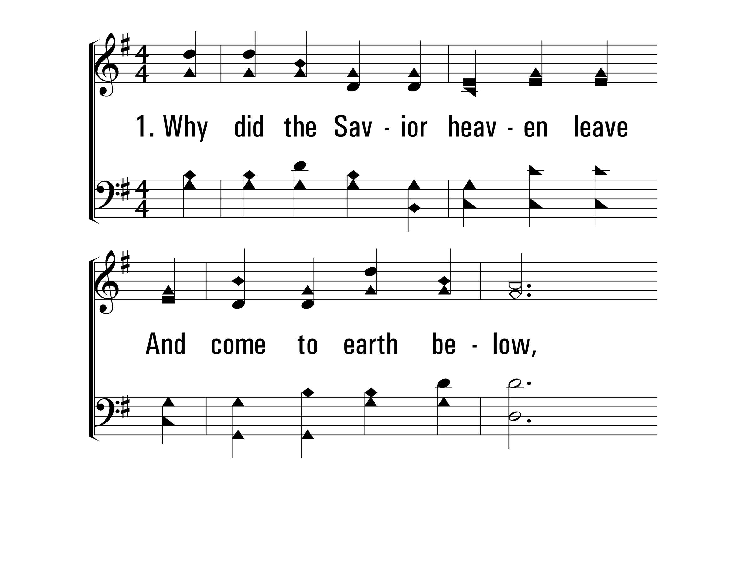
HeLovesMe_st1_a
Vs 1
© 2014 Sumphonia Productions, LLC

Slide 22
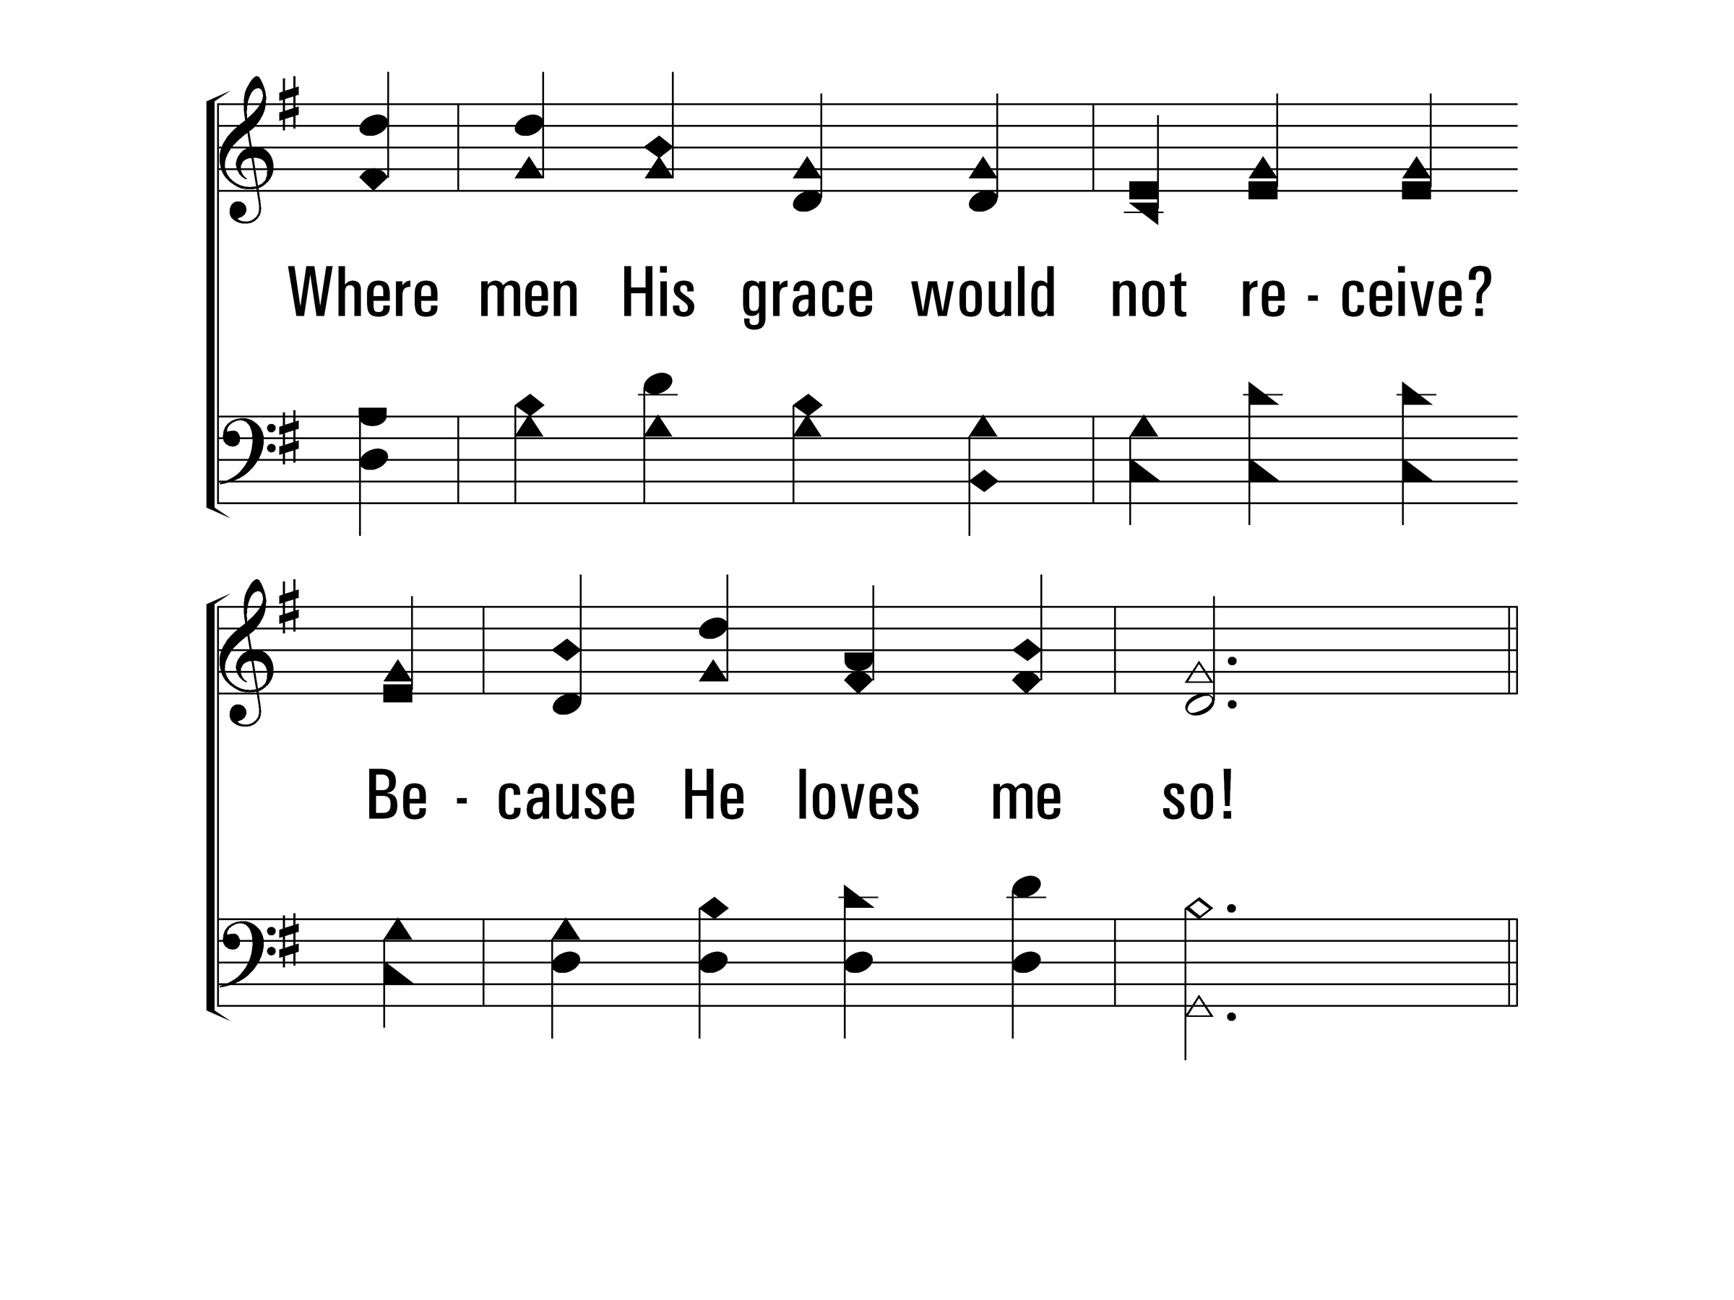
HeLovesMe_st1_b
Vs 1
© 2014 Sumphonia Productions, LLC

Slide 23
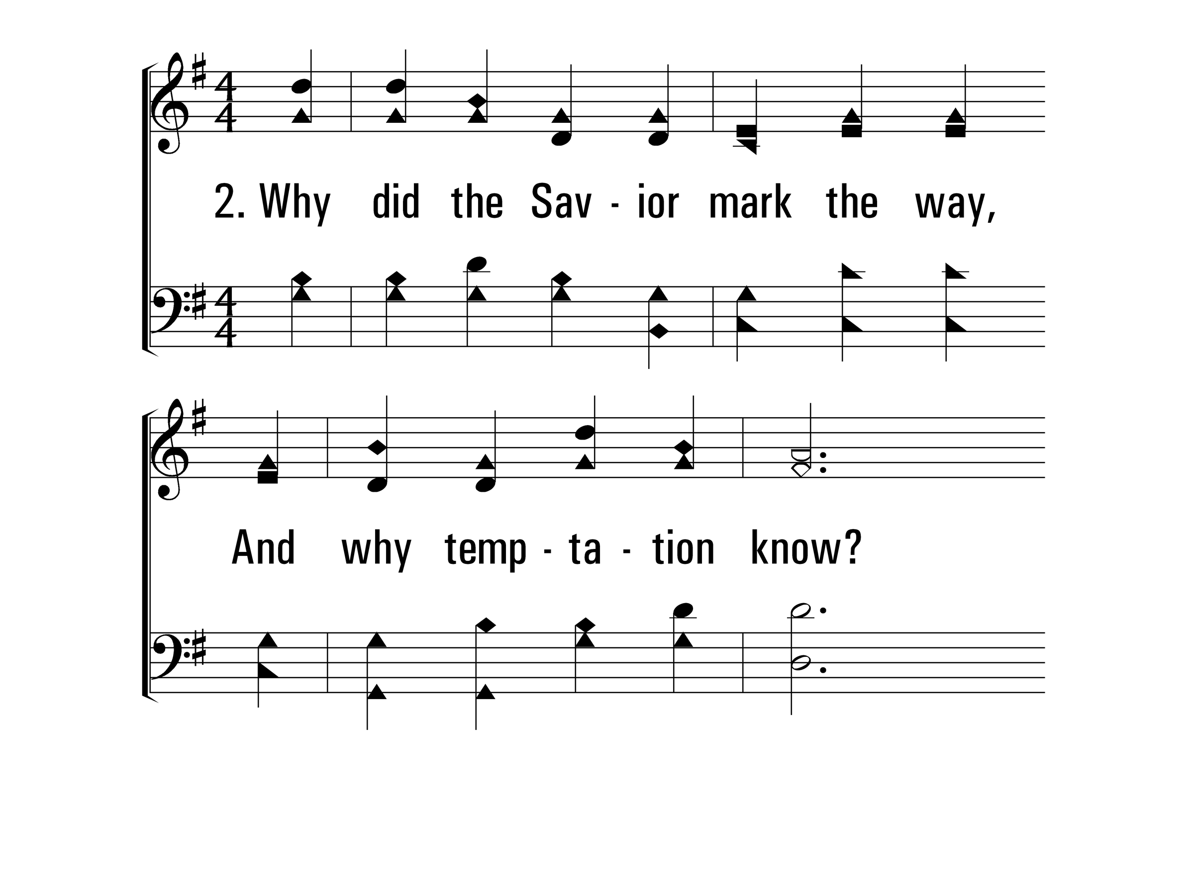
HeLovesMe_st2_a
Vs 2
© 2014 Sumphonia Productions, LLC

Slide 24
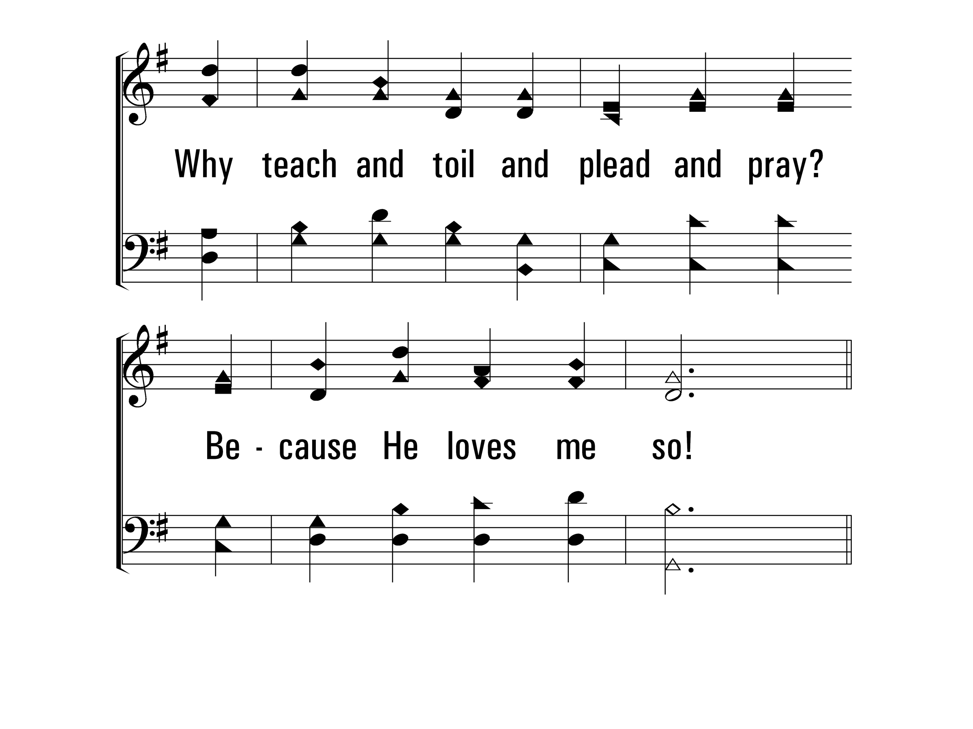
HeLovesMe_st2_b
Vs 2
© 2014 Sumphonia Productions, LLC

Slide 25
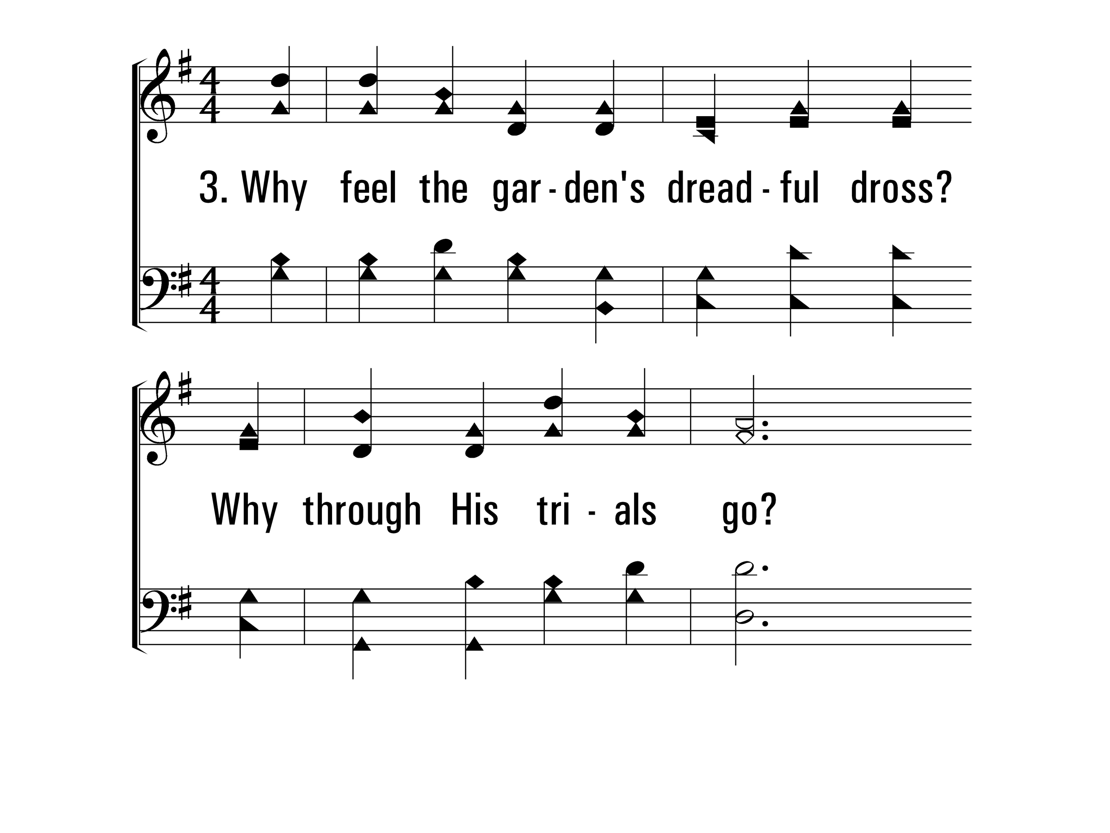
HeLovesMe_st3_a
Vs 3
© 2014 Sumphonia Productions, LLC

Slide 26
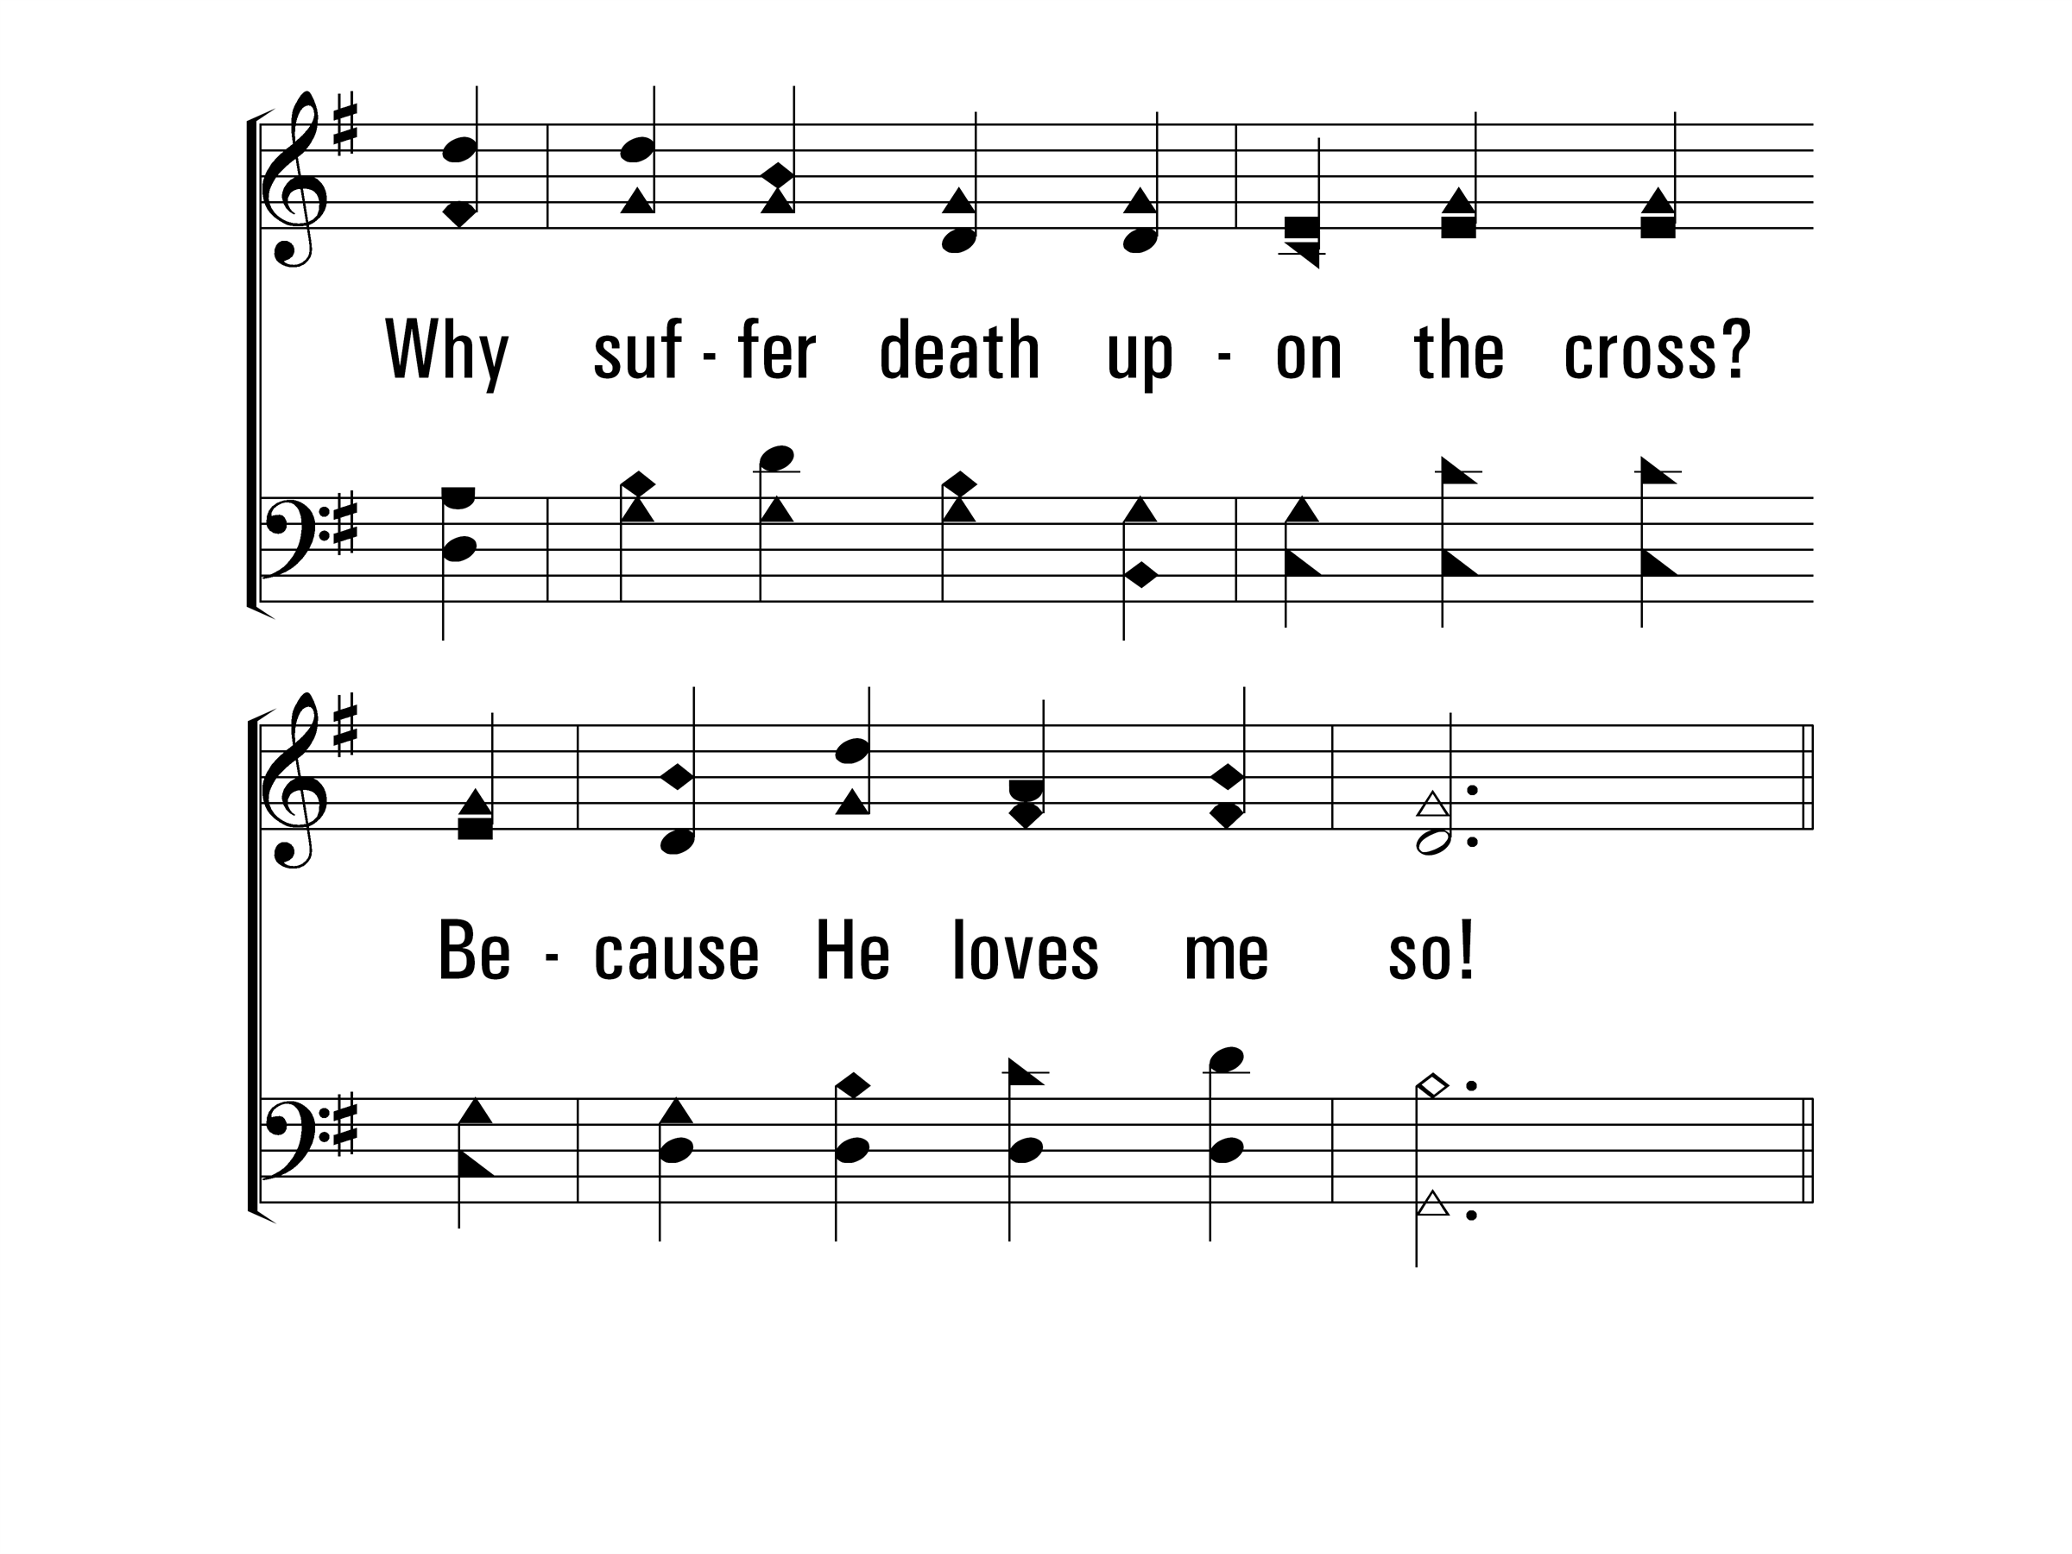
HeLovesMe_st3_b
Vs 3
© 2014 Sumphonia Productions, LLC

Slide 27
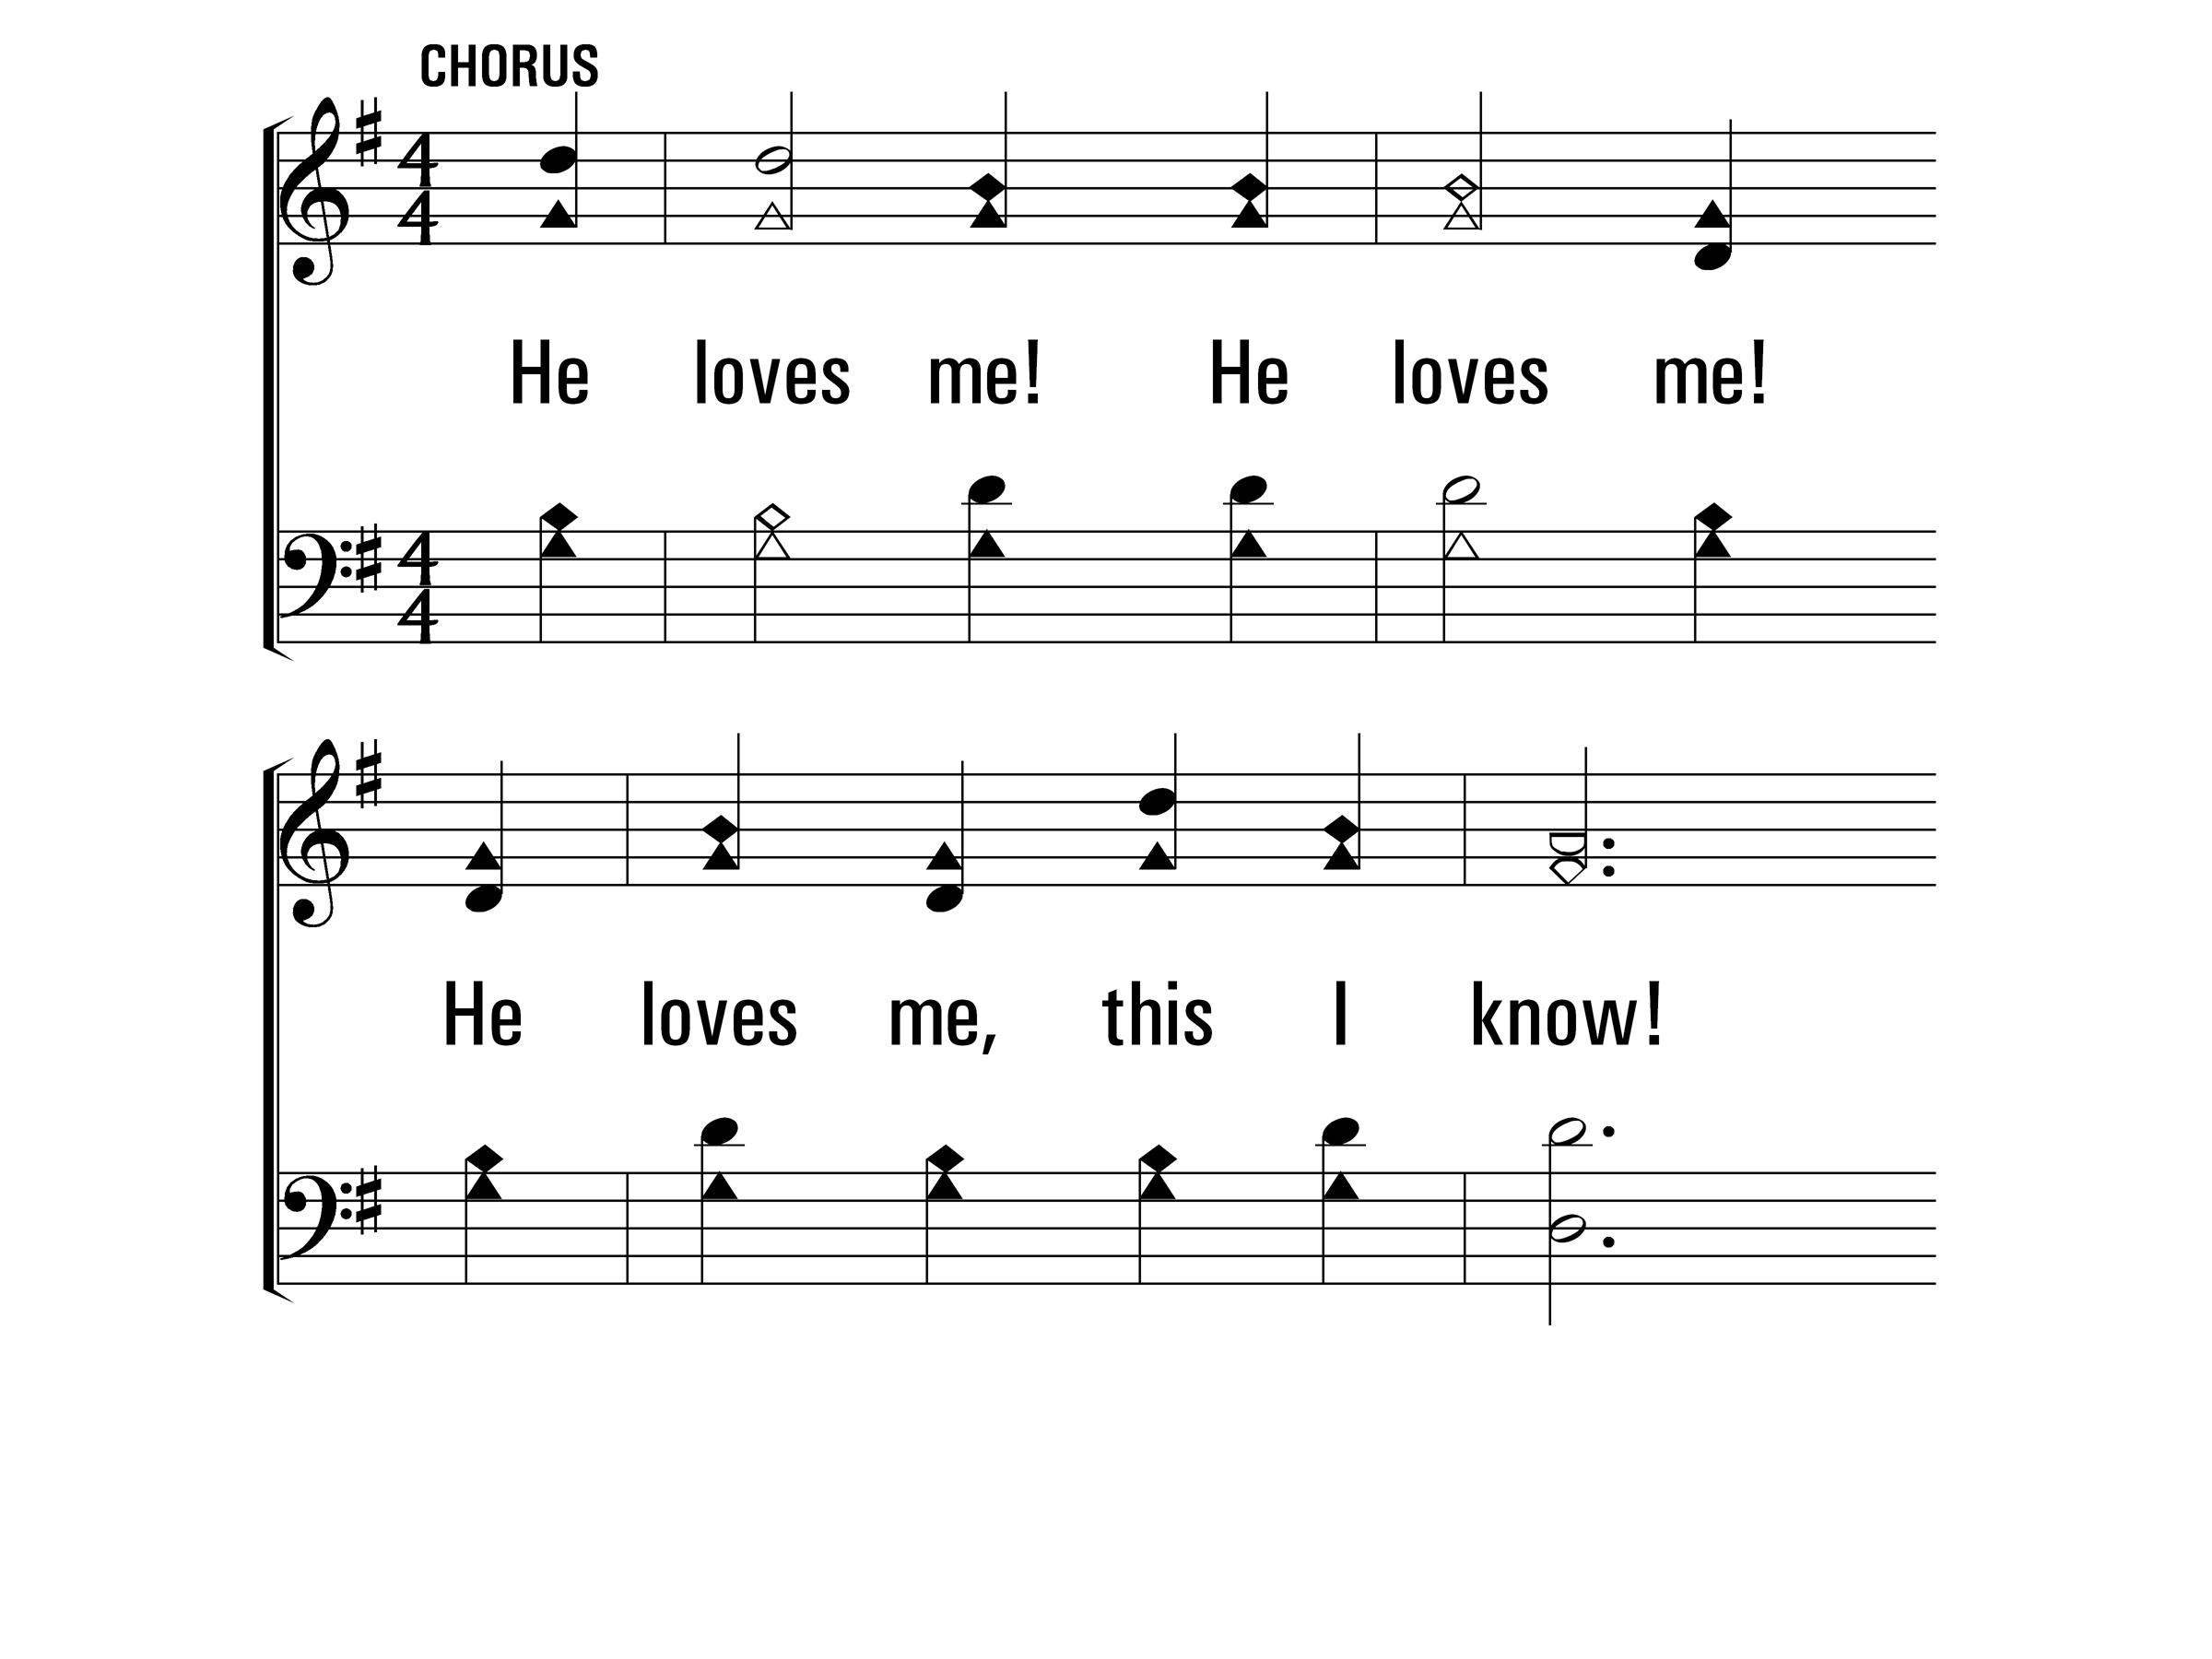
HeLovesMe_cho_a
Chorus
© 2014 Sumphonia Productions, LLC

Slide 28
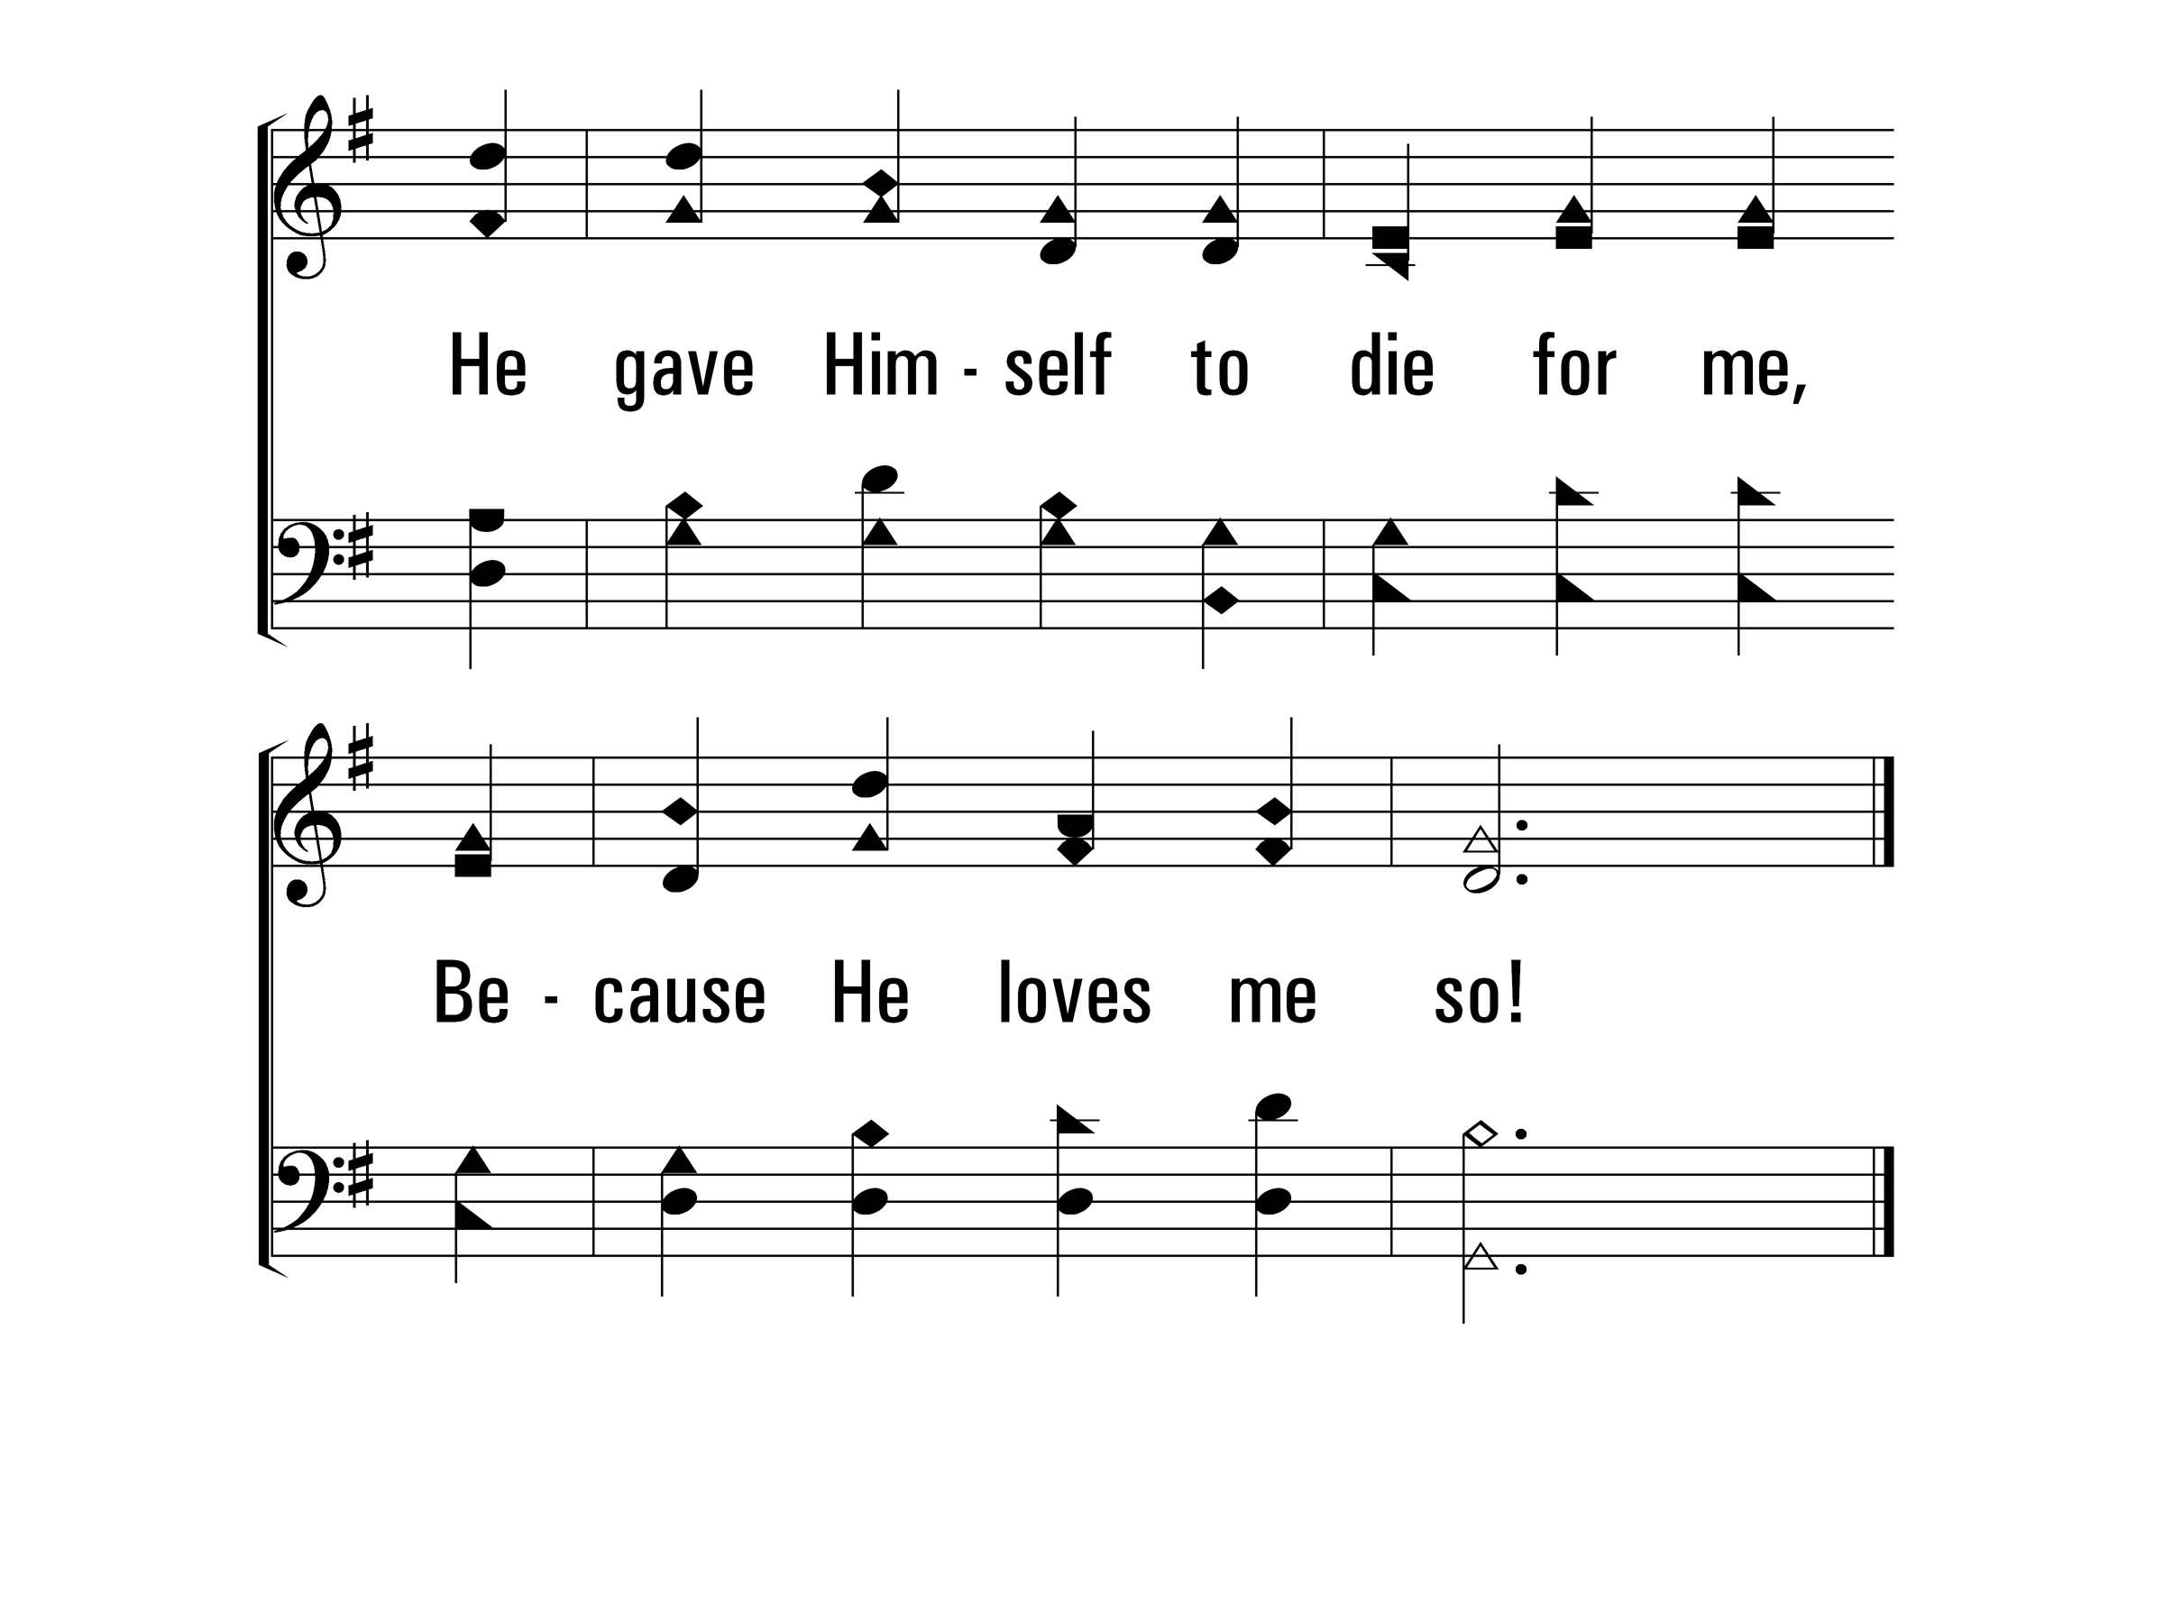
HeLovesMe_cho_b
Chorus
© 2014 Sumphonia Productions, LLC
End

Slide 30
Scripture Reading: Romans 8:35-39
Who shall separate us from the love of Christ? Shall tribulation, or distress, or persecution, or famine, or nakedness, or peril, or sword? ³⁶ As it is written:
“For Your sake we are killed all day long; We are accounted as sheep for the slaughter.”
³⁷ Yet in all these things we are more than conquerors through Him who loved us. ³⁸ For I am persuaded that neither death nor life, nor angels nor principalities nor powers, nor things present nor things to come, ³⁹ nor height nor depth, nor any other created thing, shall be able to separate us from the love of God which is in Christ Jesus our Lord.

Slide 31
In Christ Alone
306
_
_
_
Hymn: Keith Getty (2001); Stuart Townend (2001)
Tune: Keith Getty (2001); Stuart Townend (2001); arr. D. J. Bulls
© 2001 Thankyou Music (admin. by EMI Christian Music Publishing)

Slide 32
InChristAlone_st1_a
Vs 1
© 2014 Sumphonia Productions, LLC

Slide 33
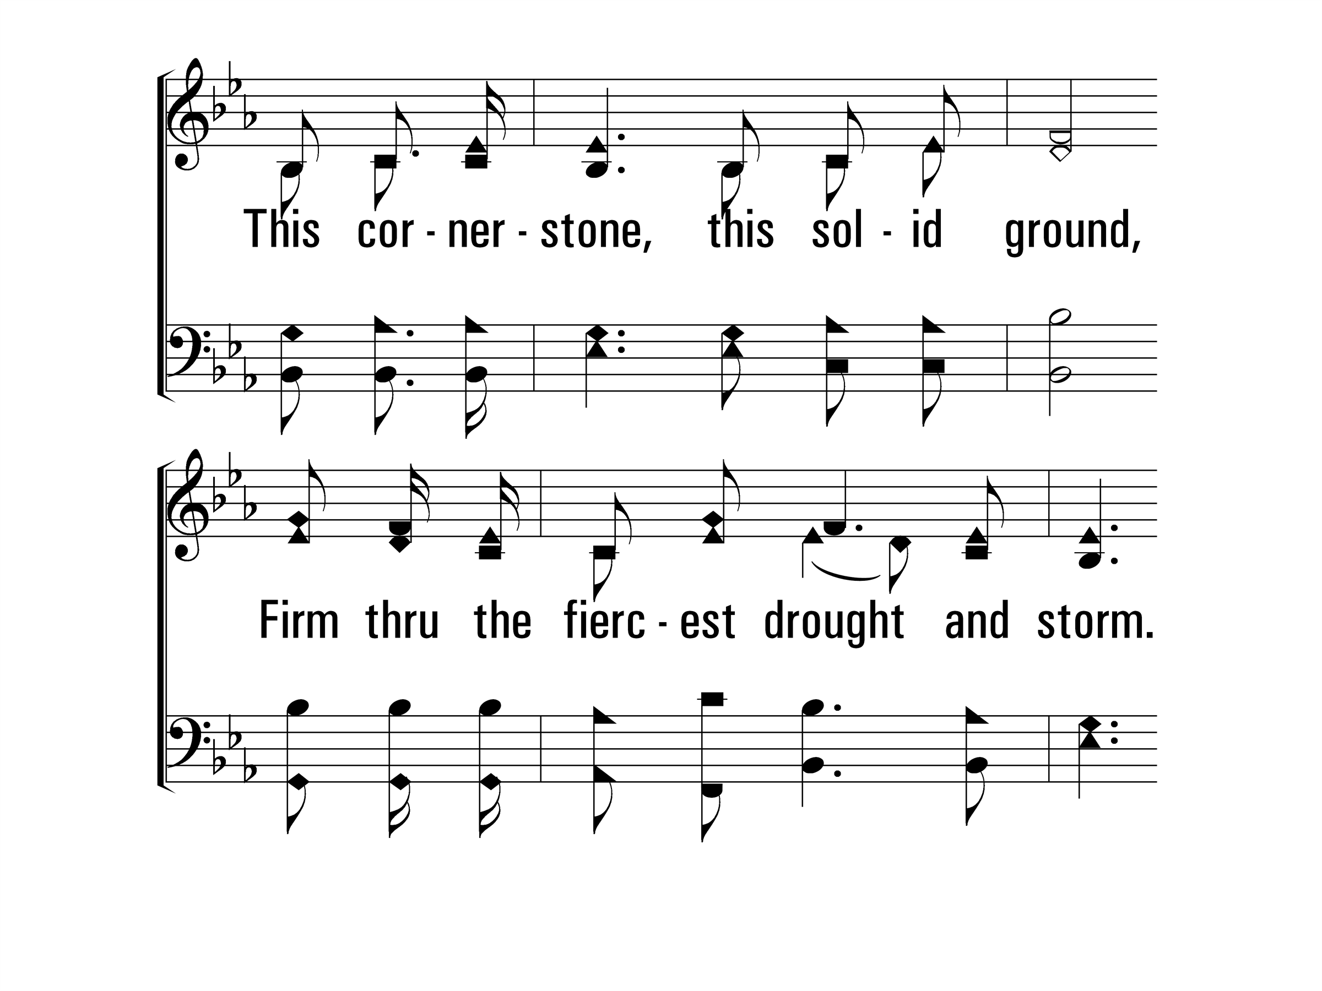
InChristAlone_st1_b
Vs 1
© 2014 Sumphonia Productions, LLC

Slide 34
InChristAlone_st1_c
Vs 1
© 2014 Sumphonia Productions, LLC

Slide 35
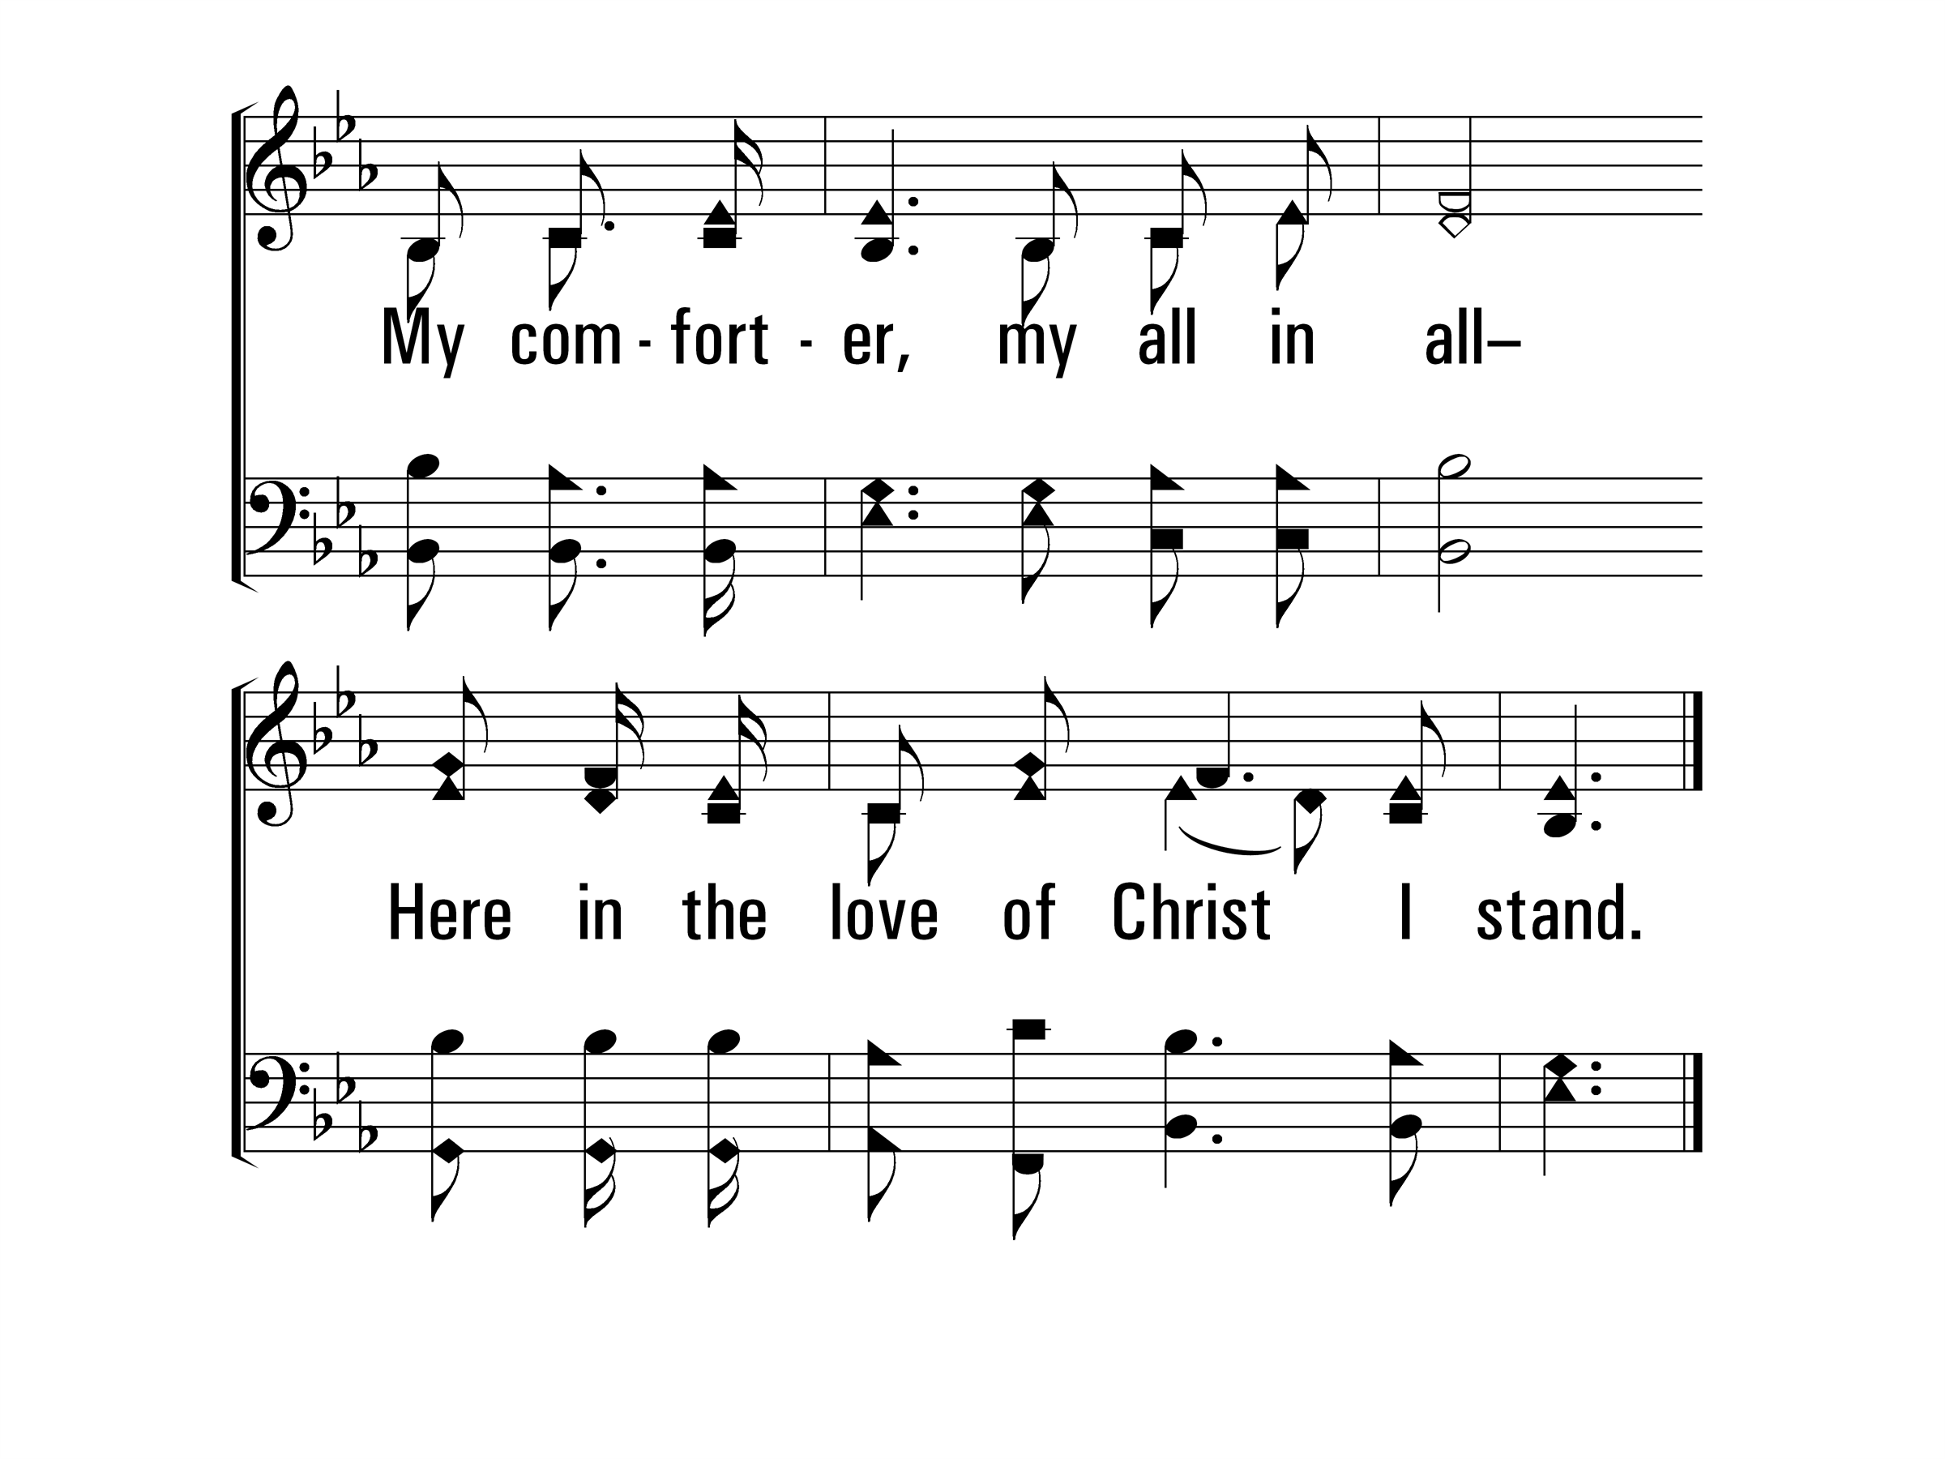
InChristAlone_st1_d
Vs 1
© 2014 Sumphonia Productions, LLC

Slide 36
InChristAlone_st2_a
Vs 2
© 2014 Sumphonia Productions, LLC

Slide 37
InChristAlone_st2_b
Vs 2
© 2014 Sumphonia Productions, LLC

Slide 38
InChristAlone_st2_c
Vs 2
© 2014 Sumphonia Productions, LLC

Slide 39
InChristAlone_st2_d
Vs 2
© 2014 Sumphonia Productions, LLC

Slide 40
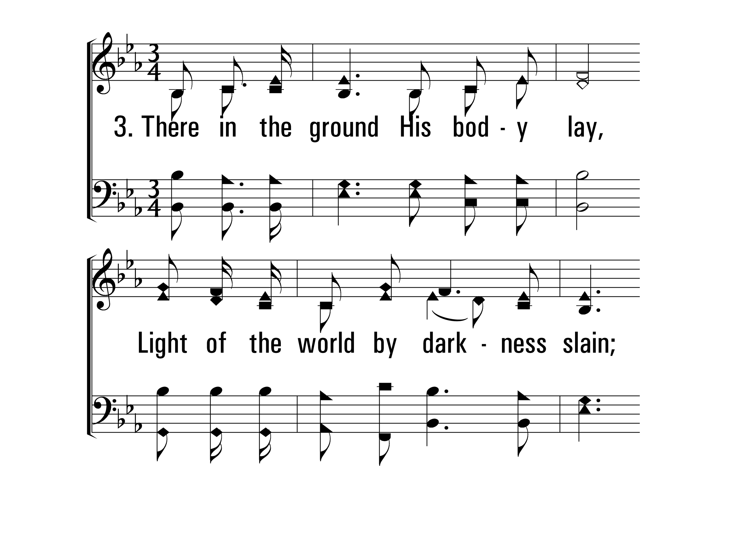
InChristAlone_st3_a
Vs 3
© 2014 Sumphonia Productions, LLC

Slide 41
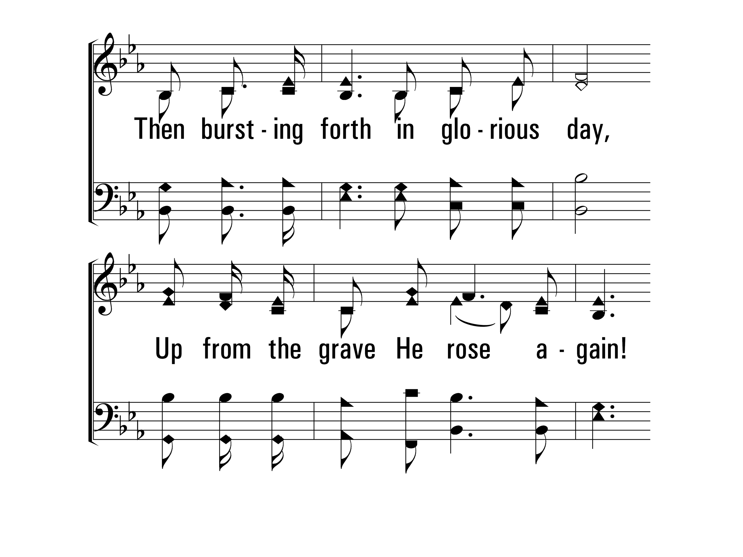
InChristAlone_st3_b
Vs 3
© 2014 Sumphonia Productions, LLC

Slide 42
InChristAlone_st3_c
Vs 3
© 2014 Sumphonia Productions, LLC

Slide 43
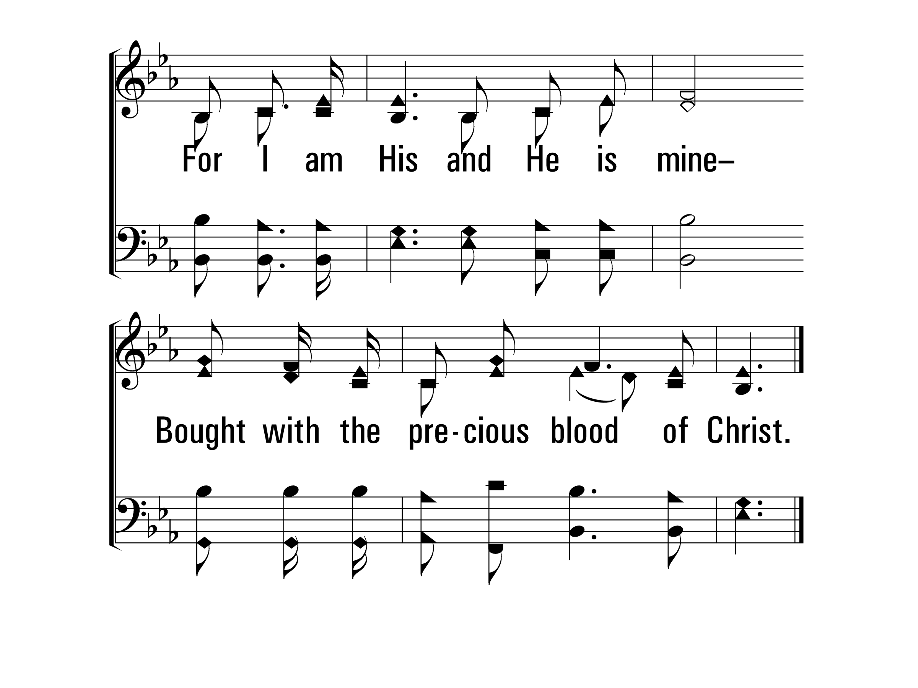
InChristAlone_st3_d
Vs 3
© 2014 Sumphonia Productions, LLC

Slide 44
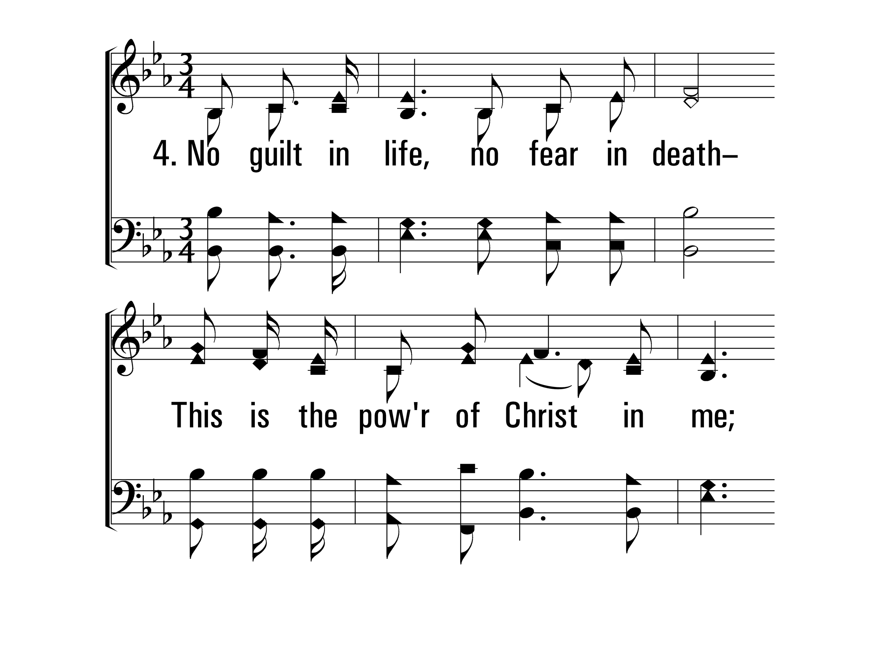
InChristAlone_st4_a
Vs 4
© 2014 Sumphonia Productions, LLC

Slide 45
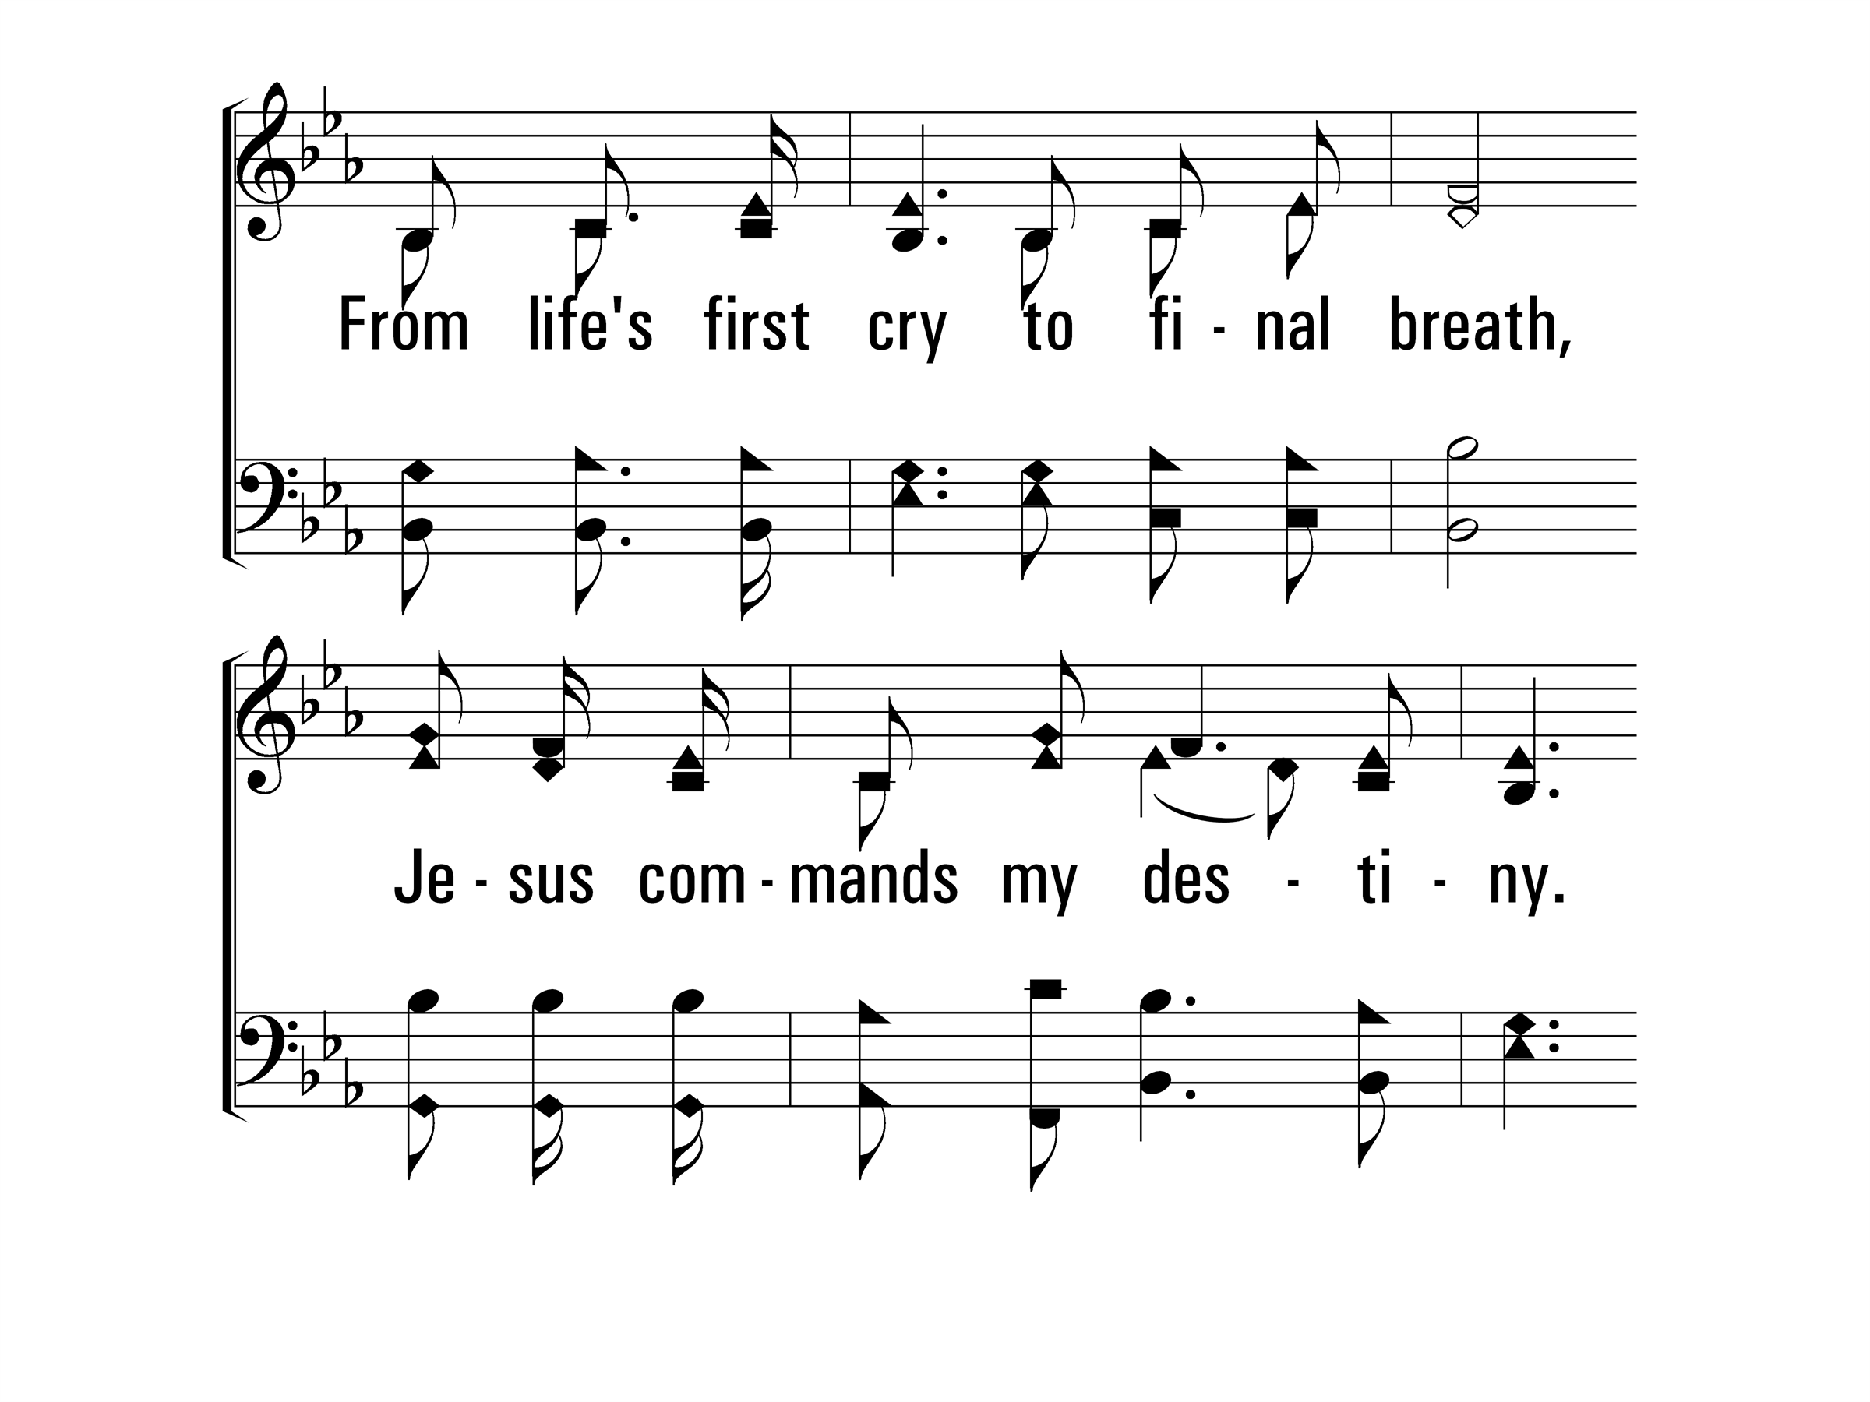
InChristAlone_st4_b
Vs 4
© 2014 Sumphonia Productions, LLC

Slide 46
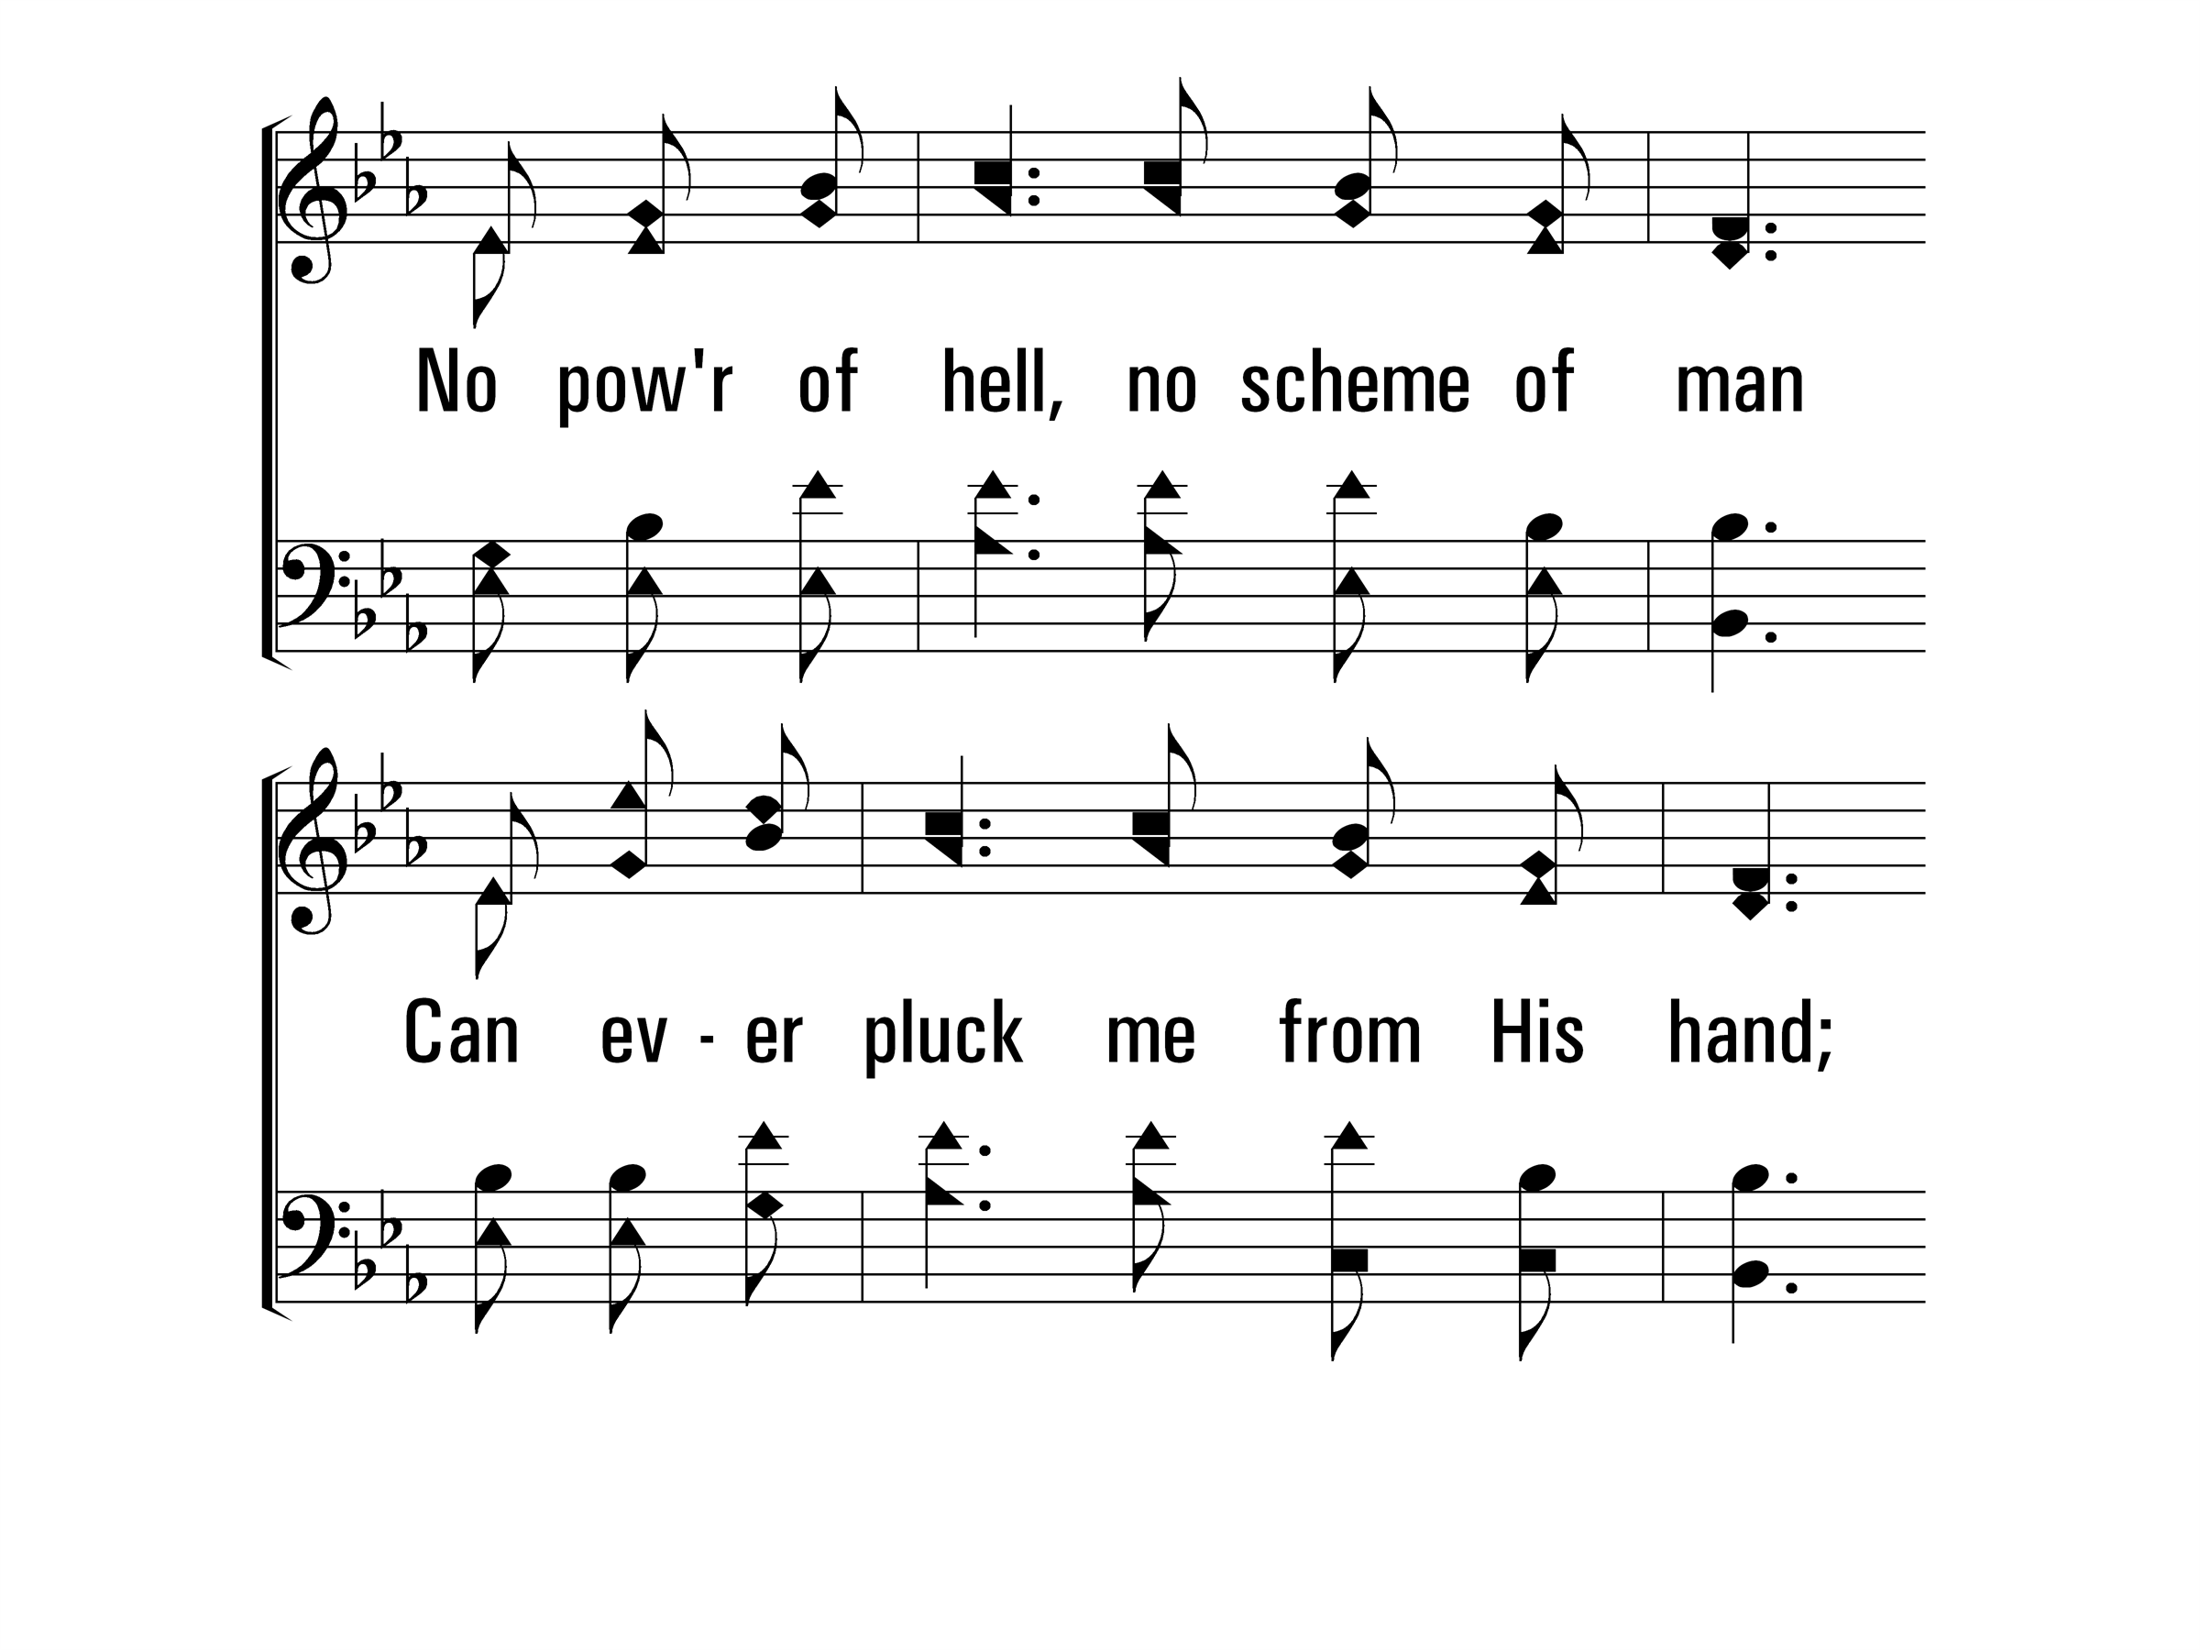
InChristAlone_st4_c
Vs 4
© 2014 Sumphonia Productions, LLC

Slide 47
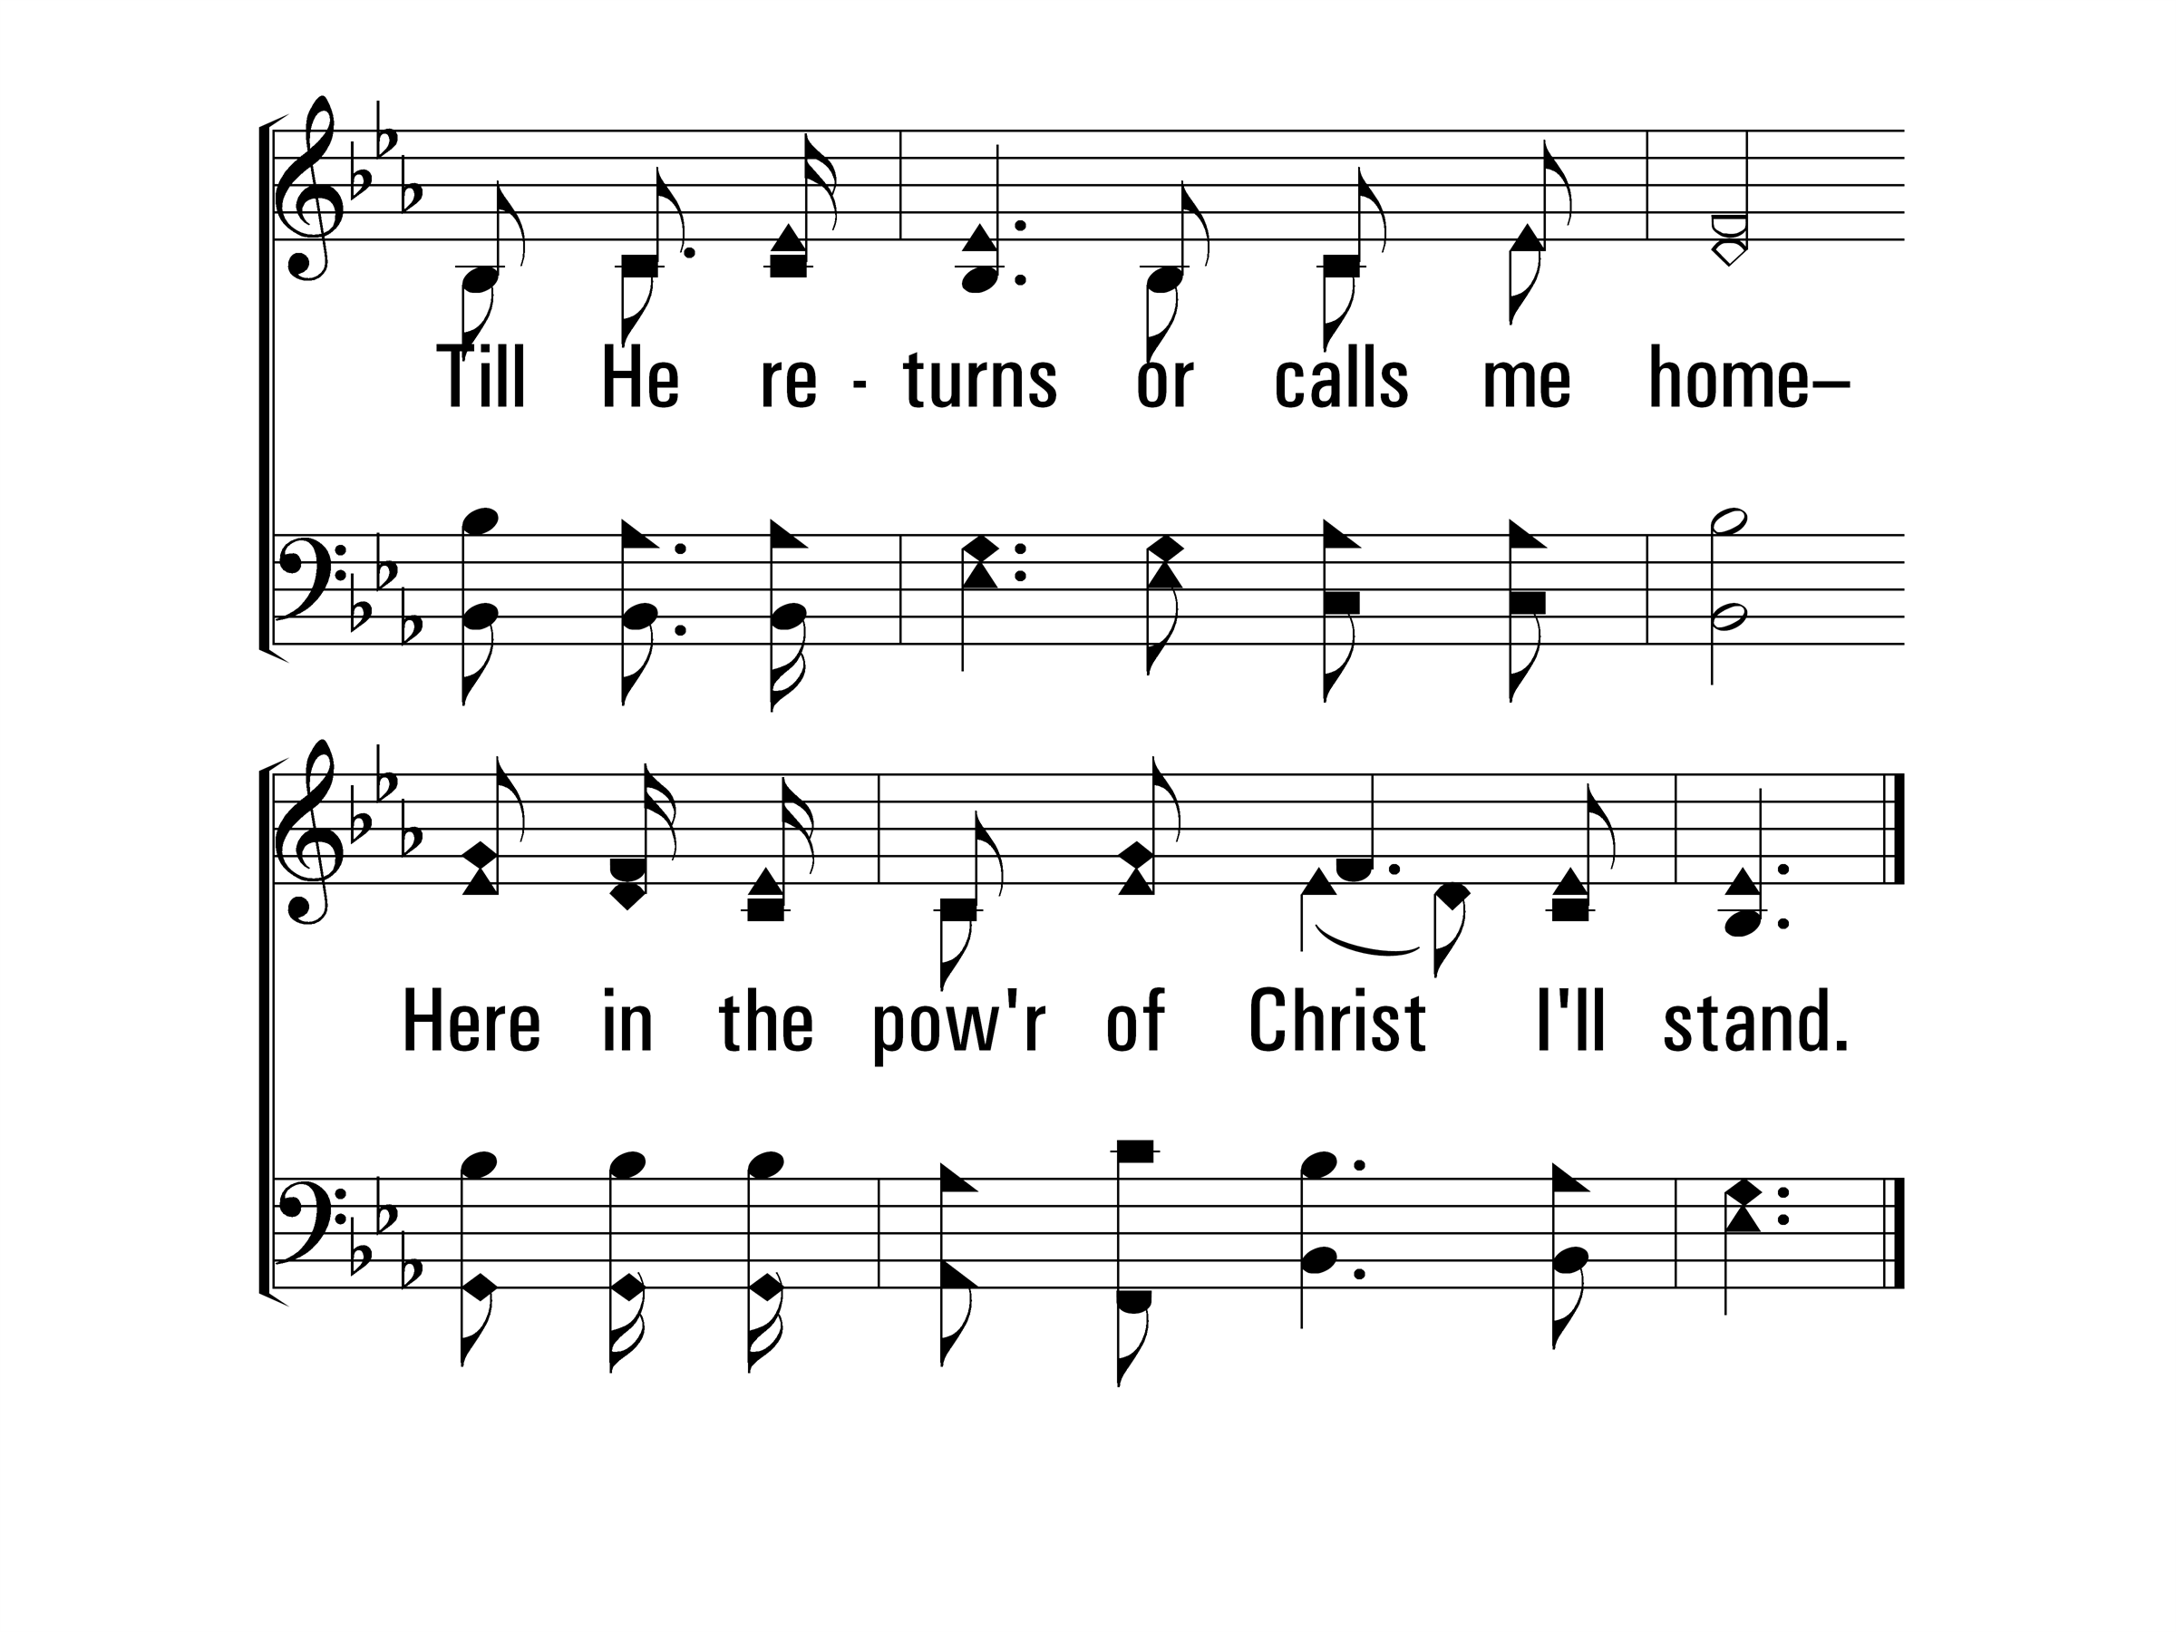
InChristAlone_st4_d
Vs 4
© 2014 Sumphonia Productions, LLC
End

Slide 61
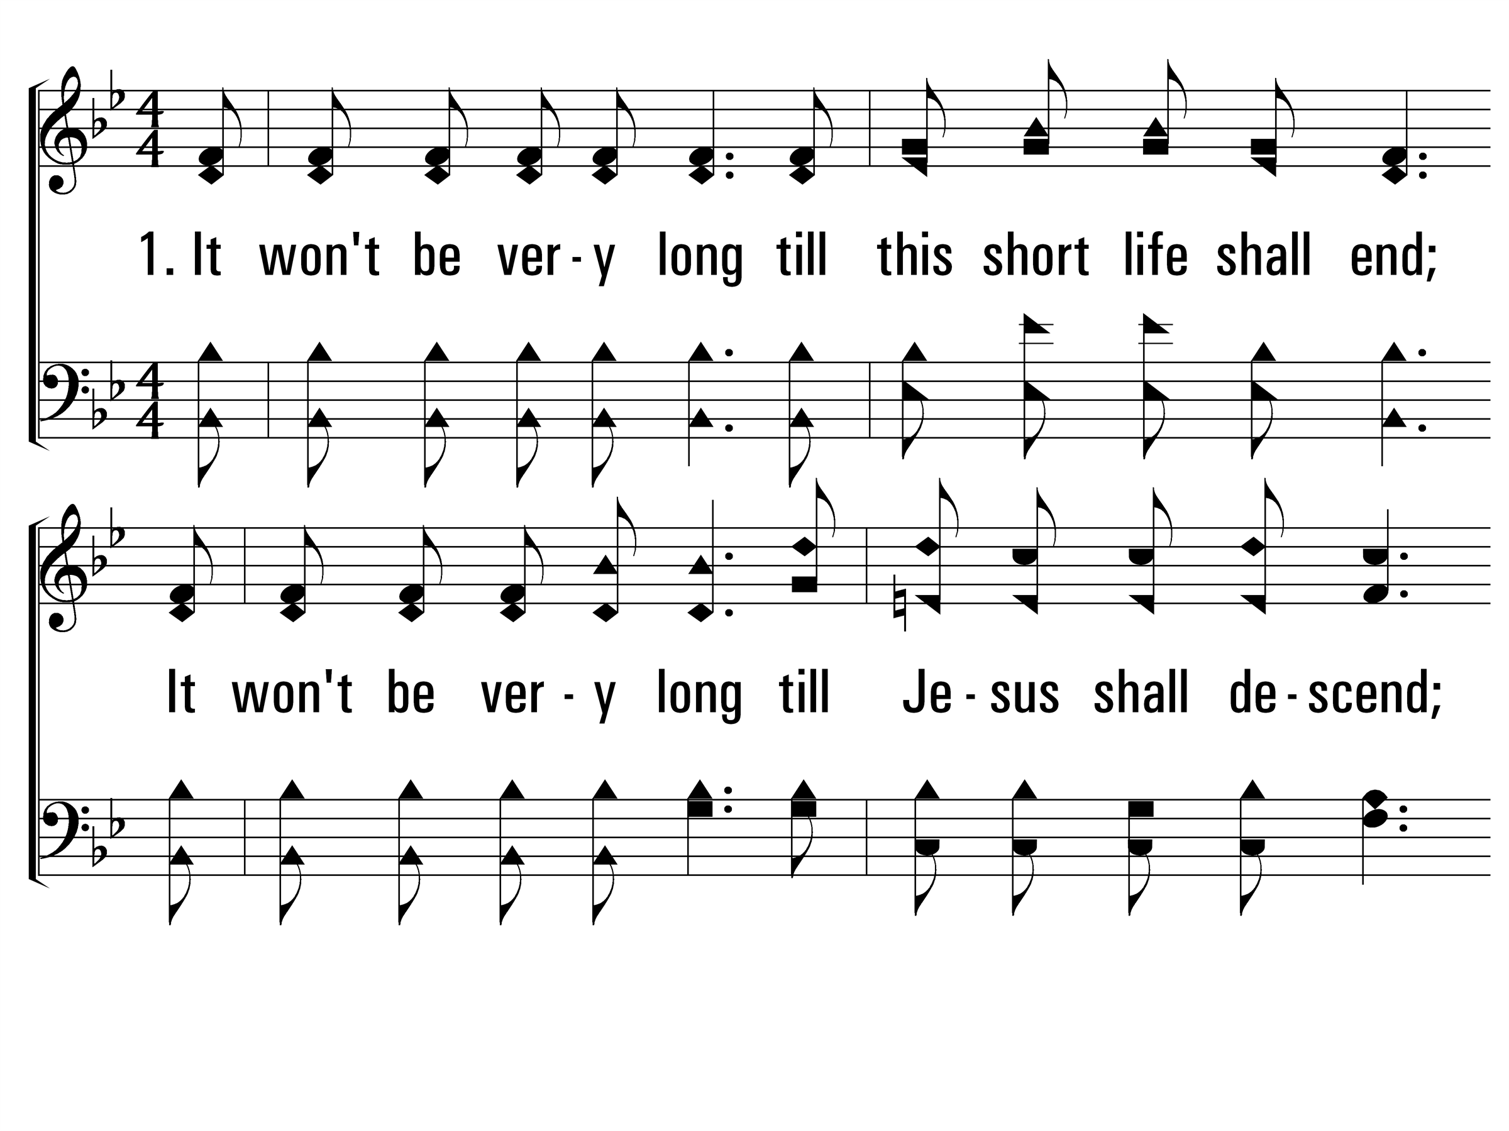
ItWontBeVeryLong_st1_a
Vs 1
© 2014 Sumphonia Productions, LLC

Slide 62
ItWontBeVeryLong_st1_b
Vs 1
© 2014 Sumphonia Productions, LLC

Slide 63
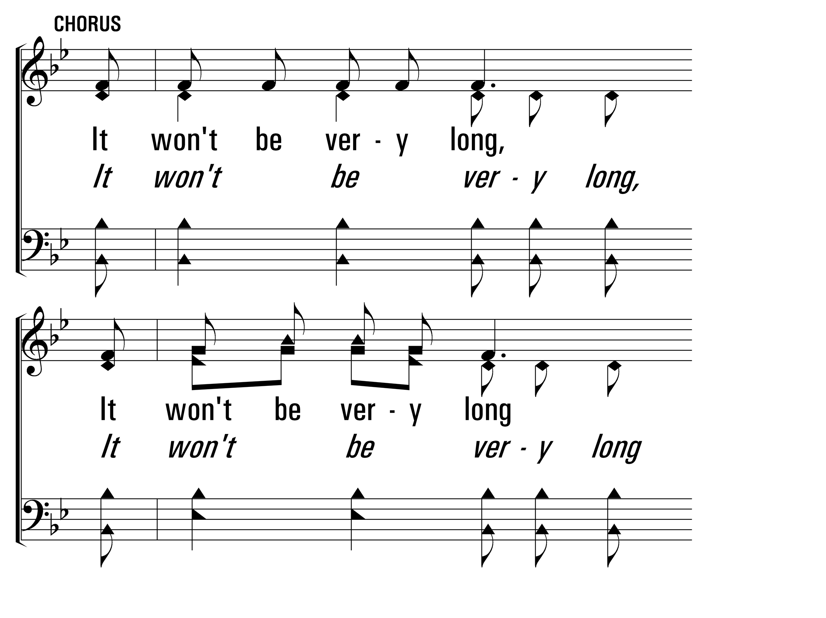
ItWontBeVeryLong_cho_a
Chorus
© 2014 Sumphonia Productions, LLC

Slide 64
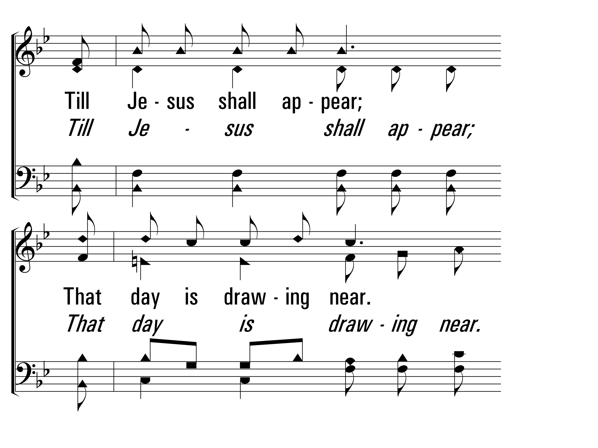
ItWontBeVeryLong_cho_b
Chorus
© 2014 Sumphonia Productions, LLC

Slide 65
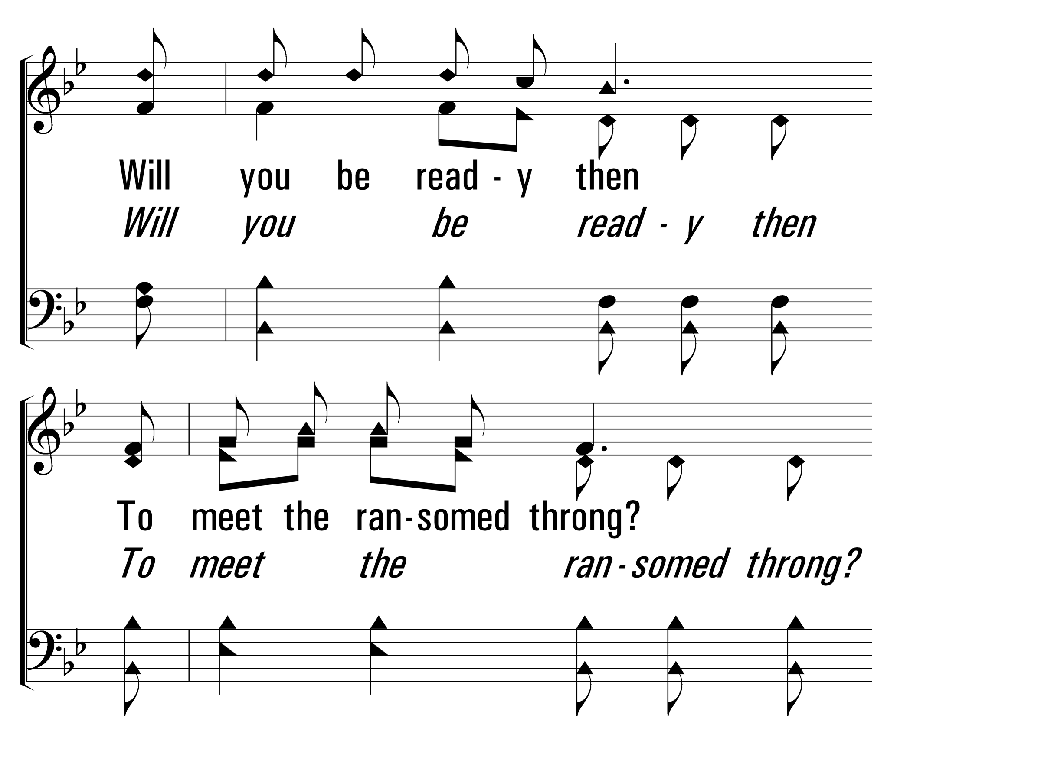
ItWontBeVeryLong_cho_c
Chorus
© 2014 Sumphonia Productions, LLC

Slide 66
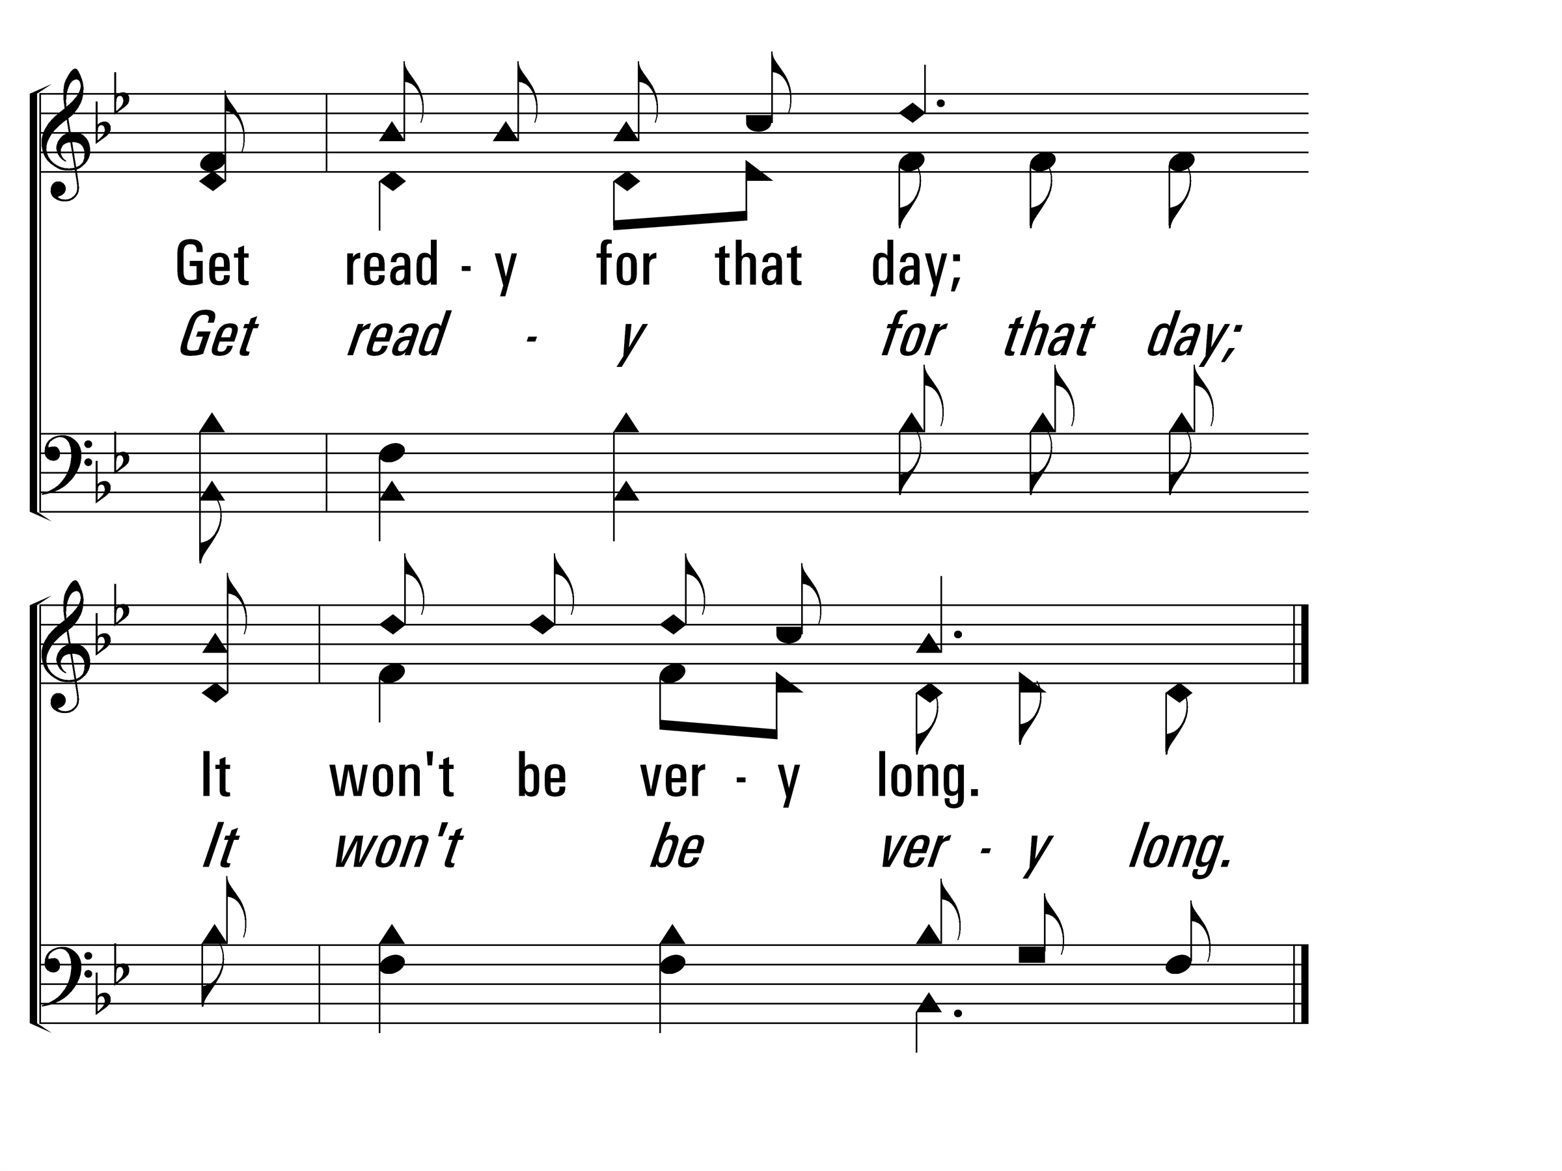
ItWontBeVeryLong_cho_d
Chorus
© 2014 Sumphonia Productions, LLC

Slide 67
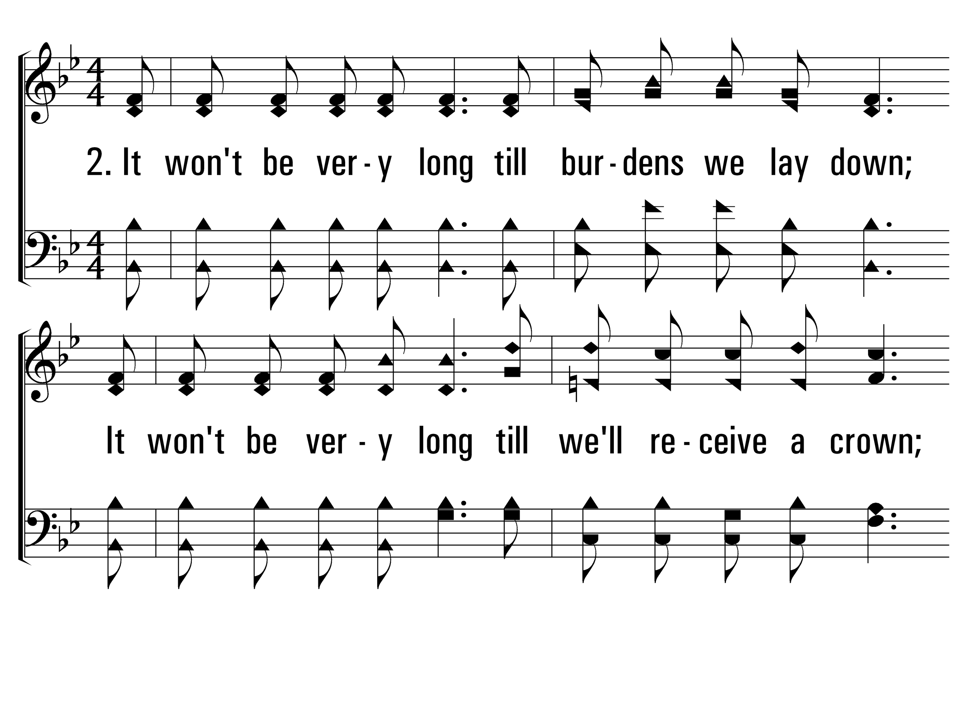
ItWontBeVeryLong_st2_a
Vs 2
© 2014 Sumphonia Productions, LLC

Slide 68
ItWontBeVeryLong_st2_b
Vs 2
© 2014 Sumphonia Productions, LLC

Slide 69
ItWontBeVeryLong_cho_a
Chorus
© 2014 Sumphonia Productions, LLC

Slide 70
ItWontBeVeryLong_cho_b
Chorus
© 2014 Sumphonia Productions, LLC

Slide 71
ItWontBeVeryLong_cho_c
Chorus
© 2014 Sumphonia Productions, LLC

Slide 72
ItWontBeVeryLong_cho_d
Chorus
© 2014 Sumphonia Productions, LLC

Slide 73
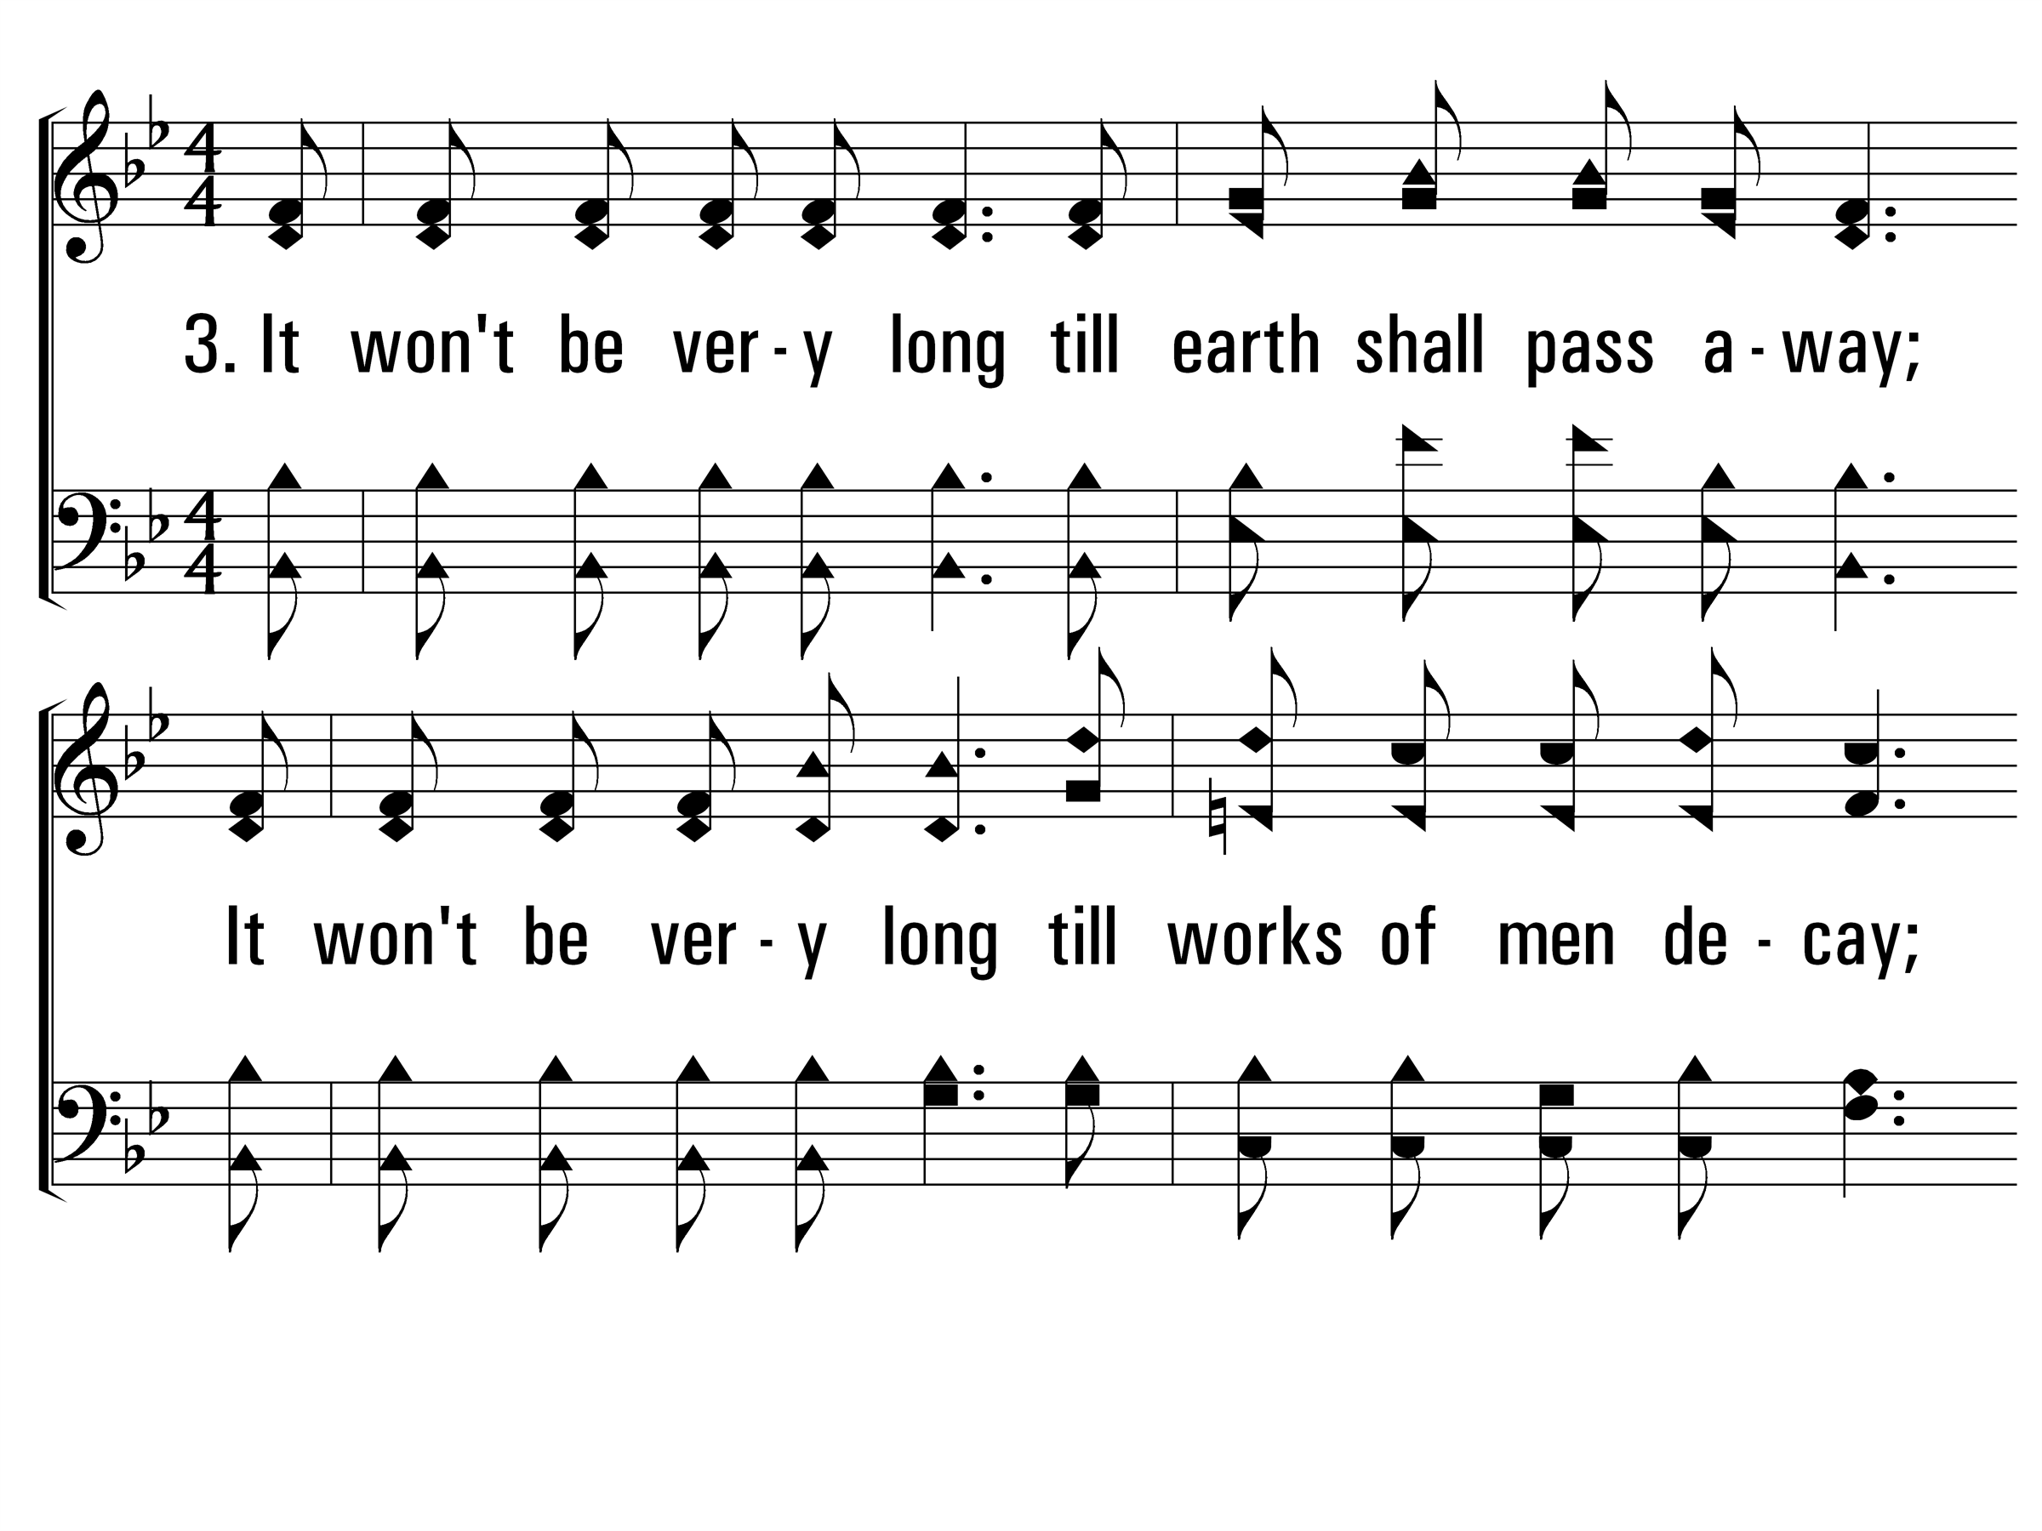
ItWontBeVeryLong_st3_a
Vs 3
© 2014 Sumphonia Productions, LLC

Slide 74
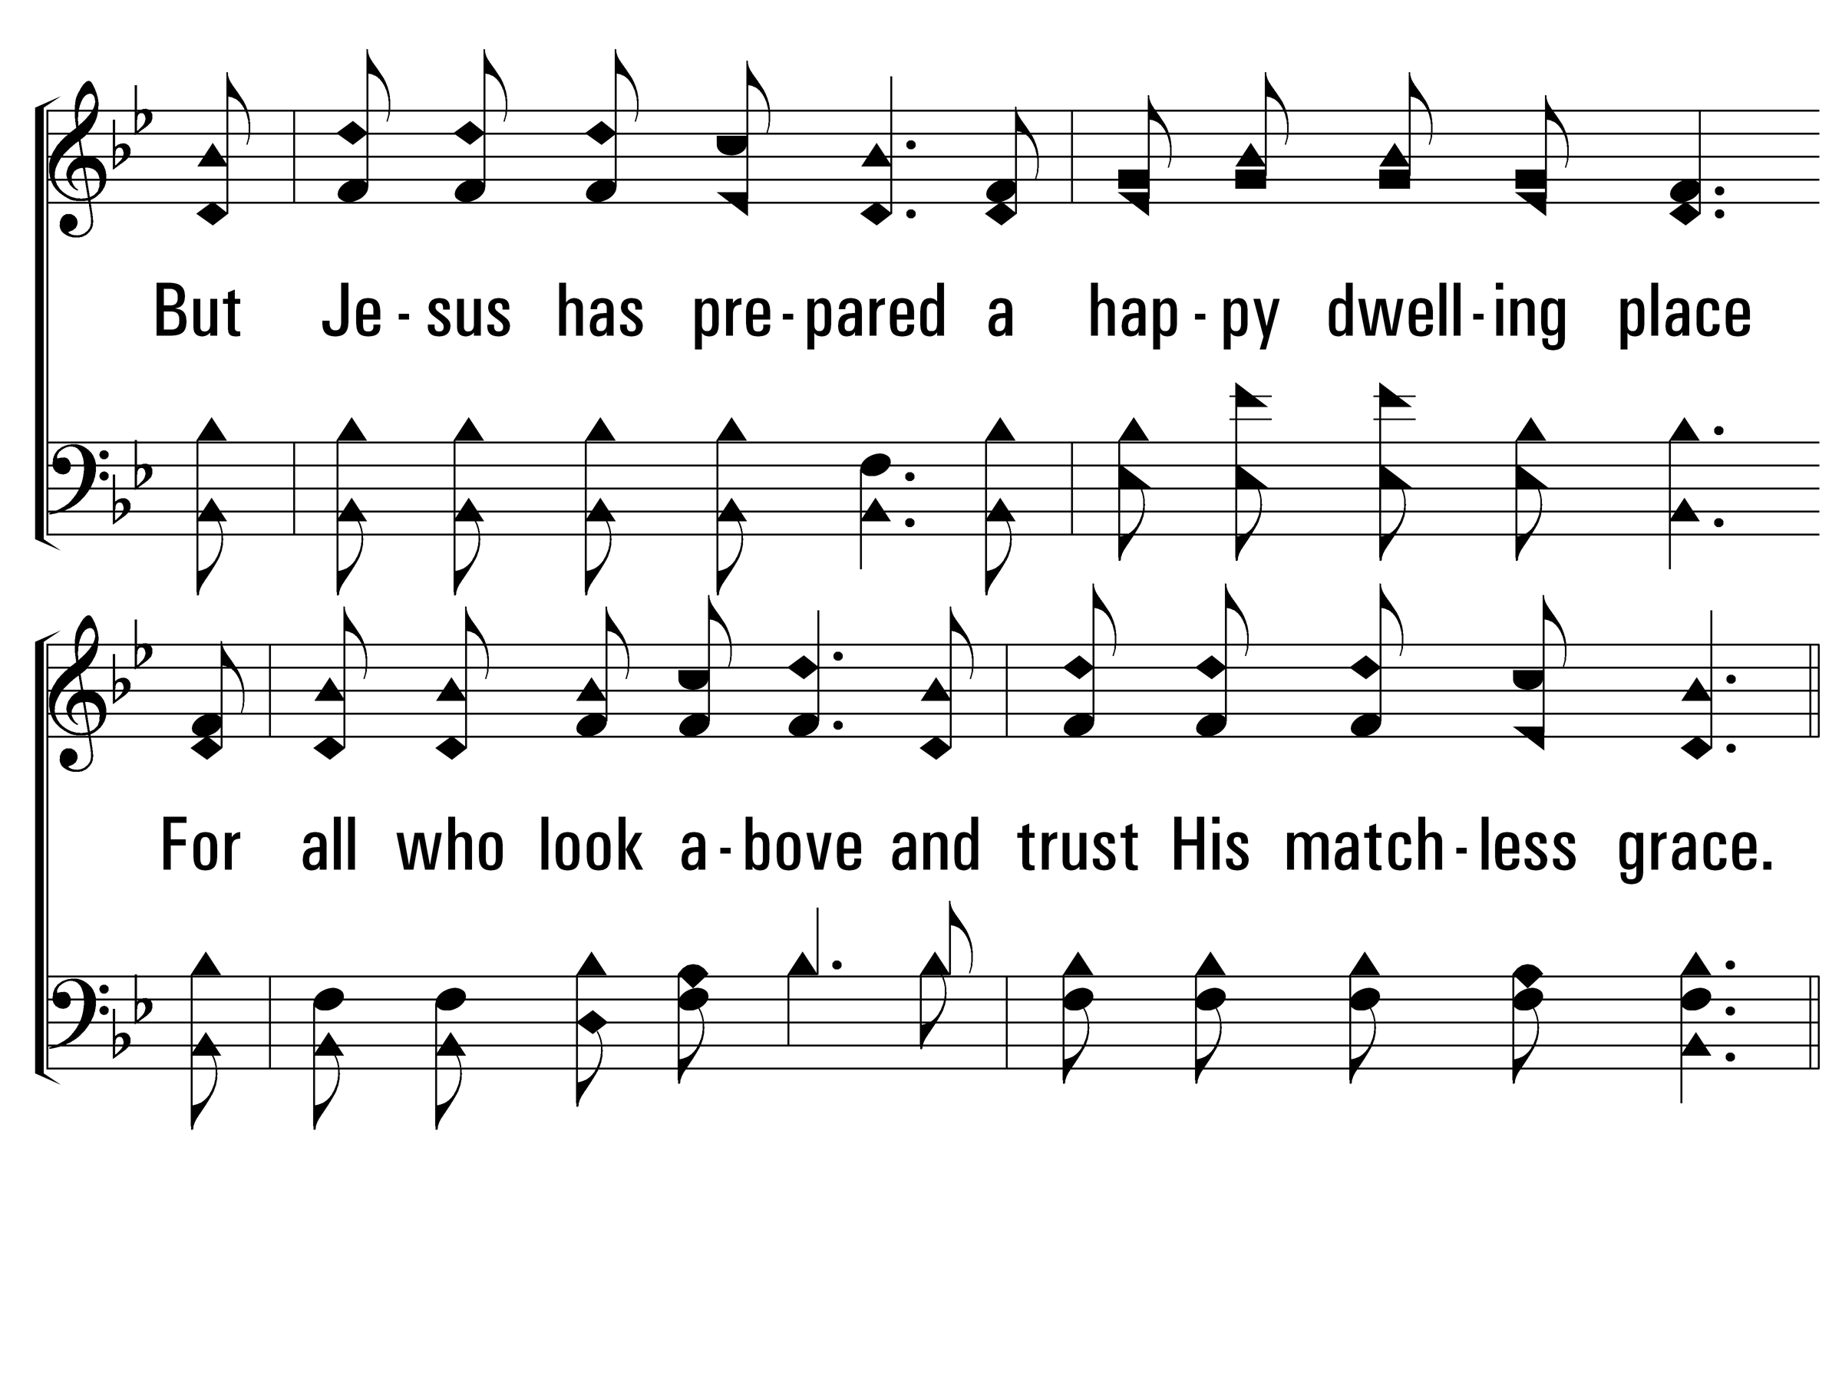
ItWontBeVeryLong_st3_b
Vs 3
© 2014 Sumphonia Productions, LLC

Slide 75
ItWontBeVeryLong_cho_a
Chorus
© 2014 Sumphonia Productions, LLC

Slide 76
ItWontBeVeryLong_cho_b
Chorus
© 2014 Sumphonia Productions, LLC

Slide 77
ItWontBeVeryLong_cho_c
Chorus
© 2014 Sumphonia Productions, LLC

Slide 78
ItWontBeVeryLong_cho_d
Chorus
© 2014 Sumphonia Productions, LLC
End

