Slide 1
A mindset to imitate
Ezra 7.10

Slide 2
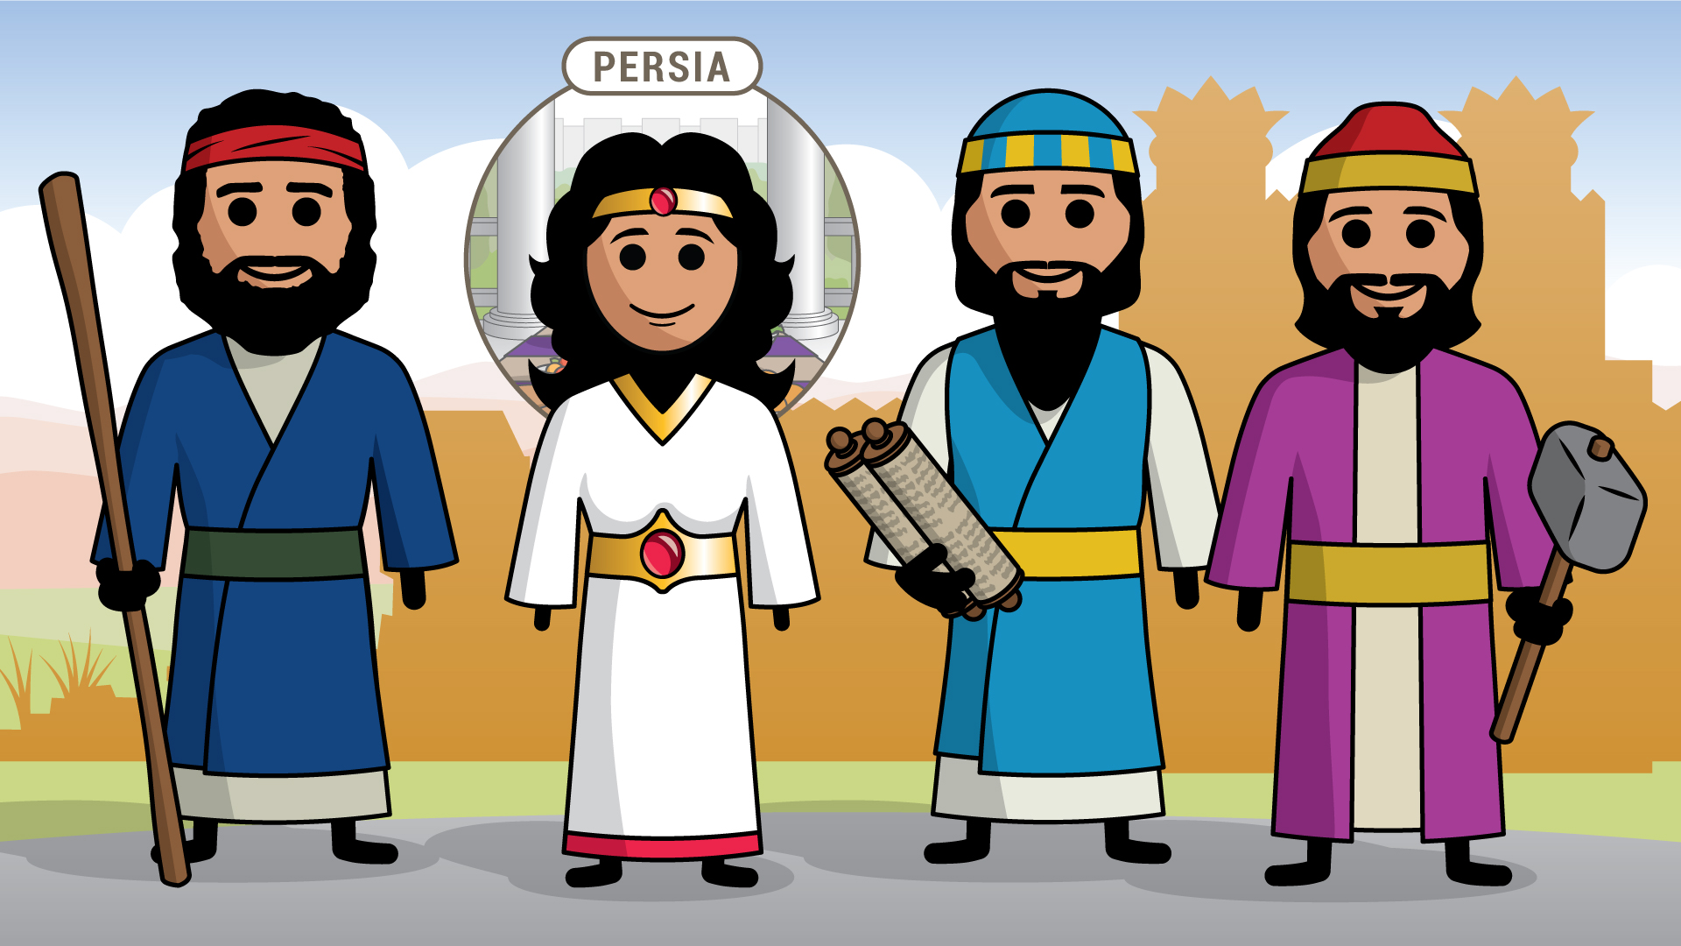
Where are we?
A bit of context
Main characters of the Return from Captivity
Ezra, Nehemiah, Esther, Zerubbabel
Dates covered by the book of Ezra
537 BC - 433 BC??
First 6 chapters of Ezra deal with the return of the people to Jerusalem
Chapters 7 - 10 detail Ezra’s return to Jerusalem sometime around 460 BC

Slide 3
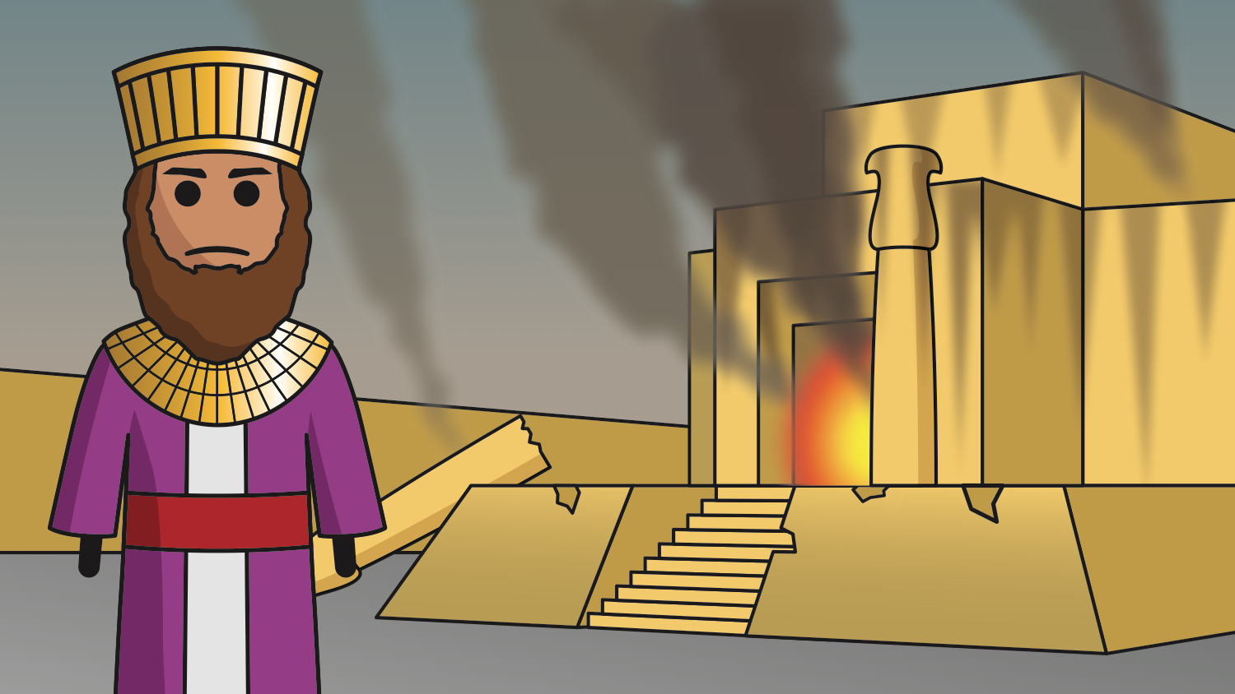
Destruction of jerusalem
A recap of Israel’s recent history
Kingdom of Judah is ultimately destroyed by Babylon in 586 BC
Destruction of the Temple
People are taken captive to Babylon
Daniel, Ezekiel
The people of Judah had become steeped in sin and rejected God’s prophets

Slide 4
2 chronicles 36.15-16
Scripture
“The Lord, the God of their fathers, sent persistently to them by His messengers, because He had compassion on His people and on His dwelling place. But they kept mocking the messengers of God, despising His words and scoffing at His prophets, until the wrath of the Lord rose against His people, until there was no remedy.” (ESV)

Slide 5
Captivity and return
A Recap of Israel’s recent history
People remained captive in the land of Babylon for 70 years.
They were allowed to return home by the decree of Cyrus, King of Persia
This was a fulfillment of God’s promises to His people through the prophets
Both Isaiah and Jeremiah
Isaiah 45.13 & Jeremiah 25.11-14

Slide 6
Ezra 1.2-4
Scripture
“Thus says Cyrus king of Persia: The Lord, the God of heaven, has given me all the kingdoms of the earth, and He has charged me to build Him a house at Jerusalem, which is in Judah. Whoever is among you of all His people, may his God be with him, and let him go up to Jerusalem, which is in Judah, and rebuild the house of the Lord, the God of Israel — He is the God who is in Jerusalem. And let each survivor, in whatever place he sojourns, be assisted by the men of his place with silver and gold, with goods and with beasts, besides freewill offerings for the house of God that is in Jerusalem.” (ESV)

Slide 7
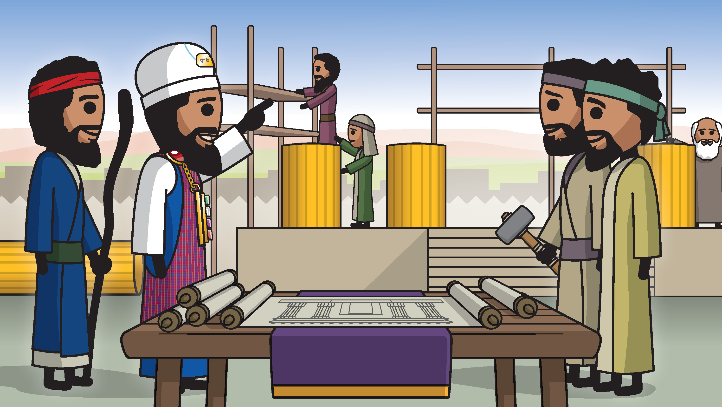
The people begin building the temple
A recap of Israel’s recent history
The people return to the land and begin rebuilding the temple immediately (536 BC)
They are stopped one year after work begins
Ezra 4
God sends Haggai and Zechariah to stir up the people to continue building (520 BC)
Temple construction is finished around 515 BC
Fast forward to Ezra 7 — 57 years later

Slide 8
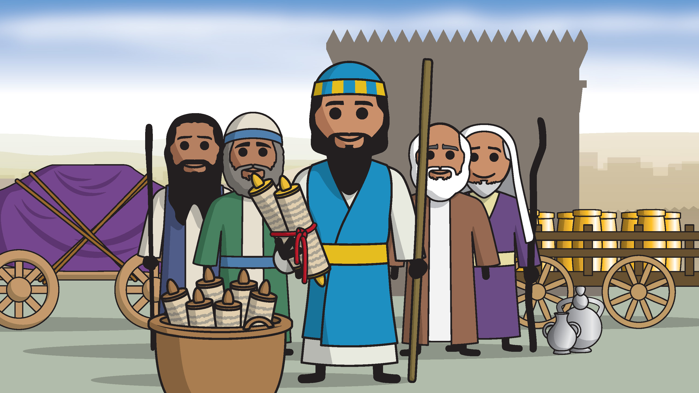
Ezra’s mindset
Ezra returns
Ezra 7.10
He had set in his heart to STUDY the Law of the Lord, and to DO IT, and to TEACH His statutes and rules in Israel
Ezra came with a different purpose
The first return was focused on rebuilding the Temple
The return led by Ezra was meant to restore Temple worship

Slide 9
Ezra’s mindset
Ezra returns
Study — Hebrew word is daras (daw-rash’)
Means to seek with care, to require
Ezra purposed in his heart to seek with care the word of God
Is this a mindset that we posses today?
Can I honestly say I seek with care, or am careful to seek out God’s word so that it can guide my life?

Slide 10
Acts 17.10-11
Scripture
“As soon as it was night, the brothers and sisters sent Paul and Silas away to Berea. Upon arrival, they went into the synagogue of the Jews. The people here were of more noble character than those in Thessalonica, since they received the word with eagerness and examined the Scriptures daily to see if these things were so.” (CSB)

Slide 11
Studying scripture
Application
Daily Bible reading is great…but let’s not just read for the sake of reading
When we read Scripture, let’s have a mindset that looks for application to us
How does this connect to me?
What can I learn from this passage?
How does this passage connect to Jesus?

Slide 12
Studying scripture
Application
Let’s look for context to the passages
Study with other people
Proverbs 27.17 — “Iron sharpens iron, and one person sharpens another.” (CSB)
Pray about your study
Psalm 119.18 — “Open my eyes, that I may behold wondrous things out of your law.” (ESV)

Slide 13
Psalms 63.1
Scripture
“God, you are my God; I eagerly seek you. I thirst for you; my body faints for you in a land that is dry, desolate, and without water.” (CSB)

Slide 14
Matthew 6.33
Scripture
“But seek first the kingdom of God and His righteousness, and all these things will be provided for you.” (CSB)

Slide 15
Ezra’s mindset
Ezra returns
Do it — Hebrew word is asa (aw-saw’)
Carries a meaning of to do, to fashion, to make, to produce
It’s not just enough to know what God says; we must be willing to put it in to practice in our lives
Am I fashioning my life as one who listens to the words of God?
Am I allowing God to shape me like a potter would with clay on a potter’s wheel?

Slide 16
2 Timothy 3.16-17
Scripture
“All Scripture is inspired by God and is profitable for teaching, for rebuking, for correcting, for training in righteousness, so that the man of God may be complete, equipped for every good work.” (CSB)

Slide 17
Isaiah 64.8
Scripture
“Yet Lord, you are our Father; we are the clay, and you are our potter; we are all the work of your hands.” (CSB)

Slide 18
Ephesians 2.10
Scripture
“For we are His workmanship, created in Christ Jesus for good works, which God prepared beforehand, that we should walk in them.” (ESV)

Slide 19
Humility
Application
We need to be humble and allow God’s word to penetrate our hearts
Only when we do that, will we allow God to mold us and shape us
We sing a song from time to time in our assemblies, #486 - None of Self and All of Thee
As we allow God to mold us, we will take the attitude of Paul
Galatians 2.20

Slide 20
Ezra’s mindset
Ezra returns
To Teach — Hebrew word is lamad (law-mad’)
Carries a meaning of to teach
Also translated as instruct/instruction/instructed
Am I doing my part to instruct those around me?

Slide 21
Deuteronomy 6.6-9
Scripture
“These words that I am giving you today are to be in your heart. Repeat them to your children. Talk about them when you sit in your house and when you walk along the road, when you lie down and when you get up. Bind them as a sign on your hand and let them be a symbol on your forehead. Write them on the doorposts of your house and on your city gates.” (CSB)

Slide 22
2 Timothy 4.2
Scripture
“Preach the word; be ready in season and out of season; reprove, rebuke, and exhort, with complete patience and teaching.” (ESV)

Slide 23
Be busy
Application
There are plenty of opportunities for us to be busy doing the work of teaching others the Gospel
We often pray for ‘doors of opportunities’ to open to us…they are there.
The instruction can be both outward (non-believers) and inward (fellow brothers and sisters)
When we set aside time to study/meditate/seek after God’s word, and allow it to shape us and transform our lives, we will be the most effective in our ‘teaching’

Slide 24
Am I right with God?

Slide 25
Question For Me
Am i right with god?
What is my condition before God?
Am I lost?
Am I saved?
Not sure?

Slide 26
Question for me
Am i right with god?
If I am lost, what do I do?
You must hear the Good News about Jesus
You must believe that Jesus is the Son of God
You must be baptized for the forgiveness of your sins
See Acts 8.26-40
Walk in newness of life after being baptized

Slide 27
Question for me
Am I right with God?
If I am saved?
Continue walking with God — 1 John 1.5-7
Live faithful — Revelation 2.10
Do good works — Ephesians 2.10, James 2.14-19
Spread the Good News — Romans 10.14-15, Matthew 28.18-20

Slide 28
Question for me
Am I right with God?
Not sure?
Talk to someone before you leave this building

