Slide 1
And truly Jesus did many other signs in the presence of His disciples, which are not written in this book; but these are written that you may believe that Jesus is the Christ, the Son of God, and that believing you may have life in His name (John 20:30-31).

Slide 2
CENI
Commands
Examples
Necessary Inferences
3 Basic Means of Communication
God tells us His Will (Commands / Statements)
God shows us His Will (Examples / Models)
God implies to us His Will (Principles / Gestures)

Slide 4
CENI was probably the biggest reason I left the CoC. It has several major flaws, the biggest of which is that the "NI" part is usually just used as an excuse for post hoc reasoning.
CENI treats the gospels and letters as if they are a rulebook meant to derive a set of unbreakable laws, particularly laws by which others are bound. "If the Son sets you free, then you are free indeed."
I have a problem with the "authorization fallacy" entirely. I think the idea that one has to find some kind of authorization to do anything is, on its own, theologically false.
“CENI is a tool. We were taught that well. But as I’ve grown and re-examined - it feels like some of it was reverse engineering where the conclusion was regionally, locally, pseudo-denominationally decided - so we always got to the same result, even when variables were introduced that should have given us pause. Grown up reality from yearly NT read - conclusions are not as simple as previously… decided?”
(Facebook thread discussing Bible Authority)
In an effort to minimize the need to follow the pattern of Scripture—a N/I preacher said:
“I’m gonna be a lot more wary in the future of just deciding that you’re not sound if you’re a baptized believer focused on Christ and the truth, living in sincerity and reading the Word of God, but there’s some ilk of it that you hold that’s different from me. Well, you’re unsound and I’m sound. I’m not doing that.” (Sermon: “What is Sound Doctrine?”)

Slide 5
Basic
Communication
We tell others (employees, children, students) what we expect.
We show others what we want and how to accomplish it.
We imply certain details and we expect others to infer (get-it).

Slide 6
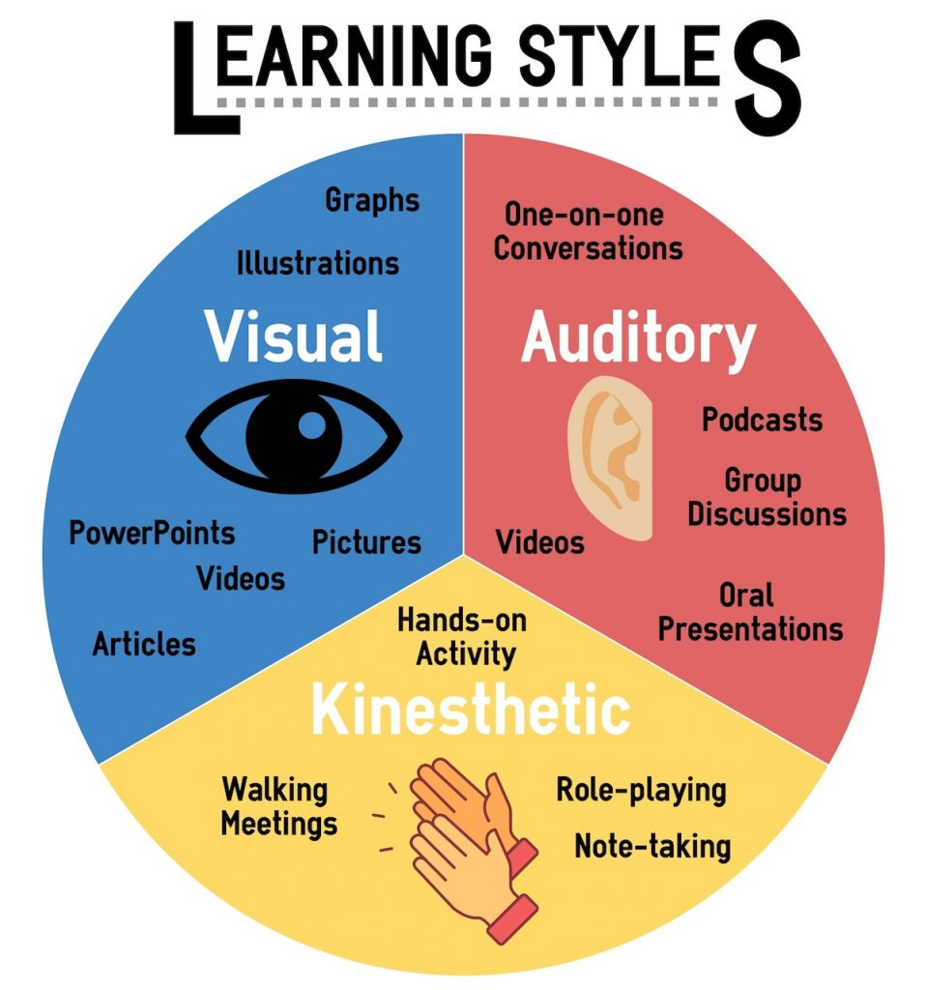
Examples
Illustrations
Statements
Commands
Conclusions
Inferences

Slide 7
Commands / Statements
Given Examples
Forced Conclusions
(Matthew 19:3-6), a man shall…be joined to his wife, and the two shall become one flesh…what God has joined together, let not man separate.
(Matthew 22:23-32), I am the God of Abraham, the God of Isaac, and the God of Jacob; God is not the God of the dead, but of the living.
(Matthew 5:21), You have heard that it was said to those of old, you shall not murder...
(Hebrews 11:3), By faith we understand that the worlds were framed by the word of God…
(1 Corinthians 10:11), Now all these things happened to them as examples, and they were written for our admonition...
(Romans 15:4), For whatever things were written before were written for our learning…
This indicated that…
…the O.T. Stated what was expected!
…the O.T. Showed what was expected!
…the O.T. Gave enough information to Necessarily Infer what was expected!

Slide 8
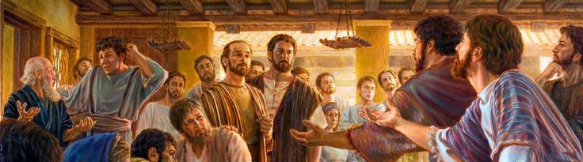
Commands / Statements
Given Examples
Forced Conclusions
The disciples understood that…
…the O.T. Stated what was God’s Will!
…gentile conversions w/o circumcision Showed what was God’s Will!
…God directing Peter to go to the gentiles, he necessarily inferred what was God’s Will!
(Acts 15:12), Then all the multitude kept silent and listened to Barnabas and Paul declaring how many miracles and wonders God had worked through them among the Gentiles.
(Conversion Gentiles, Acts 14:27), Now when they had come and gathered the church together, they reported all that God had done with them, and that He had opened the door of faith to the Gentiles.
(Acts 15:7-11), Peter rose up and said to them: men and brethren, you know that a good while ago God chose among us, that by my mouth the Gentiles should hear the word of the gospel and believe…But we believe that through the grace of the Lord Jesus Christ we shall be saved in the same manner as they.
(Conversion of Cornelius Acts 10)
(Acts 15:13-21), And after they had become silent, James answered, saying…with this the words of the prophets agree, just as it is written…So that the rest of mankind may seek the Lord, even all the Gentiles who are called by My name, says the Lord who does all these things.
(Prophesy of Amos 9:11)

Slide 9
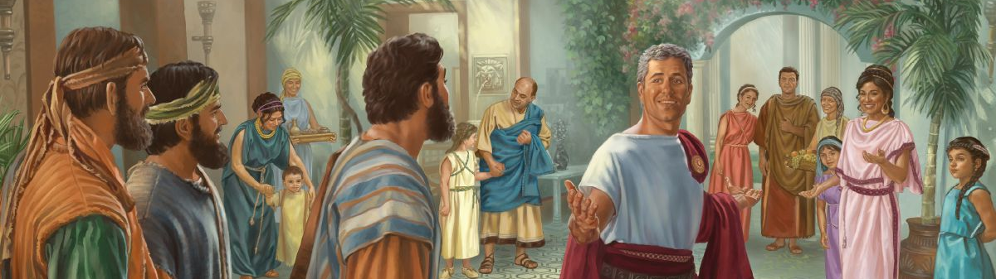
Commanded Directly
Given Illustration
Forced Conclusion
(Acts 10:34-35), Then Peter opened his mouth and said: In truth I perceive that God shows no partiality. But in every nation whoever fears Him and works righteousness is accepted by Him.
(Peter rightfully inferred), That the gentiles are now clean, and he may preach to them.
(Acts 10:9-16), Peter went up on the housetop to pray…he fell into a trance and saw…a great sheet bound at the four corners, descending to him and let down to the earth. In it were all kinds of four-footed animals of the earth, wild beasts, creeping things, and birds of the air. And a voice came to him, rise, Peter; kill and eat…what God has cleansed you must not call common.
(vv28-29), God has shown me…
(Acts 10:19-20), While Peter thought about the vision, the Spirit said to him, behold, three men are seeking you. Arise therefore, go down and go with them, doubting nothing; for I have sent them.
(v29), Therefore I came without objection as soon as I was sent for.
There are only so many ways to communicate, and these will always require some form of:
Telling!
Showing!
Implying!
If there is another way of communicating, don’t tell what it is—don’t show what it is and don’t imply what it is.

Slide 10
Obey Direct Commands and
Respect Expressed Statements
Respect and emulate
positive God approved examples
Commands to Follow (1 Cor 11:25), …This do, as often as you drink it, in remembrance of Me.
Prohibitions to Avoid (1 Pet 2:11), …abstain from fleshly lusts…
Statements to Respect (Mk 16:16), He who believes and is baptized will be saved…
(Heb 7:12-14), For the priesthood being changed, of necessity there is also a change of the law. For He of whom these things are spoken belongs to another tribe, from which no man has officiated at the altar. For it is evident that our Lord arose from Judah, of which tribe Moses spoke nothing concerning priesthood.
(Phil 3:17), Brethren, join in following my example, and note those who so walk, as you have us for a pattern.
(1 Cor 11:1-2), Imitate me, just as I also imitate Christ. Now I praise you, brethren, that you remember me in all things and keep the traditions just as I delivered them to you.
Infer the Necessary Conclusions
from available Bible Data

Slide 11
“Since many sincere interpreters contend that incidental historical details, which we have considered as examples, have the same authority that commands have, it is appropriate here to ask, which examples are binding.”
One well known & often used N/I preacher said in a sermon: “that believers will never be ‘lined up’ on which examples are binding.” I ask him if this included Acts 20:7—he refused to answer!
In another sermon he asked the audience if they would rather worship with instruments, and, by so doing, offer heartfelt praise—or—would they rather worship w/o instruments but do so ritualistically—w/o engaging the heart?

Slide 12
We cannot presume to know what God permits, 1 Cor 2:9-11.
Told to follow the apostles’ examples, Phil 3:17; 4:9.
Pause to Consider:
What does the example show?
A positive example shows God’s approval of an action—He is NOT silent.
It reveals what God has sanctioned:
Elders appointed in every church, Acts 14:13.
Support of preachers in evangelistic work, Phil 4:16.
1st Day of the Week observance of the Lord’s Supper, Acts 20:7.

Slide 13
What is my attitude toward these divinely approved examples?
Since I know God approves—then why would I not want to follow them?
To ask, “is that example binding” is really asking: “do I really have to follow what God has shown pleases Him?”
Incidental details are not to be considered necessary, Acts 20:7-9.
If I love the Lord, why would I not wish to respect and follow the examples of the apostles and the early church (Jn 13:2-15; Lk 10:25-37) that I know pleases Him?

Slide 14
UNDERSTANDING

Slide 16
John was to draw a necessary inference: “And when John had heard in prison about the works of Christ, he sent two of his disciples and said to Him, are You the Coming One, or do we look for another? Jesus answered and said to them, go and tell John the things which you hear and see: The blind see and the lame walk; the lepers are cleansed and the deaf hear; the dead are raised up and the poor have the gospel preached to them. And blessed is he who is not offended because of Me” (Matt 11:3-5).
These Christians were to draw a necessary inference: “For the priesthood being changed, of necessity there is also a change of the law. For He of whom these things are spoken belongs to another tribe, from which no man has officiated at the altar. For it is evident that our Lord arose from Judah, of which tribe Moses spoke nothing concerning priesthood” (Heb 7:12-14).

Slide 17
Necessary Inferences are conclusions that are logically unavoidable.
The Existence of God is known by means of Necessary Inference, Ac 14:15-17; Rom 1:20.
Cain’s rejected sacrifice is understood by means of Necessary Inference, Gen 4:1-7; Heb 11:4; Rom 10:17; 1 Jn 3:12.
The innocent’s right to remarry is known by means of Necessary Inference, Matt 19:9.

Slide 18
That 21st Century Americans should become Christians, Matt 28:18-20, Acts 17:30-31.
That all believers everywhere are to observe the Lord’s Supper today, Lk 22:15-20; 1 Cor 11:23-34.
That the greatest command is love God with all heart, soul, strength and mind, Matt 22:34-40.
That we should practice the “golden rule,” Matt 7:12.
That I (J.R.) should be baptized, Acts 2:38; Acts 22:16.

Slide 19
If only commands are binding—then how do we make applications to those commands—if we cannot infer?
Lk 10:37, “Go and do likewise.” (Is driving a neighbor’s sick child to the hospital obeying this—or can it only be obeyed by doing exactly what the Samaritan did?)

Slide 20
God states to us His Will in the Scriptures via Commands and/or Statements for us to respect and obey.
God shows to us His Will in the Scriptures via Examples / Models for us to reverently follow.
God implies to us His Will in the Scriptures via Principles / Gestures for us to logically conclude what to do.

