Slide 1
“Members one of another”
Rom.12:3-8

Slide 2
“Members one of another”
1 Cor.12:25, Same Care …
Col.3:13, Forbearing …
1 Thes.4:18, Comfort …
1 Thes.5:11, Edify …
Col.3:16, Eph.5:19, Admonishing, Teaching …
Gal.5:13, Serve …
Gal.6:1-2, Bearing Burdens
Heb.10:24-25, Consider, exhorting …
Rom.12:16, Same mind …
Rom.15:7, Receive …
1 Pet.3:8, Compassion …
1 John 1:7, Fellowship …
1Jn.3:11, 23, 4:11, Love…
“Christianity is not a mere spectator activity.”

Slide 3
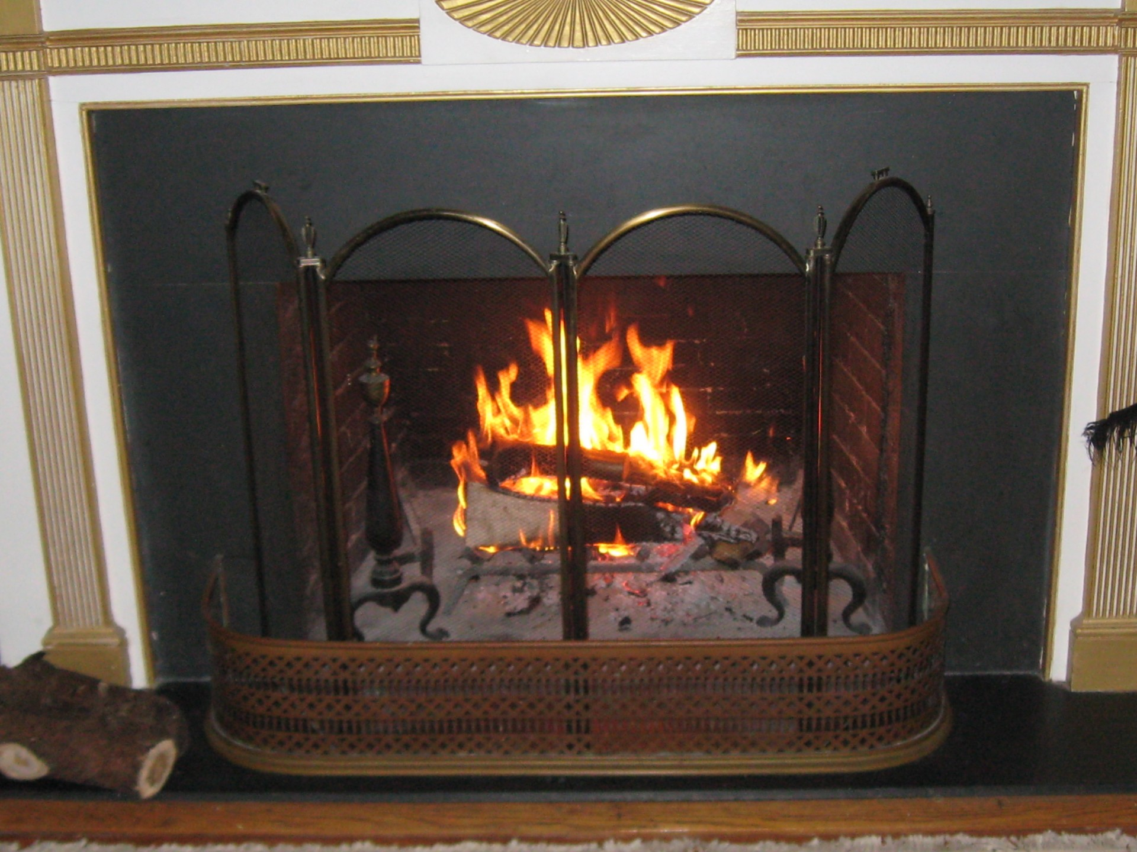
An Illustration

Slide 4
The Plan of Salvation
Hear the gospel of Christ, Rom.10:17
Believe in Jesus Christ, Rom.1:16-17
Repent and Turn to God, Acts 3:19
Confess Jesus Before Men, Rom.10:9-10
Be Baptized, Immersed in Water, Mk.16:16
------------------------
Grow in The Lord, 1 Pet.2:2
If We Err as A Christian: Repent & Pray God, Acts 8:22

